Slide 1
Two-phase Content-balancing CD-CAT Online Item Calibration
Jing Huang, Yuxaio Zhang & Huahua Chang
Purdue University

Slide 2
1
Introduction
Research questions
Theoretical Framework

Slide 3
Empirical Questions
Four content areas in physics
Kinematics
Forces
Energy
Momentum
Four attributes
Applying vectors
Conceptual relationships
Algebra
Visualizations
Item Replenishment
With Content Balancing

Slide 4
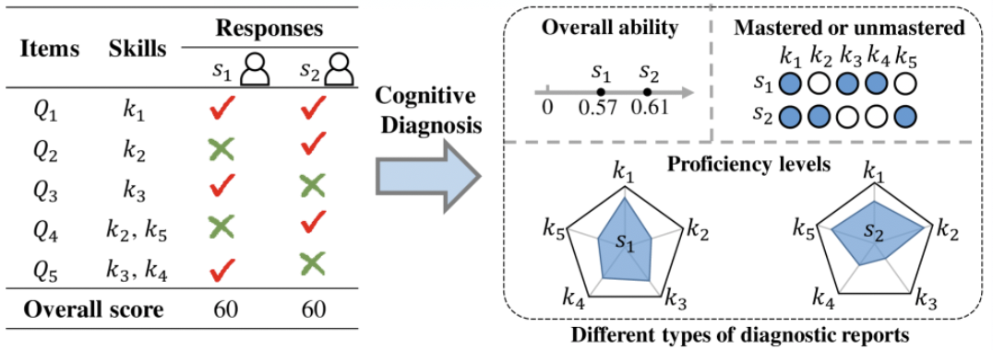
Background
CD-CAT

Slide 5
Background
Item replenishment
Online Calibration
Q-matrix of new items is known or not?
Yes
No
CD-Method A (Chen et al., 2012)
CD-OEM (Chen et al., 2012)
CD-MEM (Chen et al., 2012)
Joint Estimation Algorithm (Chen & Xin, 2011)
Single Item Estimation (Chen et al., 2015)
Simultaneous Item Estimation (Chen et al., 2015)
Two-step Procedure (Yu & Cheng, 2024)

Slide 6
Background
Psychometric
Non-statistical Constraints
Only consider KSs estimation
Shannon Entropy (Shannon, 1948; Cheng, 2009)
Kullback-Leibler Information (Xu et al., 2003)
Mutual Information (Wang, 2013)
Both KSs and Latent Trait estimation
Dual-information Method (Cheng & Chang, 2007)
Aggregated Ranked Information Method (Wang et al., 2014)
Attribute Balancing
Modified Global Discrimination Index (Cheng, 2010)
Q-control Method (Wang et al., 2012)
Exposure Control
Q Discrimination-control Method (Wang et al., 2012)
Binary Searching Design Method (Zheng & Wang, 2017; Luo et al., 2023 )

Slide 7
Background
Content-balancing methods
Constrained CAT (Kingsbury & Zara, 1989)
Modified Constrained CAT (Leung et al., 2000)
Modified Multinomial Model (Chen & Ankenman, 2004)
Procedure designs
$α$-stratification Method with Content Blocking (STR_C) using MMM (Yi & Chang, 2003)
A Two-phase Content-balancing Method using MMM in both phases (TPM) with STR_C design (Cheng et al., 2007)
Constraint-weighted $α$-stratification (Cheng et al., 2009)
IRT-CAT
Content Balancing

Slide 8
Research Question
Research Gap in Previous Studies:
A comprehensive design for content-balancing in CD-CAT does not currently exist, especially regarding online calibration in CA-CAT.
Advantages of Content Balancing:
Even and efficient item pool usage
Alignment with practical testing requirements
Enhanced support for course instruction
Specific Research Questions in This Study:
Is the two-phase design also suitable for CD-CAT?
How can this design be applied to online calibration in CD-CAT?

Slide 9
2
Methods
Online Calibration Procedures
Simulation Study

Slide 10
Two-phase Content-balancing CD-CAT Online Calibration Procedures
Shannon Entropy method. For each content area, the total number $C_{js}$ should be smaller than $u_{js}$ (the upper bound for $s$th content area). If $C_{js}≥u_{js}$, remove $s$th content area for next item selection
1
Initialization
5
Next Item Selection
2
Initial Items Selection
Select ($l_{j1},l_{j2},…,l_{jS}$) operational items from each content area for $j$th examinee
6
Iteration
Response Simulation
New Item Selection
3
7
BIBD: select $D_{j}$ new items taken by $j$th examinee for $j$th examinee
4
Attribute Pattern Estimation
8
Final Estimation

Slide 11
Simulation Study Design
A full 18 ($3×2×3$) factorial design was used:
Sample size N = c (500, 1000, 2500)
Item parameter distribution $U_{1}(0.05,0.25)$ and $U_{2}\left(0.25,0.45\right)$
Number of contents S = c (0, 3, 6)
Each condition had a total of 20 replications to ensure reliability.
The total test length was fixed at 65 with $C_{j}$ = 60 operational items and $D_{j}$ = 5 new items.
$When S=3:$
$l_{j1}=l_{j2}=l_{j3}=5$; $u_{s}$ = 22
$When S=3:$
$l_{j1}=l_{j2}=l_{j3}=5$; $u_{s}$ = 22
$When S=6:$
$l_{j1}=…=l_{j6}=5$; $u_{s}$ = 12

Slide 12
Examinee and Item Bank Generation
Examinee Generation:
the number of attributes was 4
the probability of mastery was 50% for each attribute
Item Bank Generation:
Two item banks with the same Q matrix (based on Chen et al.’s (2012) study) were simulated
guessing and slipping parameters were all randomly drawn from $U_{1}(0.05,0.25)$ and $U_{2}(0.25,0.45)$, respectively
operational items h = 300 and each content area had $\frac{h}{S}$ items
new items m = 35, randomly selected from the operational item bank

Slide 13
KS and Item Parameters Estimation & Evaluation Criterions
KS Estimation:
Maximum A Posterior (MAP) method with uniform prior distribution
Item Parameters Estimation:
Conditional maximum likelihood method
Evaluation Criterions:
Root Mean Squared Error (RMSE)
Pattern Correct Classification Rate (PCCR)
Attribute Correct Classification Rate (ACCR)
The final evaluation results in this study are the averages based on 20 replications.

Slide 14
3
Results & Discussion

Slide 15
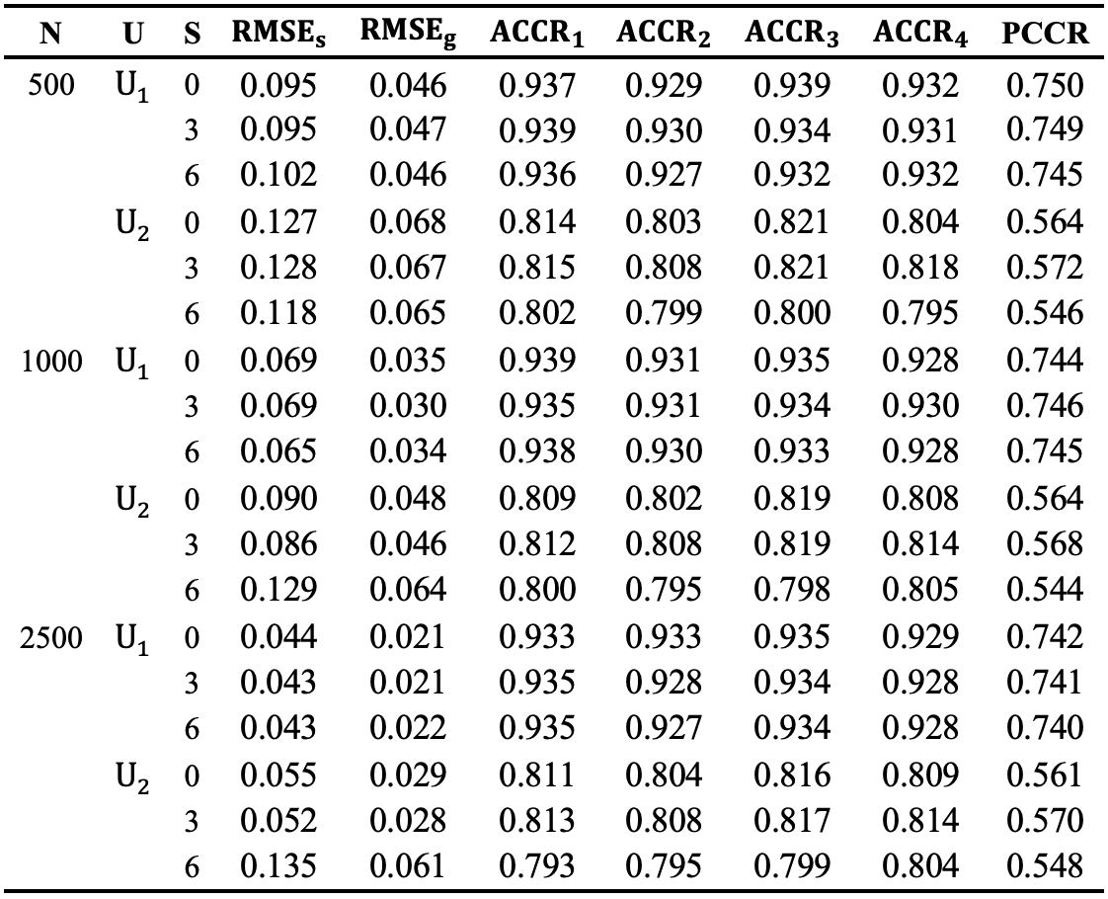
Item parameters and attribute pattern estimation results
The average RMSE
slip: 0.086
guess: 0.043
The average ${ACCR}_{i}$
${ACCR}_{1}$:0.872
${ACCR}_{2}$:0.866
${ACCR}_{3}$:0.873
${ACCR}_{4}$:0.869
The average PCCR
0.652

Slide 16
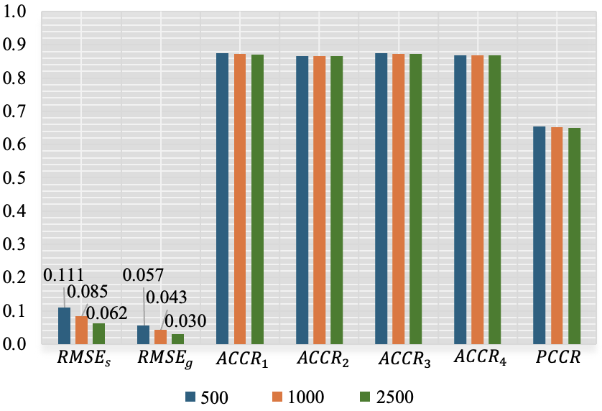
Sample Size
As sample size increases, the accuracy of new item parameter estimation gradually improves.
Figure 1 Illustration of the effect of sample size

Slide 17
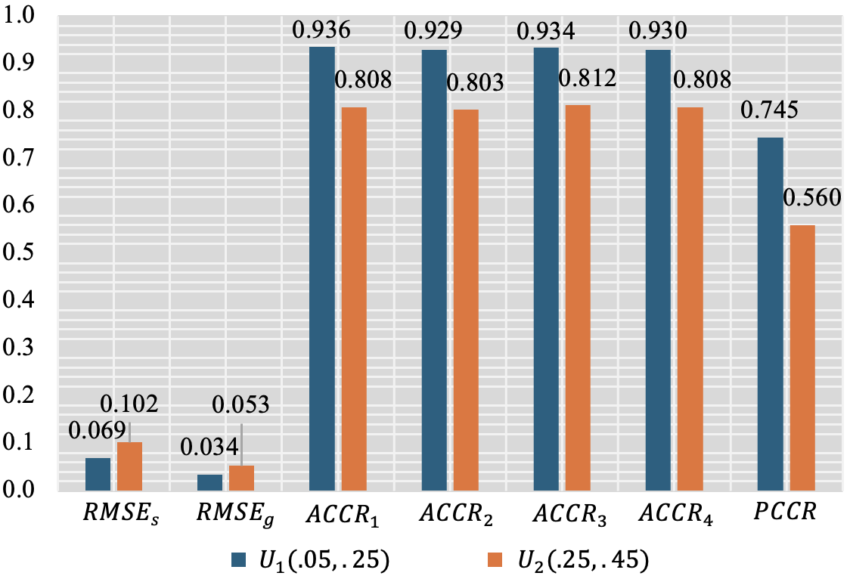
Item Parameter Distribution
As the value of item parameters decreases:
The accuracy of new item parameter estimation gradually improves
The accuracy of attribute estimation also improves
Figure 2 Illustration of the effect of item parameter distribution

Slide 18
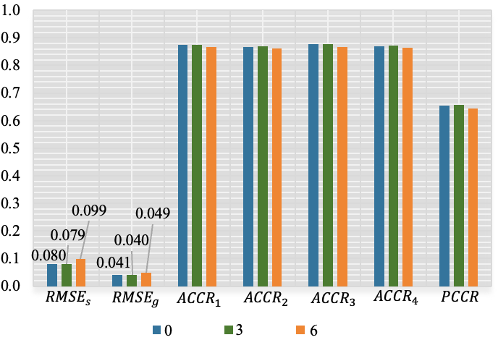
Number of Contents
S = 3, the effectiveness of new item calibration is similar to situations with no content constraints (S = 0)
as the number of content areas increases (S = 6), the estimation accuracy may decline
there may be a potential turning point for the number of content areas between 3 and 6
Figure 3 Illustration of the effect of content area numbers

Slide 19
What’s the Next Step
New Item Selection
Seed new items randomly in the whole course of the test
Besides Constrained CAT, compare more methods like Modified Multinomial Model (MMM)
Consider unbalanced content constraints
Content-balancing Method
Online Calibration Method
Compare different methods
Pivoting Point Exploration
Explore the potential turning point for the number of content area
Consider the attribute-balancing
Have the attribute-balancing at the same time

Slide 20
Thank You
Jing Huang
Email: huan1936@purdue.edu

