Slide 1
Modeling Diversity-Validity Tradeoffs: A Comparison of Pareto- and Multi-Penalty Optimization
PRESENTED BY
Hudson Pfister , Amanda Neuman, Tony Lam, Scott Morris

Slide 2
Agenda
Diversity Validity Dilemma
Pareto Optimality and Multi-Penalty Optimization
Methods
Results and Conclusions

Slide 3
Overview and Previous Research
Diversity-Validity Dilemma

Slide 4
Diversity-Validity Dilemma
Multiple Objectives
Job Performance (Pearson’s r)
Increase Diversity (AIR)
Challenge
The most valid predictors have large subgroup differences (Ployhart & Holtz, 2008)
Notes:
Employee selection context.Best predictors tend to have highest group differences

Slide 5
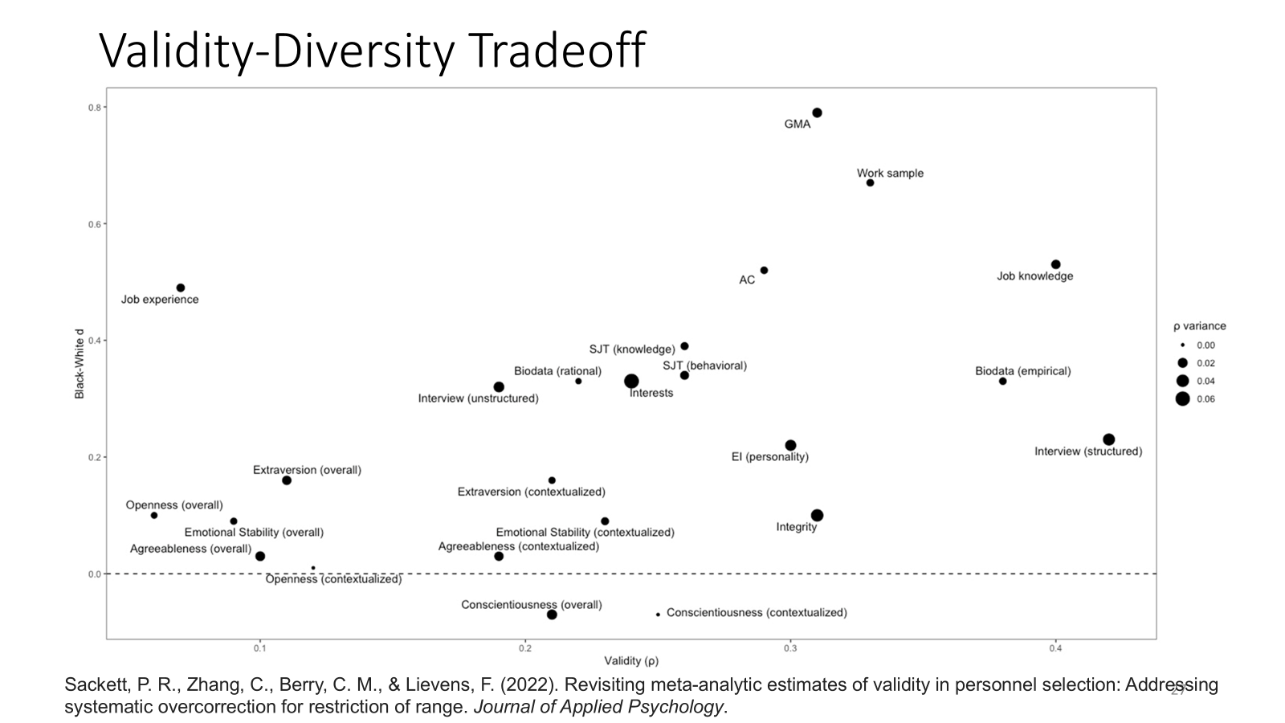
Notes:
Largest correlations tend to have moderate to large group differences

Slide 6
Pareto-Optimality
Multi-objective Optimization
Weighting scheme of predictors that balances validity and adverse impact (De Corte et al., 2008)
An effective way to achieve diversity improvements with minimal loss of validity (De Corte, Lievens, & Sackett, 2008; Wee et al., 2014; Song et al.,2017)
Notes:
The Pareto-optimal approach has emerged as a solution for designing selection systems. Pareto-optimization is a form of multi-objective optimization.
Multi-objective optimization is the process of simultaneously optimizing two or more goals. In the context of employment testing this includes both quality (e.g. selection tools with strong validity evidence) and diversity goals (e.g. selection tools with less adverse impact).
In multi-objective optimization, the goal is often to find a set of trade-off solutions where improving one objective leads to worsening another. In Pareto-optimization these solutions form the Pareto front, which consists of a range of solutions. A solution is Pareto-optimal if no other solution can improve one objective without worsening at least one other objective.

Slide 7
Notes:
The points furthest to the left of each Pareto-optimal solution shows the solution that results in the highest possible composite validity. These points also have the lowest (worst) AIR of all the presented solutions. The points farthest to the right is the inverse. These solutions have the highest level of validity and the highest (best) AIR. Higher AIR = better

Slide 8
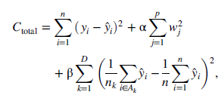
Multi-Penalty Optimization
Goal is to minimize each component of cost function
Combination of linear regression, regularization term, and group difference constraint
Tuning parameters
Rottman, C., Gardner, C., Liff, J., Mondragon, N., & Zuloaga, L. (2023). New strategies for addressing the diversity–validity dilemma with
big data. Journal of Applied Psychology.
Notes:
Add: Rottman and colleagues First term minimizes prediction errors(OLS), second term minimizes regression weights and therefore overfitting, third term minimizes group differences

Slide 9
Negative Weights
Difference between positive-constrained and unconstrained
Unconstrained MPO solves for optimal weights, regardless of direction
Prone to fairness, legal, and interpretability issues
Pareto application positively constrain weights
Notes:
Penalizing someone who is high in job related trait such as conscientiousness which could lead to legal, fairness, or interpretability issues.

Slide 10
Purpose of Current Study
Look into alternative ways to decrease adverse impact while retaining validity
Compare and contrast pareto, unconstrained MPO, and positively constrained MPO methods

Slide 11
Sample and Measures

Slide 12
Sample
480 Applicants from an Electrical Training Program
White (55.4%, n = 266)
Hispanic or Latino (31.3%, n = 150)
Black or African American (7.9%, n = 38)
Asian (2.7% ,n = 13)
American Indian of Alaskan Native (0.4%, n = 2)
Other (2.1%, n = 10)
Did not answer (0.2%, n = 1)
94.4% identified as male (n = 453)
4.6% identified as female (n = 22)
1.0% (n = 5) did not specify their gender
Notes:
This is done in three steps:
First, we collect the data needed to compile the data matrix.
Second, we use a resampling procedure to generate a distribution of results.
Finally, we calculate and plot the range of possible solutions.

Slide 13
Measures
Cognitive Ability Tests:
Numerical Computation
Numerical Reasoning
Paper Folding (Visual-Spatial)
Reading Comprehension
Mechanical Reasoning
Biodata: Education
Criterion: Grade Data
Personality:
Extraversion
Agreeableness
Conscientiousness
Emotional Stability
Openness
Notes:
To demonstrate the uncertainity of pareto optimal solutions developed from mean effect sizes we use a monte carlo procedure.
This is done by using the data about the general effect sizes to see the range of possible results in a particular setting. Repeated random resampling is used to look at a range of outcomes.
This is done in three steps:
First, we collect the data needed to compile the data matrix.
Second, we use a resampling procedure to generate a distribution of results.
Finally, we calculate and plot the range of possible solutions.

Slide 14
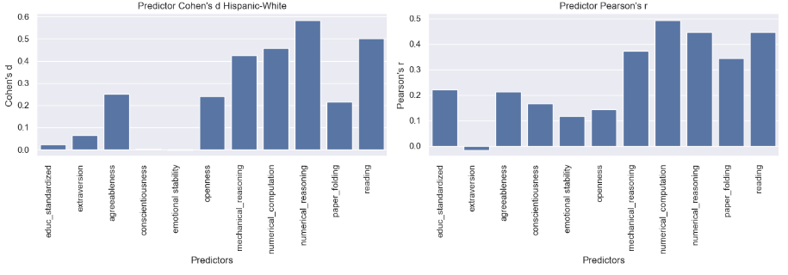
Predictor Descriptives
Notes:
This is done in three steps:
First, we collect the data needed to compile the data matrix.
Second, we use a resampling procedure to generate a distribution of results.
Finally, we calculate and plot the range of possible solutions.

Slide 15
Pareto Analysis Steps
Train test split
Compute validities, predictor correlations, and standardized mean differences with training sample
Input into Chelsea Song’s ParetoR package
Computed composite for each set of weights in test sample
Computed validity and AIR for each composite
Notes:
Used a 70/30 train test split. Pareto package gives weights to calculate composite for each solution
First, we collect the data needed to compile the data matrix.
Second, we use a resampling procedure to generate a distribution of results.
Finally, we calculate and plot the range of possible solutions.

Slide 16
MPO Analysis Steps
Unconstrained MPO
Solve cost function at a range of beta values (0-100,000)
Obtained cross-validated validity and AIR of each composite
Using Line Search Newton-Conjugate Gradient solver
Positively-Constrained MPO
Adapted Rottman et al. code to only allow positive predictor weights
Notes:
Train test split, solve the cost function for a range of beta values and then obtained a cross validated validity and AIR for each test battery composite.

Slide 17
Results
Pareto vs. MPO

Slide 18
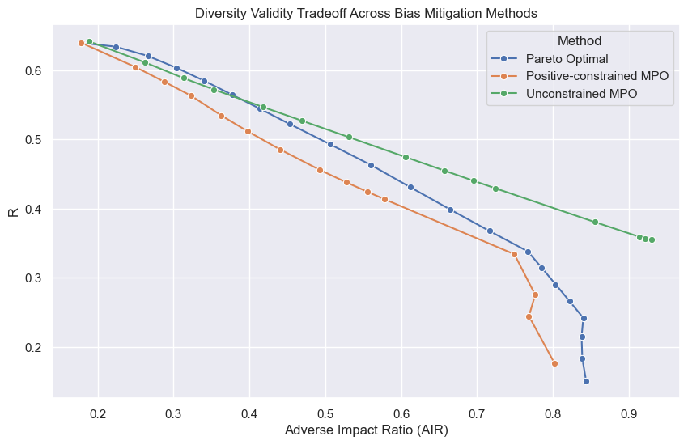
Validity-Diversity Curves
Notes:
1.) Each point for MPO represents a different beta value
2.) unconstrained performs the best
3.) Constrained and pareto perform similarly

Slide 19
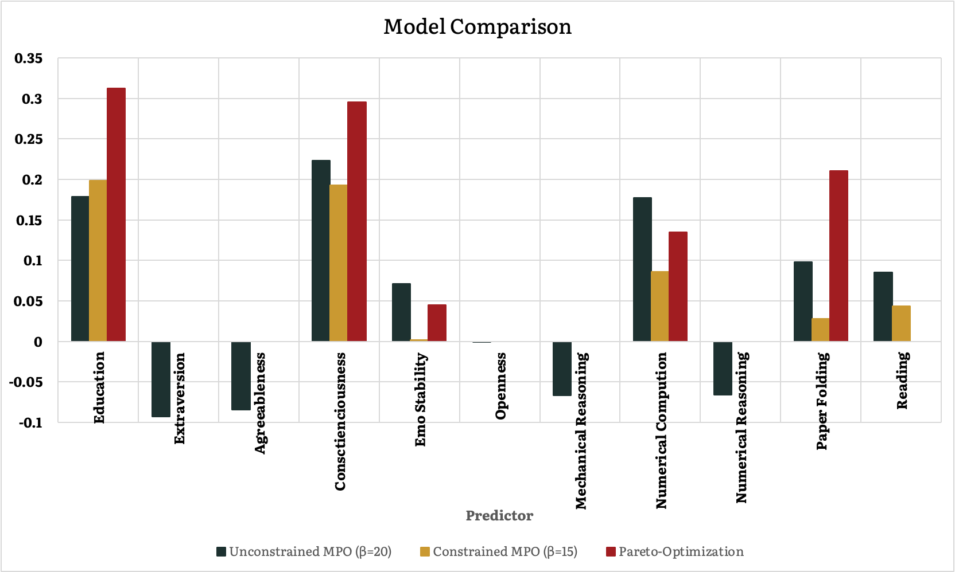
Examining Coefficients at r ≈ .45
Notes:
Point out negative weights
Differences between pareto in education biodata measure and paper folding
This demonstrates that using context specific estimates will provide a more accurate indication of pareto-optimal tradeoffs.

Slide 20
Conclusions & Discussion
Pareto-Optimality vs. MPO

Slide 21
Conclusions & Discussion
Unconstrained performed the best
Similar performance for positive-constrained and pareto
Negative coefficient issue
Recommend pareto or constrained methods
How should we evaluate and manage negative predictor weights across different contexts?
Notes:
Since we are in a room with so much expertise, we wanted to pose a question to the audience as we move on to questions: how should we treat negative weights in different contexts? In this study we have strong connections between the predictors and test performance via theory and job analysis, but how should we handle negative weights in the future if this relationship is less clear?

Slide 22
Thank you!
hpfister@hawk.iit.edu
aneuman@hawk.iit.edu
tlam4@hawk.iit.edu
scott.morris@iit.edu

