Slide 1

Assessing Topic Recovery in Open-Ended Responses:
The Effects of Sample Size, Document Length, and Similarity Threshold
Xiyu Wang, Yukiko Maeda, Yuxiao Zhang
Nov. 15, 2024

Slide 2

Outline
1
Introduction
2
Method
3
Results
4
Discussion
5
Future Direction
6

Slide 3
1. Introduction
Open-Ended (OE) Survey Questions:
  Capture opinions, beliefs, and complex constructs without restrictions.
  Test
  Survey Research
Manual Coding:
Underutilized due to challenges in analyzing unstructured textual data
  Labor-intensive, time-consuming (Zhang et al., 2022)
  Inconsistency of coding, subjectivity bias
Emerging Solution:
  Topic Modeling (TM): A text-mining technique to identify themes efficiently (e.g., Nanda et al., 2021).

Slide 4
1. Introduction
Advantages of TM:
  Identifies main themes and quantifies relationships.
  Handles large datasets and explores associations (Buenaño-Fernández et al., 2020).
Challenges:
  Validity concerns: Themes may vary from human coding.
  Interpretability
  Require large data
Notes:
Agreement rates between TM and human coding range from 70%-90% (Nanda et al., 2021).
TM uncovers unique themes not identified by human coding (Gencoglu et al., 2023).

Slide 5
1. Introduction
Questions have not been fully answered:
  How much data is needed for valid topic identification?
  Best practices for integrating TM with manual coding.
Data requirements for TM:
  Finch et al. (2018): Reliable results with 200 OE responses (30 words).
  Wheeler et al. (2021): Stricter guidelines (e.g., 5,000 OE responses for shorter texts).
Educational research context:
  Studies vary widely, from dozens to hundreds of thousands of responses (e.g., Nanda et al., 2021).
Notes:
However, Wheeler et al. (2021) conducted a simulation study and proposed much more stringent guidelines. For example, to identify a LDA model with seven topics, with the average response length increasing from 10 to 50 words, the recommended OE response quantity decreases from 5,000 to 2,000.

Slide 6

1. Introduction – Research Questions
Purpose:
Research questions:
  To what extent do the results of topic modeling, for example, vary with the structure of corpus?
  To what extent does the number of documents (D), affect the topic identification?
  To what extent does the document length ( ) in a document affect topic identification?
  To what extent does the conclusion differ by the adopted evaluation criteria for consistency?

Slide 7
2. Method
Data:
OE response data were collected via an online survey along with a set of rating questions from university instructors who teach undergraduate mathematics at various types of higher education institutions. -> 526 responses
The specific prompt of OE question was to “What do you identify as excellent teaching practices to promote student learning and success in mathematics please list as many practices that you like that you feel are unique and important to teaching undergraduate mathematics?”.

Slide 8

2. Method
Before answering the research questions:
Comparison: Manual Coding vs. Topic Modeling Results
Manual Coding -> Two domain expert based on the mathematics teacher’s specialized knowledge (MTSK) framework identified 15 themes.
TM analysis
Preprocessing (‘tm’ package): remove non-meaningful items (punctuation, whitespaces) 526-> 522
Modeling - Latent Dirichlet Allocation (LDA) model
Notes:
removing non-meaningful words, such as punctuation, numbers, whitespaces, and other words that appear frequently but carry limited information.
computes the likelihood of observing the words in the documents given a set of topics. T
he objective is to maximize this likelihood to identify a coherent set of topics.
The LDA assumes that the observed words in documents are generated from a set of latent “topics” and
models each document (i.e., OE response in our context) as a distribution over a set of topics,
and each topic as a distribution over a group of words (Blei et al., 2003).
The LDA assumes that both the document-topic and topic-word prior distributions follow a Dirichlet distribution
The resulting topic-word distributions, β ̂_(1:K), are the key elements for topic matching in our experiments.

Slide 9
2. Method
Modeling - Latent Dirichlet Allocation (LDA) model

Slide 10
2. Method
TM analysis
Preprocessing (‘tm’ package) remove
Modeling - Latent Dirichlet Allocation (LDA) model
Phase 1: Fitting an 8-topic model with full corpus
Optimal number of topics (k= 8) : Determined using four evaluation metrics:
CaoJuan2009, Arun2010, Griffiths2004, Deveaud2014
Purpose:
Comparison: Results compared with human coding
Benchmark: Serves as the benchmark for subsequent analyses.
Phase 2: Use two studies to answer the research questions. (k=8)
Study 1: The impact of the number of documents (D) on topic identification
Number of responses: Four levels (D = 50, 100, 250, 400)
Document lengths : Not controlled
Process: Randomly select the specific number of responses from full corpus
Fit the model (repeat 200 times)
Evaluation: Alignment of the identified topics with the benchmark
Notes:
Two things from the benchmark model – high frequency words of each topic, topic proportion of each document
These levels were selected as roughly 10%, 20%, 50%, and 80% of the full corpus and were often observed in class- or school-based survey research in Education.

Slide 11
2. Method
Phase 2: Use two studies to answer the research questions. (k=8)
Study 2: The impact of the document length ( ) on topic identification
Document lengths : 1) Three levels of document length
<9 (below 1st quantile)
9–22 (IQR)
23–162 (above 3rd quantile)
Tested with two response levels: D = 50, 100
2) Two levels of document length
<15 (below median)
>= 15 (no less than median)
Tested with two response levels: D = 100, 200
Process is the same as in Study 1.
Evaluation: Cosine similarity and Threshold
Cosine similarity
Threshold Levels Tested: 0.5, 0.6, 0.7, 0.8, 0.9 (Maier et al., 2020; Wheeler et al., 2021 )
Evaluation detail:
Cosine similarity calculated for each pairing between topics from the two eight-topic models;
Criteria for matching – highest cosine similarity in both the corresponding row and column
– exceed the predetermined alignment threshold (0.5-0.9)
Notes:
Maier et al. (2020): Threshold of 0.5 Wheeler et al. (2021): Threshold of 0.9 for stricter matching
Goal:
Identify suitable thresholds for studies with a number of responses (D) similar to the current study.

Slide 12
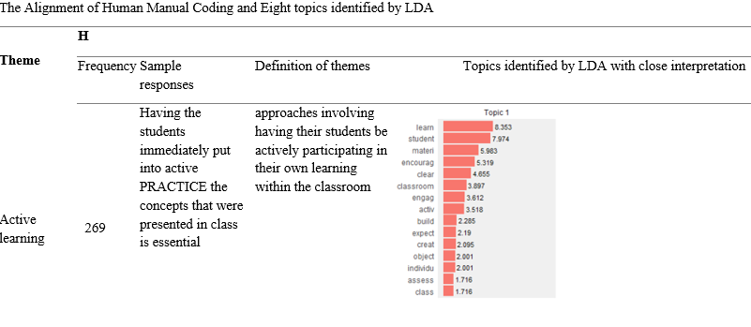
3. Results and Discussion
3. 0 Consistency of Identified Themes (Topics) by TM and manual coding
TM topics correspond well to manually identified themes.
7 out of 8 topics aligned between Topic Modeling (TM) and human coding.
TM helps find out an extra topic – collaboration.
Interestingly, “Instruction Types”, which is the 2nd prevalent theme identified by human coding, was not identified as a distinctive topic by TM analysis with LDA model,.
“Instruction Types” – abstract, high-level concept
Notes:
, Instructional Type is a more abstract, high-level concept that encompasses specific instructional approaches such as lectures, flipped classrooms, and inquiry-based instruction. Human coders were able to connect these approaches conceptually and summarize them under the broader theme of Instructional Type, a capacity that LDA lacks. Instead, LDA topic modeling absorbed each instructional approach to related learning activity topics.

Slide 13
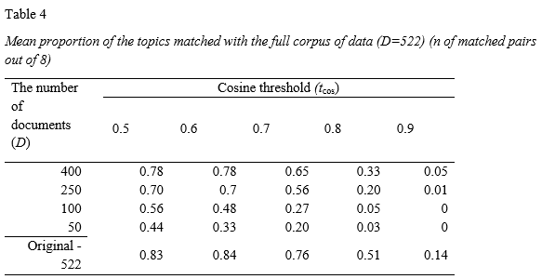
3. Results
3. 1 The impact of the number of documents (D)
Two clear patterns emerged from this analysis.
First, selecting a higher cosine threshold leads to lower consistency.
Second, for any given cosine threshold, the proportion of matching topics increases as the document sample size increases.

Slide 14
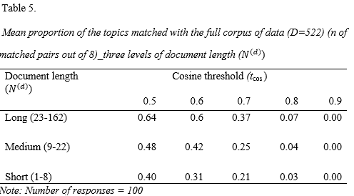
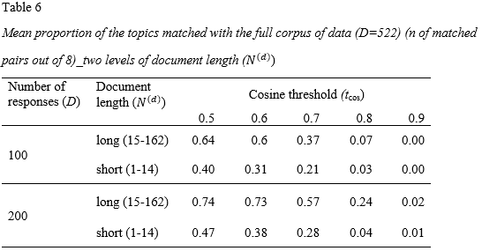
3. Results
3. 1 The impact of the document length
Two clear patterns emerged from this analysis.
First, selecting a higher cosine threshold leads to lower consistency.
Second, for any cosine threshold, topic alignment improves with increased document length.
An extra observation: , as the document sample size increases from D = 100 to 200, the improvement in topic recovery rate for shorter documents remains smaller than that for longer documents, especially when more stringent cosine thresholds are applied.

Slide 15
4. Discussion
4. 1 Consistency Between TM and Manual Coding
Complementary Role of TM:
enhances the efficiency of qualitative analysis
ensures no key themes are overlooked and adds credibility to qualitative findings.
Cautions in Overreliance on TM:
TM focuses on patterns inherent in the entire dataset, which may oversimplify complex themes appearing in smaller subsets.
Broad or unclear survey prompts can introduce irrelevant information, reducing TM’s accuracy.
TM’s reliance on statistical assumptions (e.g., latent topics as mixtures of words) may not align with human coding approaches that account for context.
Notes:
Discrepancy:
Most frequently used learner characteristics: knowledge levels and learning styles
Human coders were able to conceptually connect specific instructional approaches to the broader theme of "Instructional Type."
TM lacks the ability to capture contextual nuances and abstract connections.

Slide 16
4. Discussion
4. 2 Impact of document sample size and length on topic identification
Practical Insights:
  1. Encourage Longer Responses:
  1) Even with 100 responses, documents containing at least 15 meaningful words achieved a 60% recovery rate.
  2) At 250 responses, the recovery rate reached 70% (with tcos = 0.5).
  2. Small Samples:
  1) TM is still valuable for exploring textual data when large datasets are unavailable.
  2) Lower thresholds (e.g., tcos = 0.5) improve recovery rates with smaller datasets.
Contribution to Literature:
  Real OE data was used, avoiding the oversimplifications of simulated datasets.
  Results reflect realistic social science conditions with small-to-medium sample sizes and moderate document lengths (around 50 words).
  Contrasts findings from studies with larger datasets (e.g., Wheeler et al., 2021).

Slide 17
5. Future Direction
Study Limitations:
  Focused on an 8-topic model; did not evaluate the effect of varying topic numbers.
  Findings may depend on the quality of OE responses and survey design.
Recommendations for Future Research:
  Investigate optimal thresholds for topic matching under different contexts.
  Explore additional factors influencing TM accuracy (e.g., hyperparameter settings, algorithms).
  Examine strategies for integrating TM and manual coding to maximize strengths of both approaches.
  Link survey design (e.g., response box size, motivational prompts) to improved TM accuracy.

Slide 18
Thank You

