Slide 1
Assessing ChatGPT's Proficiency in Generating Accurate Questions and Answers for Statistics Education
Meredith Sanders, Anh Thu Le, Ying Cheng
November 15, 2024

Slide 2
Introduction
Increased use of AI in education
Enhances the learning and teaching experience - potential uses for automatic grading, virtual tutoring, etc.
Lesson Plan Creation (Powell & Courchesne, 2024)
Questionable components
Omitted key details
Highlights need to assess the program’s accuracy
ChatGPT’s ability to generate questions and solutions across topic areas has yet to be explored

Slide 3
Objective
To investigate the types of errors ChatGPT produces when generating questions and solutions for AP Statistics attributes.

Slide 4
Method
Categorize attributes
Prompting Strategy
Include attribute, specify question request
Two levels
Evaluate Output
Does the question satisfy the attribute?
Is the question correct - is the correct answer present?
Is the solution performed and explained correctly?

Slide 5
Attributes
157 attributes given for the AP Statistics curriculum
Classified under one of 4 sections:
Exploring Data
Sampling and Experimentation
Anticipating Patterns
Statistical Inference
Multiple topics within each section
ie. 1A = Constructing and interpreting graphical displays of distributions of univariate data

Slide 6
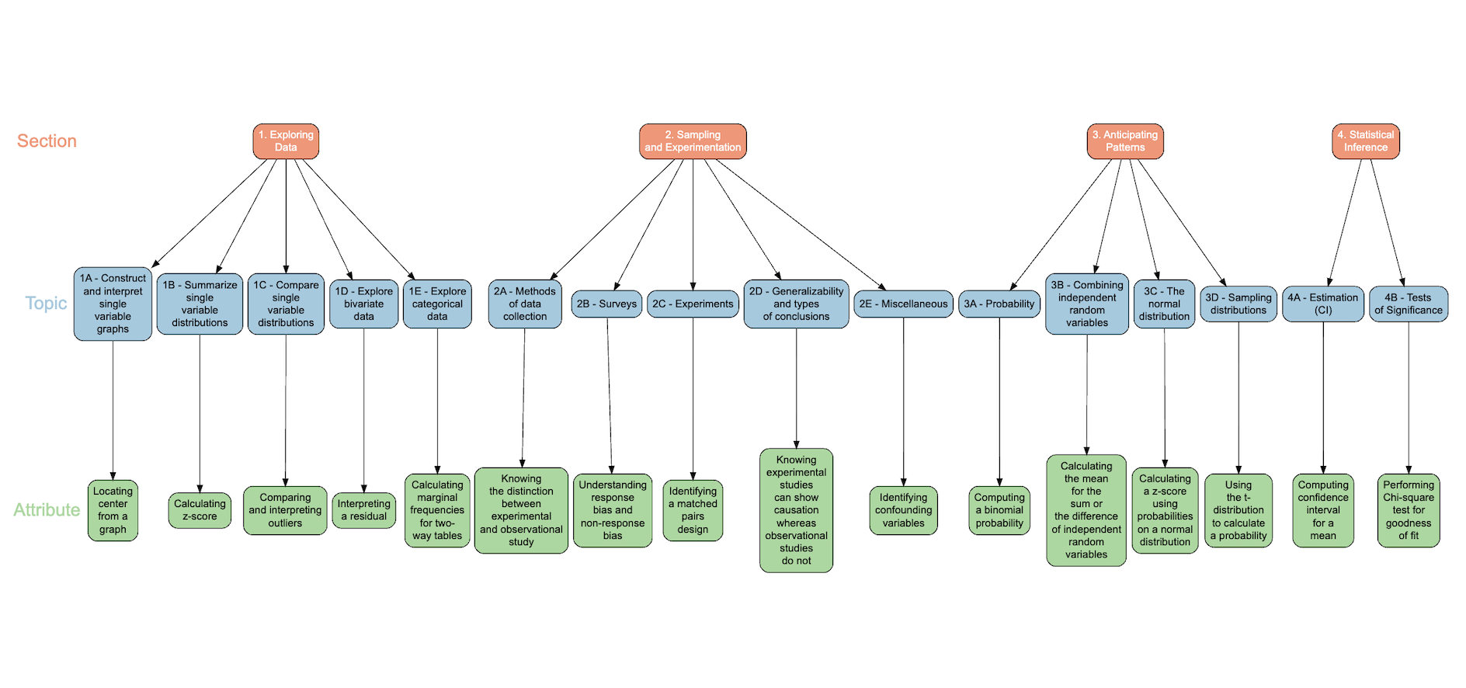
Attributes

Slide 7
Prompting and Classification
ChatGPT 3.5
Provided with description of individual attribute
Asked to generate both a question and solution
Additional prompting until expected output was provided
Examination for errors
Analyses and visualizations conducted using R-Studio

Slide 8
Example Level 1 Question Generation
Attribute 1.B.2: Calculating Mean
Prompt: Generate a question to test students ability to calculate mean and explain the solution.
Question Output:
A group of students took a math quiz, and their scores are as follows:
85, 90, 92, 78, 82, 88, 95, 86
Calculate the mean score for this group of students.

Slide 9
Example Level 2 Question Generation
Attribute 1.B.2: Calculating Mean
Prompt: You are an AP Statistics teacher who is trying to prepare your students for the AP Test in May. You want to ensure that your students can effectively apply the concepts they have learned in the classroom to problems that represent real world scenarios, instead of simply spitting back definitions. Please generate a word problem to test students ability to calculate mean and explain the solution.
Question Output:
In a bustling city, a survey was conducted to analyze the commute times of residents. The data collected showed the commute times (in minutes) for a sample of 20 residents from different neighborhoods. The following commute times were recorded: [24, 28, 32, 20, 35, 18, 40, 45, 22, 30, 38, 26, 34, 19, 27, 31, 37, 23, 29, 36]. Calculate the mean commute time for the residents in this sample.

Slide 10
Error Types
Question-related errors were classified as the following:
Contradiction
Does Not Fulfill Attribute
Inadequate Output
Repeats Attribute
Requires Additional Knowledge
Unsolvable
Solution-related errors were classified as the following:
Careless Error
Computational Error
Did Not Solve
Explanatory Error
Inadequate Graph
Indeterminable
Procedural Error
Notes:
*be able to provide examples for each of these

Slide 11
Question Error Example
Attribute 4.B.6: Concept of Type II Errors
Prompt: Generate a question to test students ability to understand the concept of Type II errors in statistics and explain the solution
Question Output: In a medical test designed to detect a rare disease, a Type II error occurs when the test wrongly indicates that a healthy person actually has the disease. Explain the consequences of a Type II error in this context and propose a situation where minimizing Type II errors is crucial. Additionally, discuss potential strategies to reduce the likelihood of Type II errors in such a scenario.
Error: Contradiction
Notes:
Incorrectly defines type 2 error in the context of the situation

Slide 12
Solution Error Example
Attribute 1.B.18: Calculating Outliers using fences
Question Output: Consider the following set of exam scores obtained from a group of students: 78, 85, 90, 67, 88, 92, 81, 75 Calculate any outliers in the dataset using the 1.5*IQR rule
Solution Output:
1. Calculate the interquartile range (IQR):
- First, arrange the scores in ascending order: 67, 75, 78, 81, 85, 88, 90, 92
- ( Q1 = 75 ) (the 25th percentile) ( Q3 = 88 ) (the 75th percentile)
- ( IQR = Q3 - Q1 = 88 - 75 = 13 )
3. Identify any scores outside the fences as outliers:
- There are no scores below the lower fence (55.5). Score 92 is above the upper fence (107.5).
Error: Computational and Careless
Notes:
This has the incorrect Q1 and Q3. They should be 76.5 and 89. Additionally 92 is not above 107.5. There are no outliers but the process was incorrect.

Slide 13
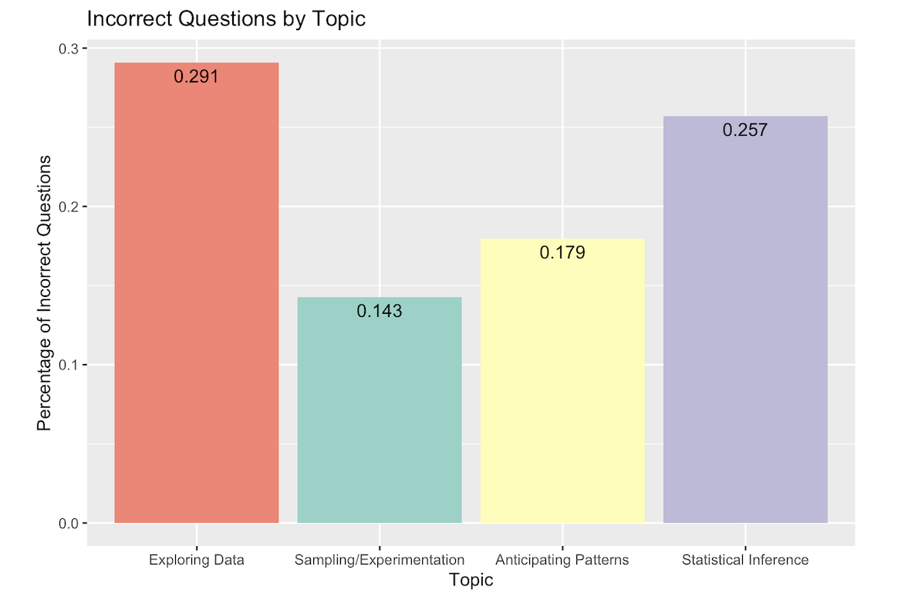
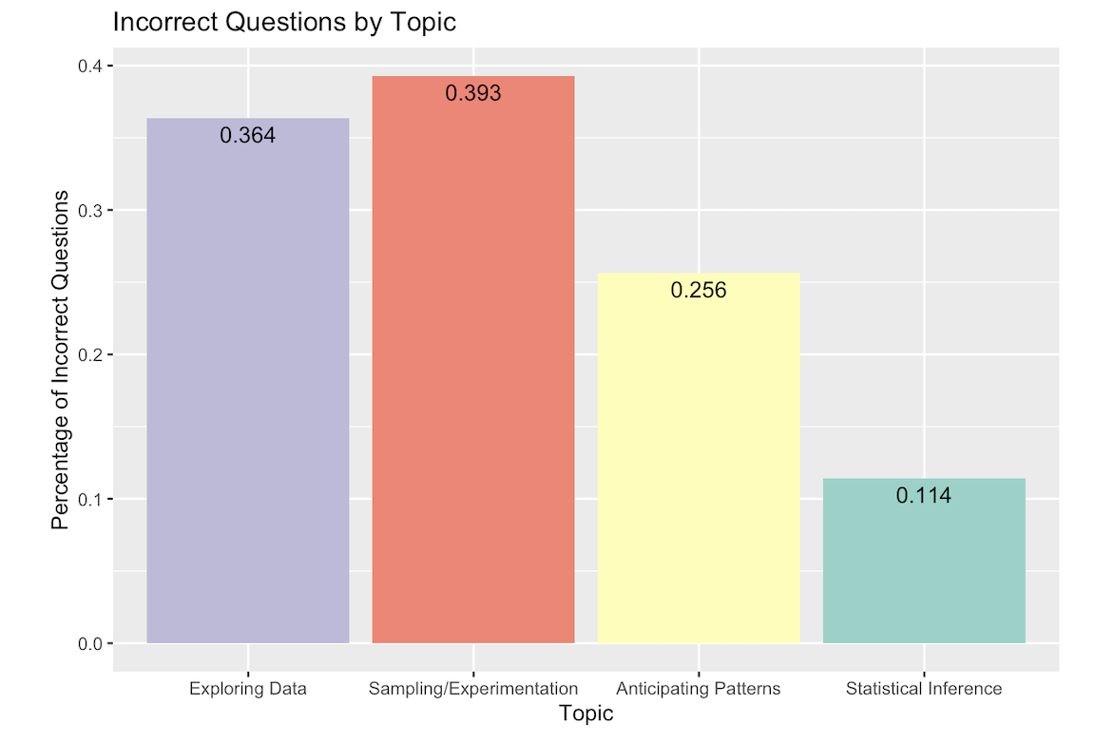
Results
Level 1:
Level 2:
Figure 1: Incorrect Questions by Section
Figure 2: Incorrect Questions by Section
36 total questions contained errors.
45 total questions contained errors.
45 total questions contained errors.
Notes:
Graphs, describing and comparing data distributions - bad output
4. Confidence intervals and significance tests - repeated attribute/unsolvable
1: 15/55
2: 4/28
3:7/39
4: 9/35
Level 1: 36 question errors

Slide 14
Results Cont.
Level 1:
Labels:
1A - Construct and interpret single variable graphs
1B - Summarize single variable distributions
1C - Compare single variable distributions
1D - Explore bivariate data
1E - Explore categorical data
2A - Methods of data collection
2B - Surveys
2C - Experiments
2D - Generalizability and types of conclusions
2E - Miscellaneous
3A - Probability
3B - Combining independent random variables
3C - The normal distribution
3D - Sampling distributions
4A - Estimation (CI)
4B - Tests of Significance
Figure 3: Incorrect Questions by Topic
Notes:
1a: 5/10 1b: 3/18 1c: ⅖ 1d: 4/16 1e: 2/6 2a: 0/2 2b: 1/9 2c: 3/12 2d:0/2 2e: 0/3 3a: 0/18 3b: ½ 3c: 0/5 3d: 6/14 4a: 4/10 4b: 5/25

Slide 15
Results Cont.
Level 2:
Labels:
1A - Construct and interpret single variable graphs
1B - Summarize single variable distributions
1C - Compare single variable distributions
1D - Explore bivariate data
1E - Explore categorical data
2A - Methods of data collection
2B - Surveys
2C - Experiments
2D - Generalizability and types of conclusions
2E - Miscellaneous
3A - Probability
3B - Combining independent random variables
3C - The normal distribution
3D - Sampling distributions
4A - Estimation (CI)
4B - Tests of Significance
Figure 4: Incorrect Questions by Topic
Notes:
1a: 5/10 1b: 3/18 1c: ⅖ 1d: 4/16 1e: 2/6 2a: 0/2 2b: 1/9 2c: 3/12 2d:0/2 2e: 0/3 3a: 0/18 3b: ½ 3c: 0/5 3d: 6/14 4a: 4/10 4b: 5/25

Slide 16
Results Cont.
Level 1:
Level 2:
Figure 5: Errors in Questions Generated by ChatGPT
Figure 6: Errors in Questions Generated by ChatGPT
Notes:
The most common errors we saw in question generation were ChatGPT just repeating the attribute in the form of a question, a question that didn’t fulfill the attribute, and questions that required a graph of other output that was not present or unreadable.
When evaluating the solutions ChatGPT provided for its own questions, the most common solution errors were computational errors, careless errors, and solutions that could not be evaluated, often due to unreadable graphs.
35 question errors, 36 solution errors?

Slide 17
Results Cont.
Level 1:
Level 2:
36 total solutions contained errors.
Figure 7: Incorrect Solutions by Section
45 total solutions contained errors.
Figure 8: Incorrect Solutions by Section
*While ChatGPT made the same number of errors as the questions for both levels, these did not necessarily align with the same attributes.
Notes:
This is generally due to solutions that were indeterminable due to unreadable graphs
1: 23/55 2: 2/28 3: 7/39 4: 4/35

Slide 18
Results Cont.
Level 1:
Labels:
1A - Construct and interpret single variable graphs
1B - Summarize single variable distributions
1C - Compare single variable distributions
1D - Explore bivariate data
1E - Explore categorical data
2A - Methods of data collection
2B - Surveys
2C - Experiments
2D - Generalizability and types of conclusions
2E - Miscellaneous
3A - Probability
3B - Combining independent random variables
3C - The normal distribution
3D - Sampling distributions
4A - Estimation (CI)
4B - Tests of Significance
Figure 9: Incorrect Solutions by Topic
Notes:
1A 1C 3B 3D 4A question problems 1a: 9/10 1b: 6/18 1c: ⅗ 1d: 4/16 1e: ⅙ 2a: 0/2 2b: 2/9 2c: 0/12 2d: 0/2 2e: 0/3 3a: 5/18 3b: 0/2 3c: 0/5 3d: 2/14 4a: 0/10 4b: 4/25
1a careless and indeterminable
1c bad graphs

Slide 19
Results Cont.
Level 2:
Labels:
1A - Construct and interpret single variable graphs
1B - Summarize single variable distributions
1C - Compare single variable distributions
1D - Explore bivariate data
1E - Explore categorical data
2A - Methods of data collection
2B - Surveys
2C - Experiments
2D - Generalizability and types of conclusions
2E - Miscellaneous
3A - Probability
3B - Combining independent random variables
3C - The normal distribution
3D - Sampling distributions
4A - Estimation (CI)
4B - Tests of Significance
Figure 10: Incorrect Solutions by Topic
Notes:
1A 1C 3B 3D 4A question problems 1a: 9/10 1b: 6/18 1c: ⅗ 1d: 4/16 1e: ⅙ 2a: 0/2 2b: 2/9 2c: 0/12 2d: 0/2 2e: 0/3 3a: 5/18 3b: 0/2 3c: 0/5 3d: 2/14 4a: 0/10 4b: 4/25
1a careless and indeterminable
1c bad graphs

Slide 20
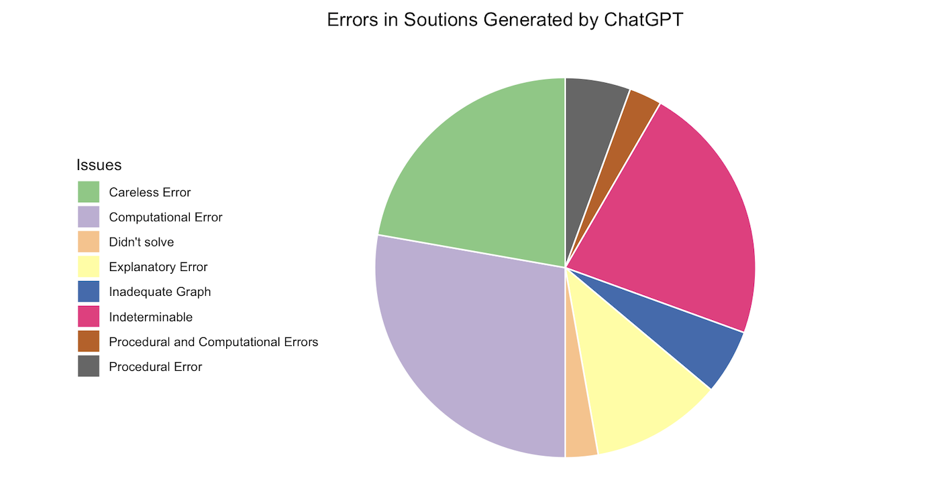
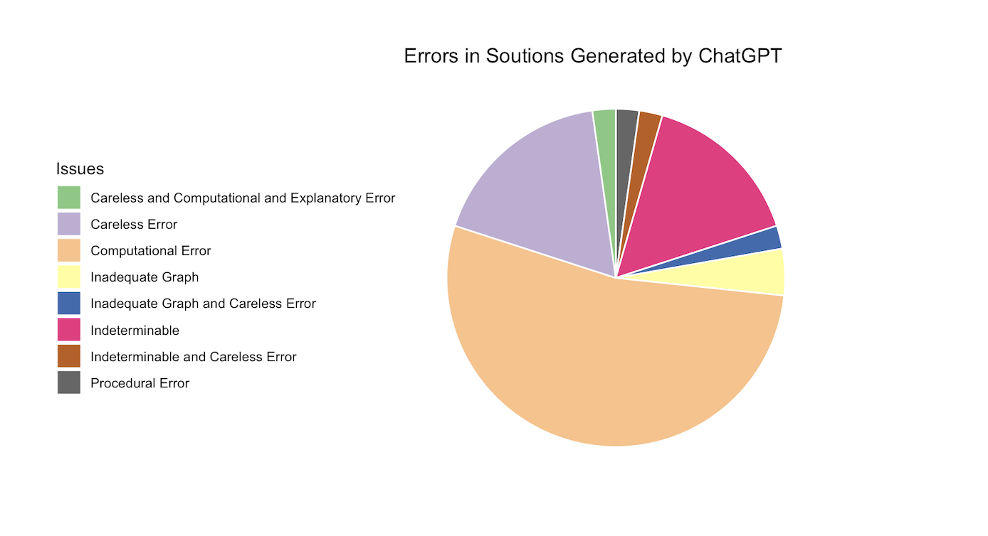
Results Cont.
Level 1:
Level 2:
Figure 11: Errors in Solutions Generated by ChatGPT
Figure 12: Errors in Solutions Generated by ChatGPT
Notes:
The most common errors we saw in question generation were ChatGPT just repeating the attribute in the form of a question, a question that didn’t fulfill the attribute, and questions that required a graph of other output that was not present or unreadable.
When evaluating the solutions ChatGPT provided for its own questions, the most common solution errors were computational errors, careless errors, and solutions that could not be evaluated, often due to unreadable graphs.
35 question errors, 36 solution errors?

Slide 21
Discussion and Conclusion
Prompting strategy: 29% of questions and solutions contained errors for Level 2, compared to 23% for Level 1
Most effective at generating solutions for Section 2 (Sampling and Experimentation)
No section with most consistently accurate generated questions
Refine computational skills and ability to generate and analyze visual outputs
Notes:
*third bullet point?

Slide 22
Future Direction
Comparing to OpenAI o1, which is claimed to have improved reasoning capabilities (Milne, 2024)
Examining different levels of prompting
Adding a level where we use the same prompt as Level 1 but with an added example question
Retesting all of these levels in ChatGPT 3.5 and OpenAI o1 for replication and analysis at the attribute level
Notes:
*do we want to add what else we were working on?

Slide 23
References
Milne, S. (2024, September 17). AI researcher discusses the new version of CHATGPT’s
advances in math and reasoning. UW News. https://www.washington.edu/news/2024/09/17/ai-chatgpt-openai-math-reasoning-o1/
OpenAI (2023). ChatGPT (March 14 version) [Large language model]. https://chat.openai.com
Powell, W., & Courchesne, S. (2024). Opportunities and risks involved in using ChatGPT to
create first grade science lesson plans. PloS one, 19(6), e0305337.
http://doi.org/10.1371/journal.pone.0305337

Slide 24
Thank You

Slide 25
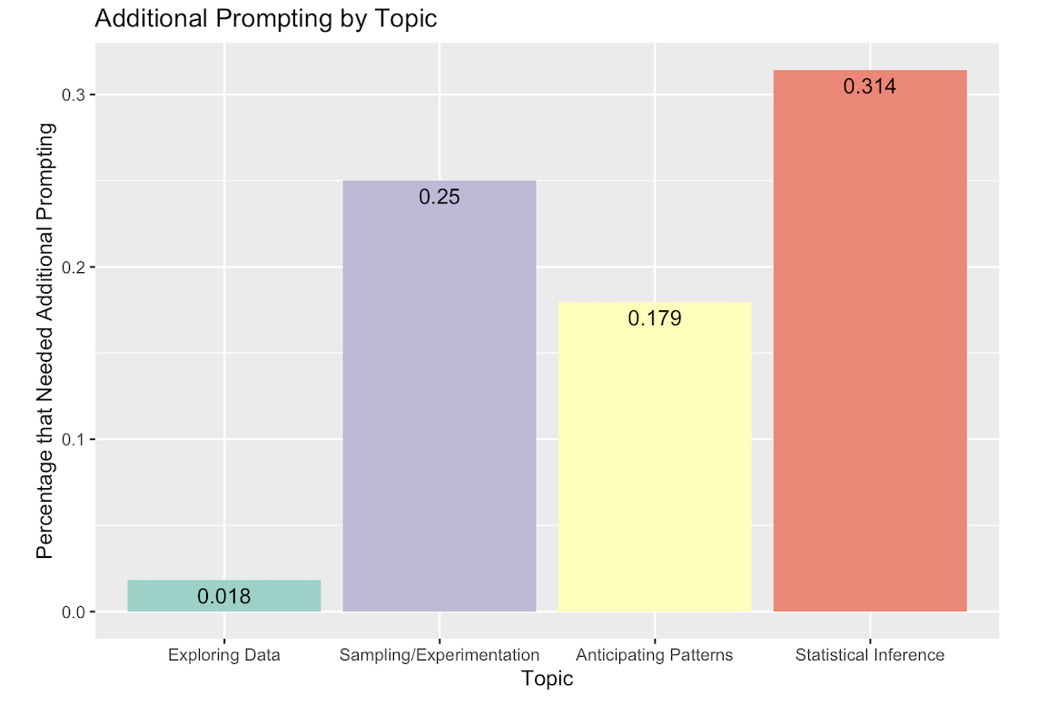
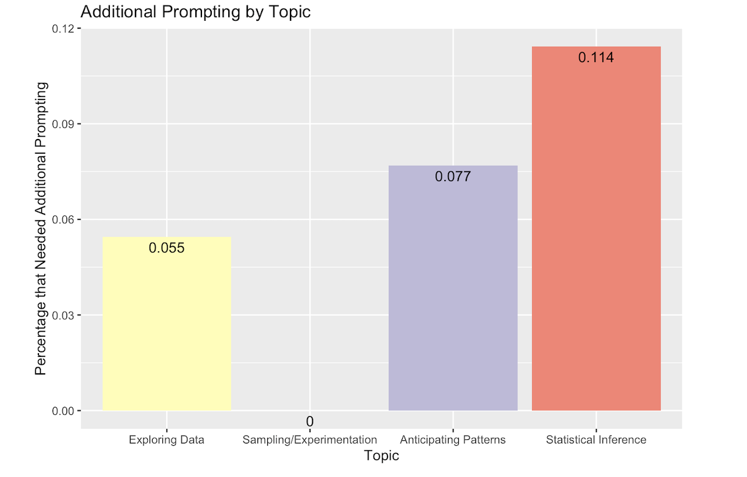
Additional Prompting
Level 1:
Level 2:
26 attributes required additional prompting to generate a solution
10 attributes required additional prompting to generate a solution
Figure 13: Additional Prompting by Topic
Figure 14: Additional Prompting by Section
Notes:
2 mostly conceptual 4B very computation heavy solutions. For some of the questions, ChatGPT didn’t provide a solution or a full solution. For these questions we attempted to continue prompting the AI to receive a solution we could evaluate.
1: 1/55 2: 7/28 3: 7/39 4: 11/35 1a: 0/10 1b: 0/18 1c: 0/5 1d: 0/16 1e: ⅙ 2a: 0/2 2b: 1/9 2c: 4/12 2d: ½ 2e: ⅓ 3a: 6/18 3b: 0/2 3c: 0/5 3d: 1/14 4a: 0/10 4b: 11/25

Slide 26
Additional Prompting
Level 1:
Level 2:
Figure 15: Additional Prompting by Section
Figure 16: Additional Prompting by Section
Notes:
2 mostly conceptual 4B very computation heavy solutions. For some of the questions, ChatGPT didn’t provide a solution or a full solution. For these questions we attempted to continue prompting the AI to receive a solution we could evaluate.
1: 1/55 2: 7/28 3: 7/39 4: 11/35 1a: 0/10 1b: 0/18 1c: 0/5 1d: 0/16 1e: ⅙ 2a: 0/2 2b: 1/9 2c: 4/12 2d: ½ 2e: ⅓ 3a: 6/18 3b: 0/2 3c: 0/5 3d: 1/14 4a: 0/10 4b: 11/25

Slide 27
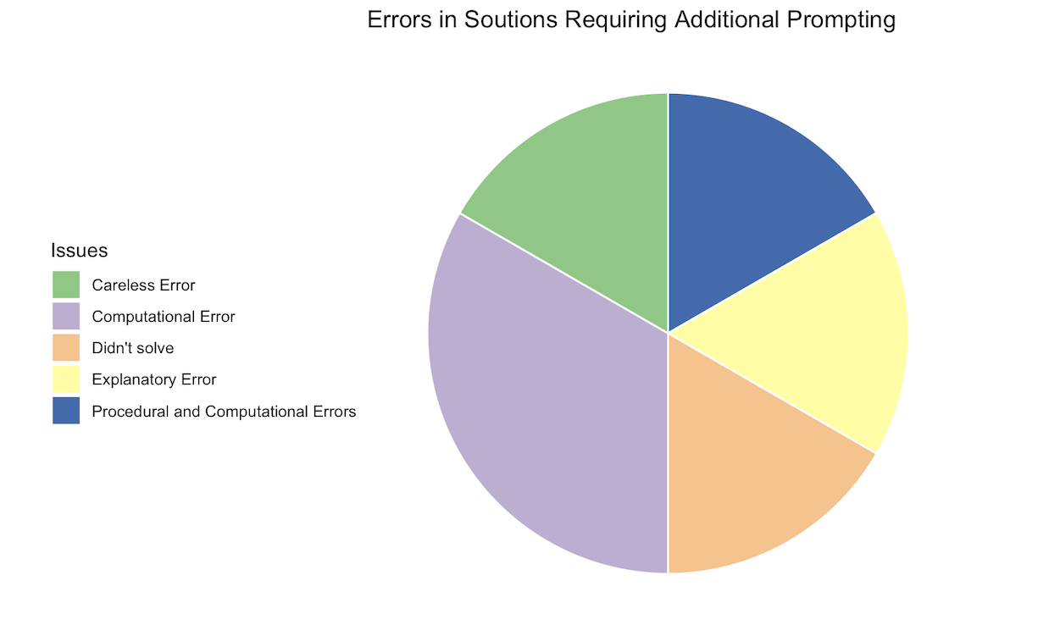
Additional Prompting
Level 1:
The proportion of error-containing solutions that required additional prompting was 0.229.
The proportion of error-containing solutions that DID NOT require additional prompting was 0.231.
Figure 17: Errors in Solutions Requiring Additional Prompting
Notes:
For some of the questions, ChatGPT didn’t provide a solution or a full solution. For these questions we attempted to continue prompting the AI to receive a solution we could evaluate. 26/157 needed additional prompting

Slide 28
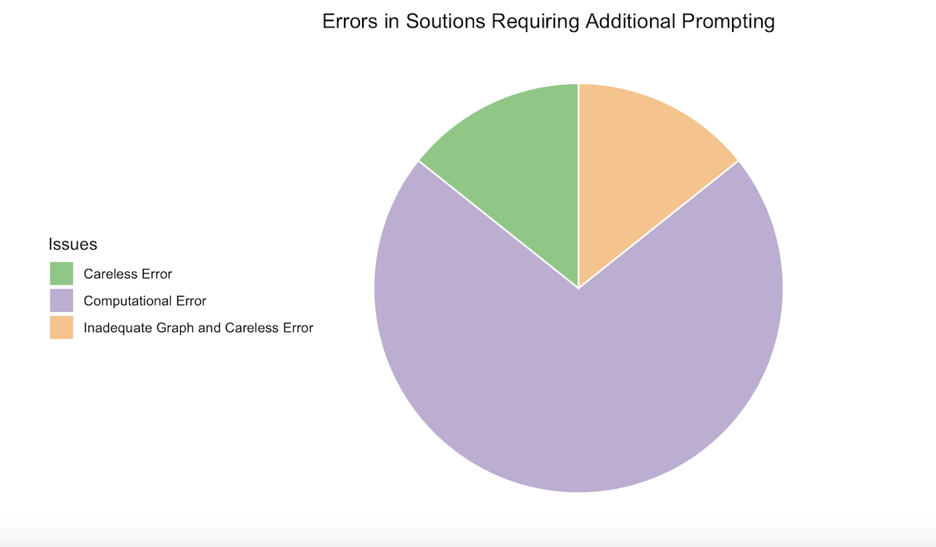
Additional Prompting
Level 2:
The proportion of error-containing solutions that required additional prompting was 0.7.
The proportion of error-containing solutions that DID NOT require additional prompting was 0.259.
Figure 18: Errors in Solutions Requiring Additional Prompting
Notes:
For some of the questions, ChatGPT didn’t provide a solution or a full solution. For these questions we attempted to continue prompting the AI to receive a solution we could evaluate. 26/157 needed additional prompting

