Slide 1
The Work Disability Functional Assessment Battery (WD-FAB)
Michael Bass (Northwestern University)

Slide 2
Background
In the United States, national disability programs are challenged to adjudicate millions of work disability claims each year in a timely and accurate manner.
The Work Disability Functional Assessment Battery (WD-FAB) was developed to provide work disability agencies and other interested parties a comprehensive and efficient approach to profiling a person’s function related to their ability to work
The WD-FAB is constructed using contemporary item response theory methods to yield an instrument that can be administered efficiently using computerized adaptive testing techniques.
The WD-FAB could provide relevant information about work-related functioning for a wide range of clinical and policy applications.

Slide 3
Domain Hierarchy (version 3)
Behavioral Health
Cognition & Communication (n=98)
Resilience & Sociability (n=32)
Self-Regulation (n=36)
Mood & Emotions (n=27)
Physical Function
Basic Mobility (n=56)
Upper Body Function (n=43)
Fine Motor Function (n=49)
Community Mobility (n=20)
Wheelchair (n=8)

Slide 4
Feasibility and Psychometric Properties Fields test ¹
Participants: Adults (N=973) unable to work because of a physical (n=497) or a mental (n=476) disability (opt-in Internet survey panel)
Efficiency of CAT administration (Time which 95% of Respondents Completed)
Physical Function (13.27 min)
Behavioral Health (15.00 min)
Person fit (standardized log-likelihood statistic) accuracy criteria of <5%
Self-Efficacy was noticeably above at 13.7%.
[1] Meterko, M., Marfeo, E.E., McDonough, C.M., Jette, A.M., Ni, P., Bogusz, K., Rasch, E.K., Brandt, D.E., Chan, L.:Work Disability Functional Assessment Battery: Feasibility and Psychometric Properties. Archives of Physical Medicine and Rehabilitation 96(6), 1028-1035 (2015) https://doi.org/10.1016/j.apmr.2014.11.025

Slide 5
Development and Validation Studies
Overview of WD-FAB v3.0
Jette, A.M., Ni, P., Rasch, E., Marfeo, E., McDonough, C., Brandt, D., Kazis, L., Chan, L.: The Work Disability Functional Assessment Battery (WD-FAB). Physical Medicine and Rehabilitation Clinics 30(3), 561-572 (2019) https://doi.org/10.1016/j.pmr.2019.03.004
Expand the WD-FAB scales of mood & emotions, resilience, social interactions, and behavioral control to improve the depth and breadth of the current scales and expand the content coverage to include aspects of cognition & communication function.
Marfeo, E.E., Ni, P., McDonough, C., Peterik, K., Marino, M., Meterko, M., Rasch, E.K., Chan, L., Brandt, D., Jette, A.M.: Improving Assessment of Work Related Mental Health Function Using the Work Disability Functional Assessment Battery (WD-FAB). Journal of Occupational Rehabilitation 28(1), 190-199 (2018) https://doi.org/10.1007/s10926-017-9710-5
Assess the feasibility and psychometric properties of 8 scales covering 2 domains of the newly developed Work Disability Functional Assessment Battery (WD-FAB): physical function (PF) and behavioral health (BH) function.
Meterko, M., Marfeo, E.E., McDonough, C.M., Jette, A.M., Ni, P., Bogusz, K., Rasch, E.K., Brandt, D.E., Chan, L.: Work Disability Functional Assessment Battery: Feasibility and Psychometric Properties. Archives of Physical Medicine and Rehabilitation 96(6), 1028-1035 (2015) https://doi.org/10.1016/j.apmr.2014.11.025

Slide 6
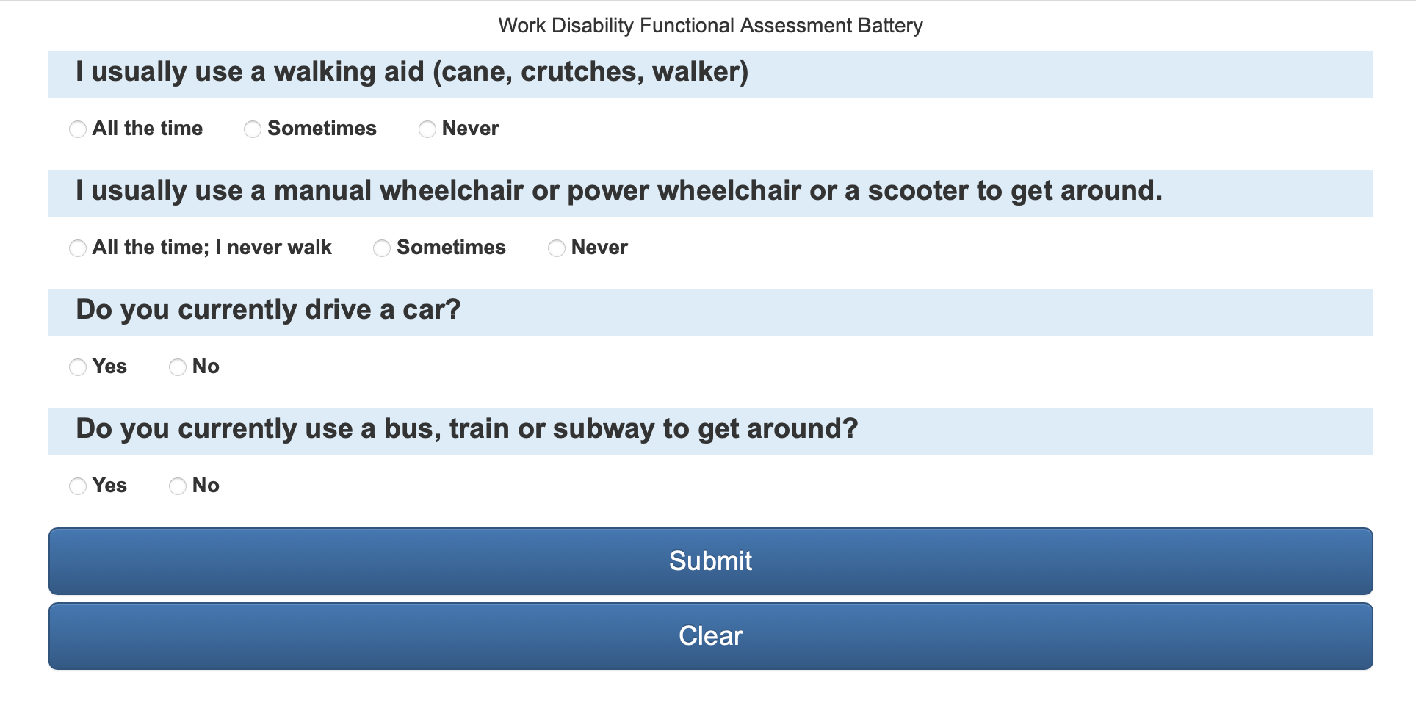
Domain Filter
Wheelchair (n=8)
Community Mobility (n=20)
Wheelchair (n=8)

Slide 7
CAT Stopping rules
Min Item administer = 5
Max Item administer = 10
SE < 0.3873

Slide 8
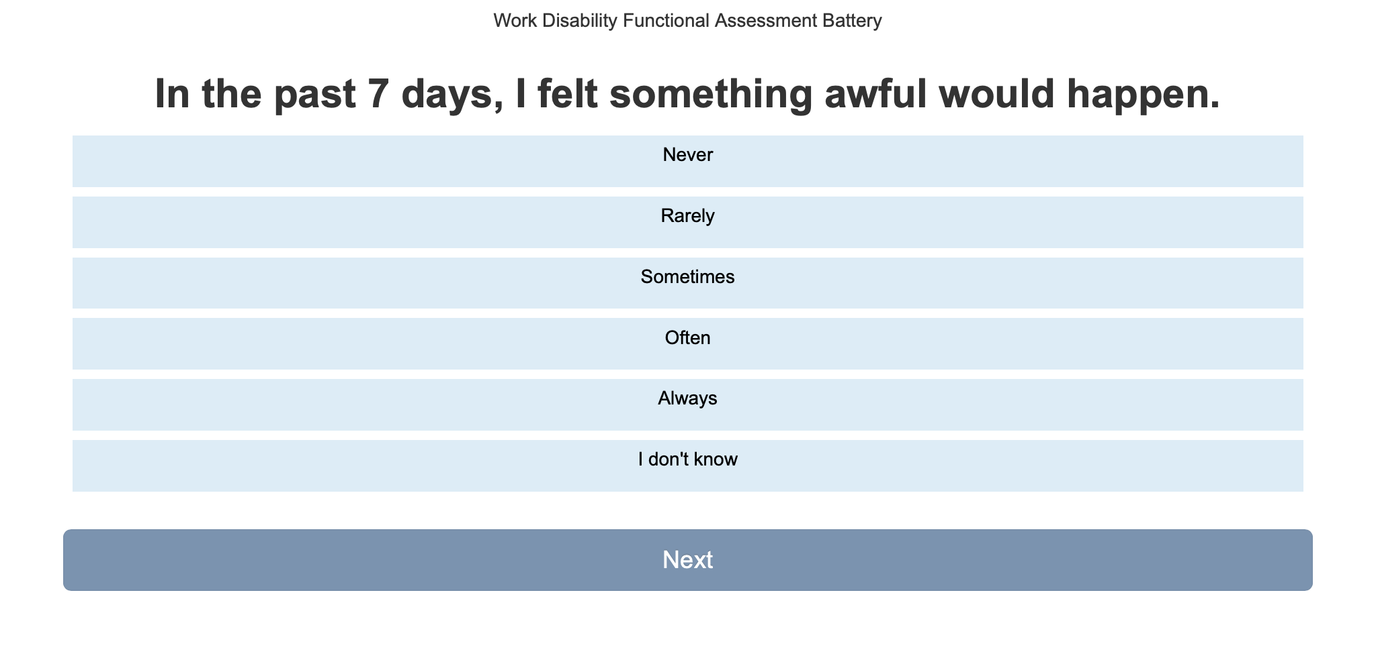
Non-scored Responses (skipped)

Slide 9
Filter item that have diff
The bitwise operator & is used to exclude items that have diff.
e.g.
if( parseInt(FORMS[j].Items[i].Operator) != 0 && (parseInt(FORMS[j].Items[i].Operator) & user.exlusion_code) > 0 )
{
console.log("removing " + FORMS[j].Items[i].Name);
FORMS[j].Items.splice(i,1);
}

Slide 10
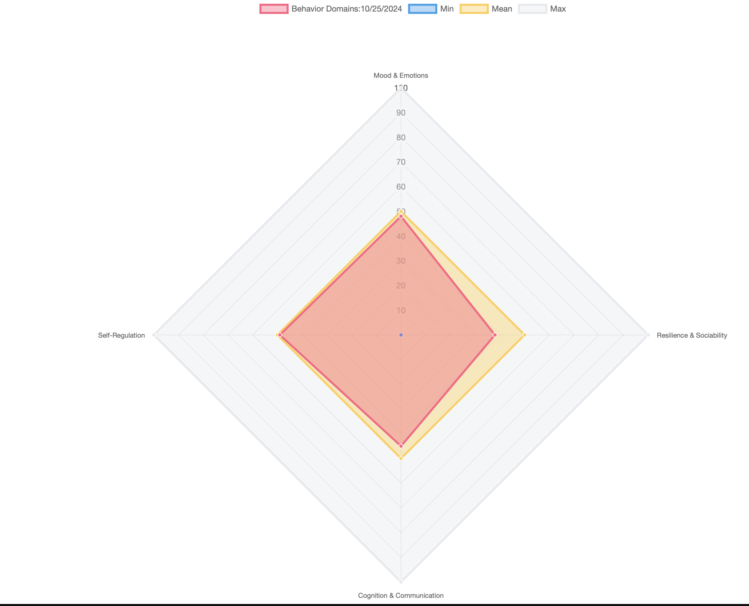
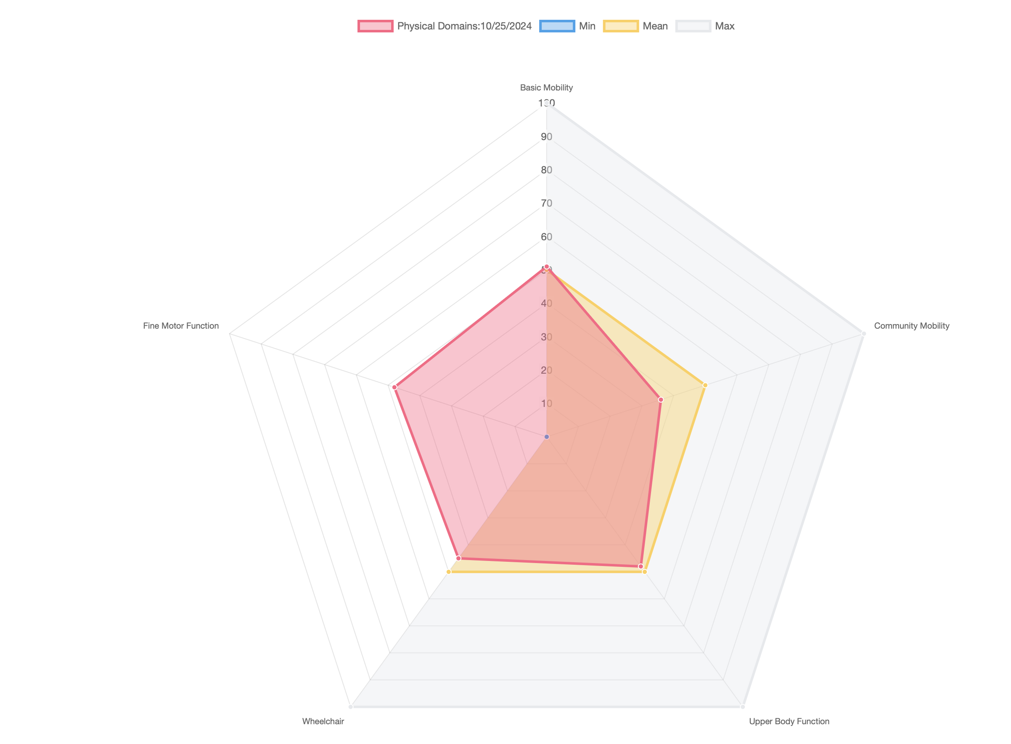
Individual results

Slide 11
Future Development
CAT Selection algorithm
Kullback–Leibler (KL) information
Randomization for Item Exposure
Software Architecture
CAT algorithm implemented in Go (https://go.dev)
Docker distribution (https://www.docker.com)
Localization – Spanish (Possible recalibration?)

Slide 12
Future Project
All of Us Research Project (https://allofus.nih.gov)
Precision Medicine Initiative (2015)
Partnered Ancillary Study (WD-FAB)
Protocol Summary
Size: More than one million participants will enroll.
Diversity: The program will actively recruit from minority populations that have been historically underrepresented in biomedical research.
Scope: Collection of a wide variety of molecular, environmental, physiologic, and behavioral information.
Duration: 10 years or more

