Slide 1
Polytomous Item Sets in CAT: Novel Representations for Online Calibration
Zhuoran Wang
William Muntean
Joe Betts

Slide 2
Background --Polytomous item Set
When multiple items utilized the same stimulus or a sequence of stimuli, these items forms an item set.
Item | D_1 | D_2 | D_3
1 | -2.27 | 0.17 | 2.3
2 | 1.73 | 2.35 | 2.64
3 | -2.73 | -0.55 | 0.31
Notes:
First let’s talk about what is item set and why we want to include item sets in our exams.
When multiple items utilized the same stimulus or a sequence of stimuli, these items forms an item set. Administering item sets reduces the time spent processing stimuli compared to administering multiple independent items. Furthermore, item sets facilitate problem-solving within the testing process, resulting in a more cohesive and streamlined assessment experience. In this way, item sets are used more and more in CAT. A similar concept is testlet. I think item set and testlet are generally interchangeable. It’s just testlet usually is associated with testlet item response model.
Here is an item set that contains 3 items. Each row contains the item parameters. Each item is a polytomous item that is scored from 0 to 3. In this way, each item contains 3 thresholds D1 to D3. For demonstration purpose, all the examples we have are based on this item set.

Slide 3
Background --Online calibration
In CAT, OP items are assigned to candidates adaptively, so candidates’ ability can be most accurately estimated.
Online calibration is usually applied within a CAT.
Online calibration assign EXP items to candidates adaptively, so EXP item parameters can be most accurately calibrated.
Notes:
1. In CAT administration, items are assigned to best estimate candidate’s ability, that is select item that suits candidate’s ability the best.
2. Online calibration is usually applied within a CAT. It can definitely work in other kinds of computer-based exam.
3. Online calibration assign EXP items to candidates adaptive, however the goal is to calibrate EXP items. That is, select candidates that suits items’ parameter the best.

Slide 4
Background --Item set online calibration
The goal of item set online calibration is to estimate all item difficulties (all thresholds in polytomous items) equally accurate, while the entire item set is assigned to a candidate at once.
Notes:
Now we are going to talk about what is special about item set online calibration, why it needs to be studies.
1. The goal of item set online calibration is to estimate all item difficulties (all thresholds in polytomous items) equally accurate, while the entire item set is assigned to a candidate at once.
For example, the item sets we used in our licensure exams, contain 6 items each, most of time there would be more than 10 thresholds involved. In this way, selecting the most appropriate candidate to answer each item sets would be a pretty complex task, as we are supposed to leverage over the more than 10 thresholds at the same time.

Slide 5
Pretest Item Set Selection
KL information, mutual information, and entropy-based methods require multidimensional integration, which would be increasingly complicated for polytomous item set selection.
Fisher information-based methods is promising as the Fisher information matrix is always 2-dimensional.
How to construct Fisher information matrix for item set?
5
Notes:
Online calibration usually contains two parts: pretest item selection and calibration algorithm. In this study, we only talk about item selection.
Here we are going to select item sets instead of single items.
A group of methods that have promising performance in previous CAT study is hard to be applied to item set online calibration. KL information, mutual information, and entropy-based methods require integration. In item set online calibration, due to the number of thresholds involved, it would be multidimensional integration.
Fisher information-based method on the other hand, would be more promising. Fisher information for multidimensional problem would always be a 2-dimensional matrix. Then a matrix computation would be performed to get a scaler and used for selection.
Then the question becomes How to construct Fisher information matrix for item set.

Slide 6
Fisher information matrix construction
Item Parameters
Candidate
Item Information
Item | D_1 | D_2 | D_3
1 | -2.27 | 0.17 | 2.3
2 | 1.73 | 2.35 | 2.64
3 | -2.73 | -0.55 | 0.31
$$θ:$$
1.33 | 0.32 | -0.1 | -0.16 | -0.28 | -0.68 | 1.34 | -2.12 | -1.04 | -0.25
1.3 | 0.44 | 0.03
0.44 | 1.81 | 0.2
0.03 | 0.2 | 0.53
1.3 | 0.22 | 0.04
0.22 | 0.34 | 0.06
0.04 | 0.06 | 0.07
0.45 | 0.18 | 0.05
0.18 | 1.69 | 0.58
0.05 | 0.58 | 1.62
6
Notes:
This is the item set you’ve seen before. It contains 3 items. each item has 3 thresholds.
As we are talking about online calibration, we are accumulating information for each threshold, item and item set. In this way, the information provided by each candidate can be simply added up. Here, we are getting the item information of each item after these 10 candidates administered it.
These are the ability of the 10 candidates.
Here are the item information of each item in the set. As there are 3 thresholds in each item, the information matrix of an item is 3 by 3.

Slide 7
Fisher information matrix construction -- Summation
Item Information
Set Information
1.3 | 0.44 | 0.03
0.44 | 1.81 | 0.2
0.03 | 0.2 | 0.53
1.3 | 0.22 | 0.04
0.22 | 0.34 | 0.06
0.04 | 0.06 | 0.07
0.45 | 0.18 | 0.05
0.18 | 1.69 | 0.58
0.05 | 0.58 | 1.62
3.05 | 0.84 | 0.12
0.84 | 3.84 | 0.84
0.12 | 0.84 | 2.22
7
Notes:
Here we propose 4 ways of constructing item set information matrix. The first is summation.
1. Here are the item information matrices of the three items in the set
5. When selecting operational item sets in CAT, the summation of item information is used as item set information. It is intuitive to assume that would also work for online calibration.
The summation item set information is the summation of all item information. For this item set, it’s a 3 by 3 matrix. Although it is intuitive, the summation of information is a blend of individual item thresholds.

Slide 8
Fisher information matrix construction --Block Diagonal
Item Information
Set Information
1.3 | 0.44 | 0.03
0.44 | 1.81 | 0.2
0.03 | 0.2 | 0.53
1.3 | 0.22 | 0.04
0.22 | 0.34 | 0.06
0.04 | 0.06 | 0.07
0.45 | 0.18 | 0.05
0.18 | 1.69 | 0.58
0.05 | 0.58 | 1.62
1.3 | 0.44 | 0.03
0.44 | 1.81 | 0.2
0.03 | 0.2 | 0.53
0 | 0 | 0
0 | 0 | 0
0 | 0 | 0
0 | 0 | 0
0 | 0 | 0
0 | 0 | 0
0 | 0 | 0
0 | 0 | 0
0 | 0 | 0
1.3 | 0.22 | 0.04
0.22 | 0.34 | 0.06
0.04 | 0.06 | 0.07
0 | 0 | 0
0 | 0 | 0
0 | 0 | 0
0 | 0 | 0
0 | 0 | 0
0 | 0 | 0
0 | 0 | 0
0 | 0 | 0
0 | 0 | 0
0.45 | 0.18 | 0.05
0.18 | 1.69 | 0.58
0.05 | 0.58 | 1.62
8
Notes:
The second item set information construct is called block diagonal
These are the item information for each item in this item set
The set information is a larger matrix, each row or column corresponds to one threshold. As we have 3 items in this item set and each item has 3 thresholds, the item set information matrix is a 9 by 9 matrix. The item information matrices are placed sequentially in the diagonal positions of this 9 by 9 matrix. The off-diagonal positions are filled with zeros. This indicates that each item provides information independently. This construct would also work if the item set contains both dichotomous items and polytomous items.

Slide 9
Fisher information matrix construction --Super Polytomous
Super Item Parameters
Set Information
D_1 | D_2 | D_3 | D_4 | D_5 | D_6 | D_7 | D_8 | D_9
-2.95 | -1.52 | -0.7 | -0.04 | 0.64 | 1.55 | 2.16 | 2.57 | 3.23
0.22 | 0.12 | 0.05 | 0.01 | 0 | 0 | 0 | 0 | 0
0.12 | 0.77 | 0.41 | 0.17 | 0.05 | 0.01 | 0 | 0 | 0
0.05 | 0.41 | 1.4 | 0.68 | 0.22 | 0.04 | 0.01 | 0 | 0
0.01 | 0.17 | 0.68 | 1.57 | 0.57 | 0.13 | 0.03 | 0 | 0
0 | 0.05 | 0.22 | 0.57 | 1.12 | 0.34 | 0.09 | 0.02 | 0
0 | 0.01 | 0.04 | 0.13 | 0.34 | 0.67 | 0.2 | 0.05 | 0.01
0 | 0 | 0.01 | 0.03 | 0.09 | 0.2 | 0.29 | 0.07 | 0.01
0 | 0 | 0 | 0 | 0.02 | 0.05 | 0.07 | 0.08 | 0.01
0 | 0 | 0 | 0 | 0 | 0.01 | 0.01 | 0.01 | 0.01
Notes:
The 3rd set information construct is called super polytomous.
1. This item set information representation treats an item set as a single super-polytomous item. A 3-item set, with items scored from 0 to 3, can be treated as one item scored from 0 to 9. The p-value of each score category is computed based on the p-values of each item scored from 0 to 3. In this way, the thresholds of this super polytomous item can be derived.
3. Based on the derived super polytomous item thresholds, we can get the item information matrix of this super-polytomous item and use it as the item set information. As you can see, the elements that are far from the diagonal are very small.

Slide 10
Fisher information matrix construction --Ordered Thresholds
Super Item Parameters
Set Information
D_1 | D_2 | D_3 | D_4 | D_5 | D_6 | D_7 | D_8 | D_9
-2.73 | -1.27 | -0.55 | 0.17 | 0.31 | 1.73 | 2.30 | 2.35 | 2.64
0.29 | 0.14 | 0.06 | 0.02 | 0.01 | 0 | 0 | 0 | 0
0.14 | 0.91 | 0.48 | 0.21 | 0.08 | 0.01 | 0 | 0 | 0
0.06 | 0.48 | 1.47 | 0.7 | 0.28 | 0.04 | 0.01 | 0 | 0
0.02 | 0.21 | 0.7 | 1.49 | 0.66 | 0.13 | 0.02 | 0.01 | 0
0.01 | 0.08 | 0.28 | 0.66 | 1.13 | 0.29 | 0.07 | 0.02 | 0
0 | 0.01 | 0.04 | 0.13 | 0.29 | 0.65 | 0.19 | 0.06 | 0.01
0 | 0 | 0.01 | 0.02 | 0.07 | 0.19 | 0.27 | 0.08 | 0.02
0 | 0 | 0 | 0.01 | 0.02 | 0.06 | 0.08 | 0.09 | 0.02
0 | 0 | 0 | 0 | 0 | 0.01 | 0.02 | 0.02 | 0.02
Notes:
The last item set information construct is called ordered thresholds.
1.This method list out all the thresholds in the item sets and treat that as a single ordered-threshold item. The 9 by 9 information matrix of this newly constructed item is used as the item set information.

Slide 11
Research Design
50-Item CAT
10th OP Item
Experimental Items
EXP Set
EXP Set
EXP Set
EXP Set
EXP Set
EXP Set
Adaptative Methods
Summation
Block Diagonal
Super Polytomous
Ordered Thresholds
E-optimality
Examinees:
Exp Pool Size:
Replications:
2,500
60 Sets (3-item sets)
100
Notes:
Now we have 4 item set information constructs, we want to know which one should we choose. Simulation study is a good way to find the empirical best ones.
In the simulation, we have 2500 candidates, each take a CAT that contains 50 OP items and 18 EXP items. The 18 EXP items are presented as 6 item sets each contains 3 items. Each item is scored from 0 to 3. The item bank contains 500 OP items and 180 EXP items. On average, each EXP items are administered to 250 candidates.
The EXP items are administered after 10 OP items are finished. The interim ability estimate of a candidate is used to adaptively select the EXP item sets. Four item set information construct were used combined with E-optimality item selection method. E-optimality aims to minimize the greatest eigen value of the theoretical covariance matrix. The item set with the largest reduction in its present greatest eigenvalue was assigned to the current candidate.
100 replications are done to get stable results.

Slide 12
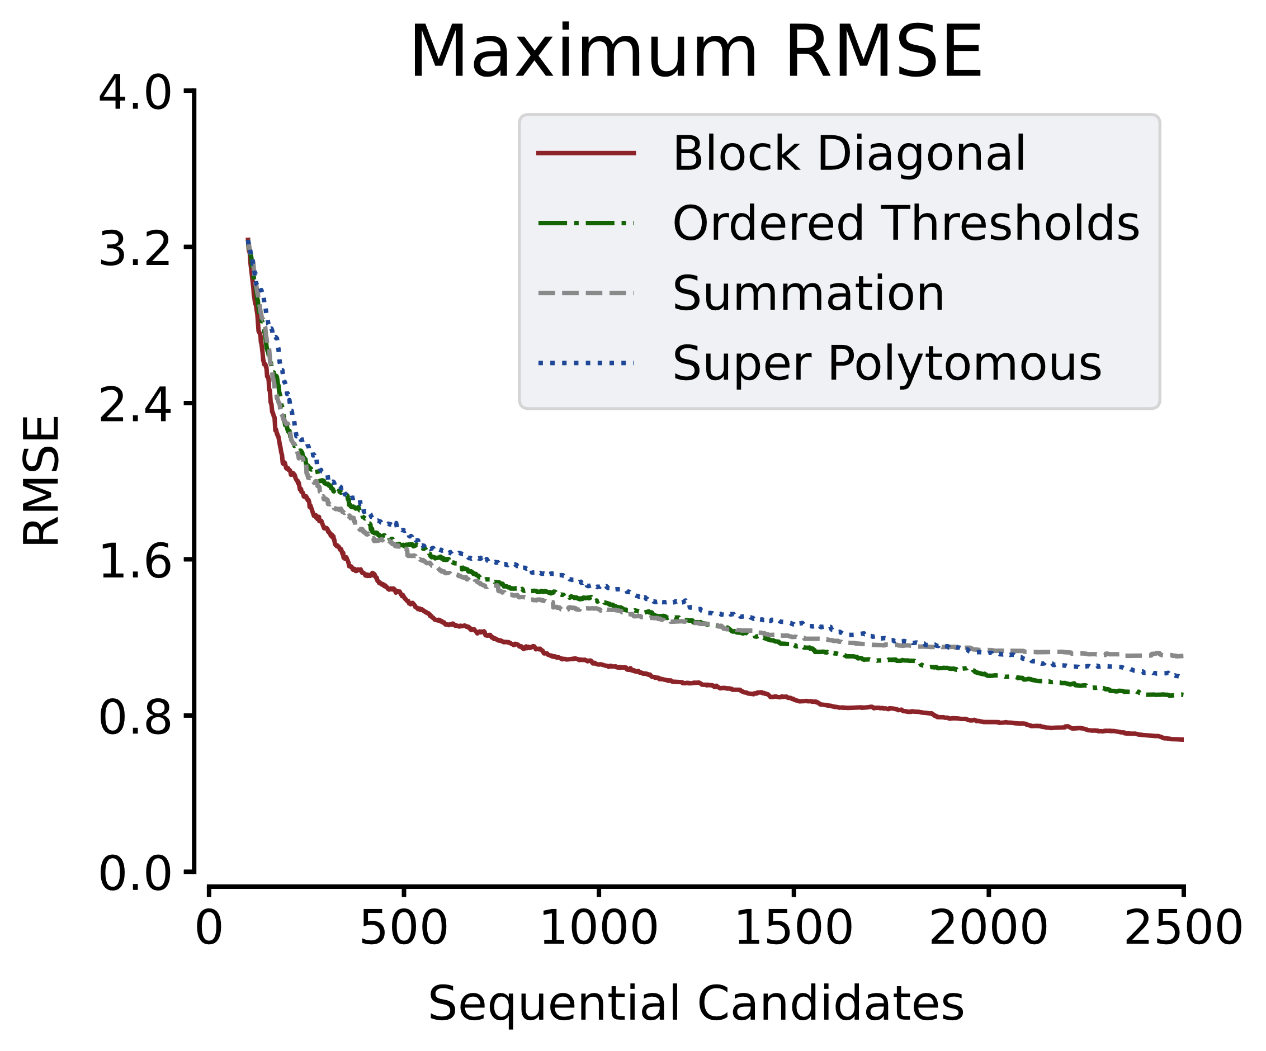
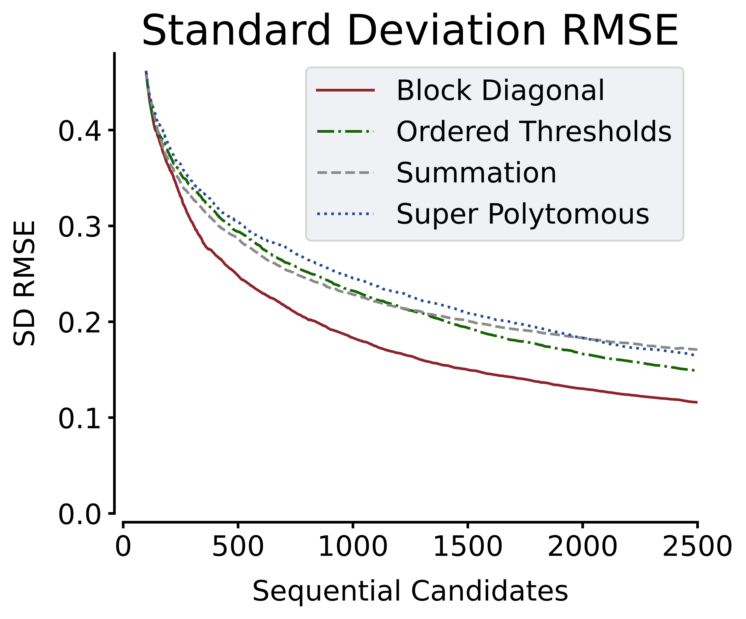
Item Level Results
Notes:
Here’re some results.
1. The first result is about the largest RMSE of threshold in the EXP bank. As our goal for item set online calibration is to make every threshold have equally high accuracy, we want the RMSE of thresholds to be low and similar. This statistic denote the largest discrepancy we have in calibration. As we can see the red solid line which denote block diagonal results in lowest maximum RMSE and it drops really fast at the early stage of online calibration.
2. The second result is about the standard deviation of threshold RMSE. As we want all thresholds to be measured equally well, we want this standard deviation to be small. In this comparison block diagonal still works the best.

Slide 13
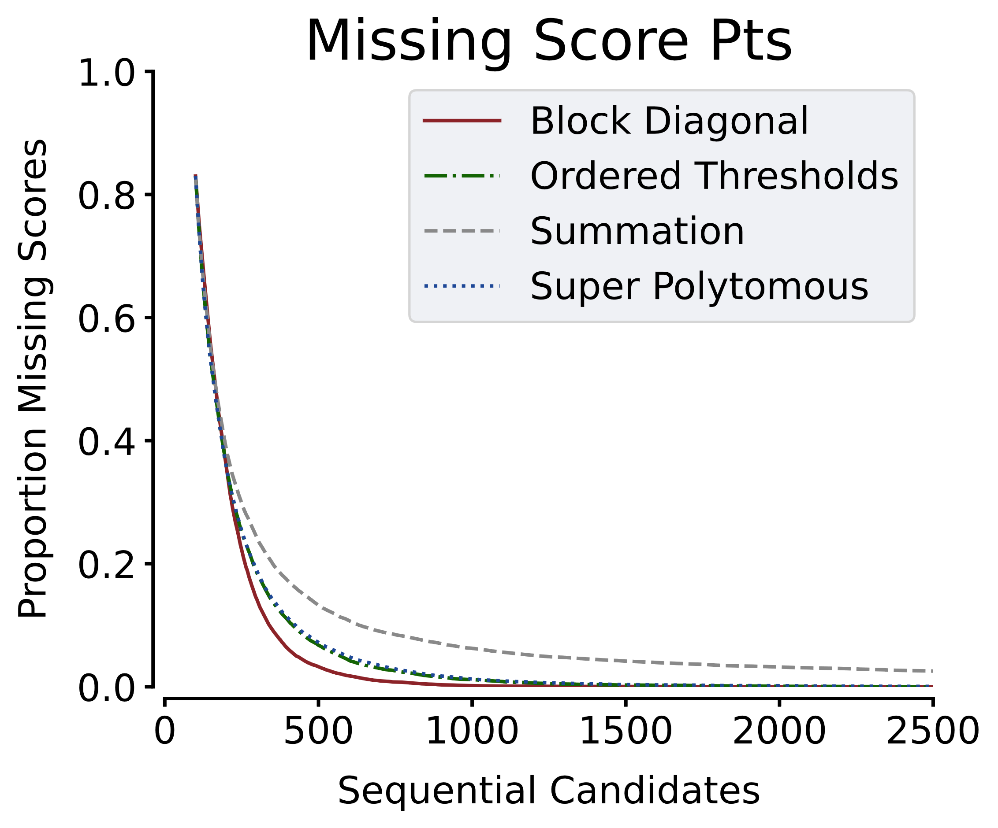
Item Level Results
Notes:
The next comparison is about missing scoring points.
For a polytomous item, if no candidate endorse certain scoring category, certain threshold would be impossible to calibrate which would definitely reduce calibration accuracy. In this way, for calibration purpose, we want all scoring points to have adequate number of endorsement. In this comparison, the red solid line, block diagonal quickly drop to zero, which means all thresholds are estimable. On the other hand, the grey dashed line, summation has missing scoring points even at the end of the online calibration.

Slide 14
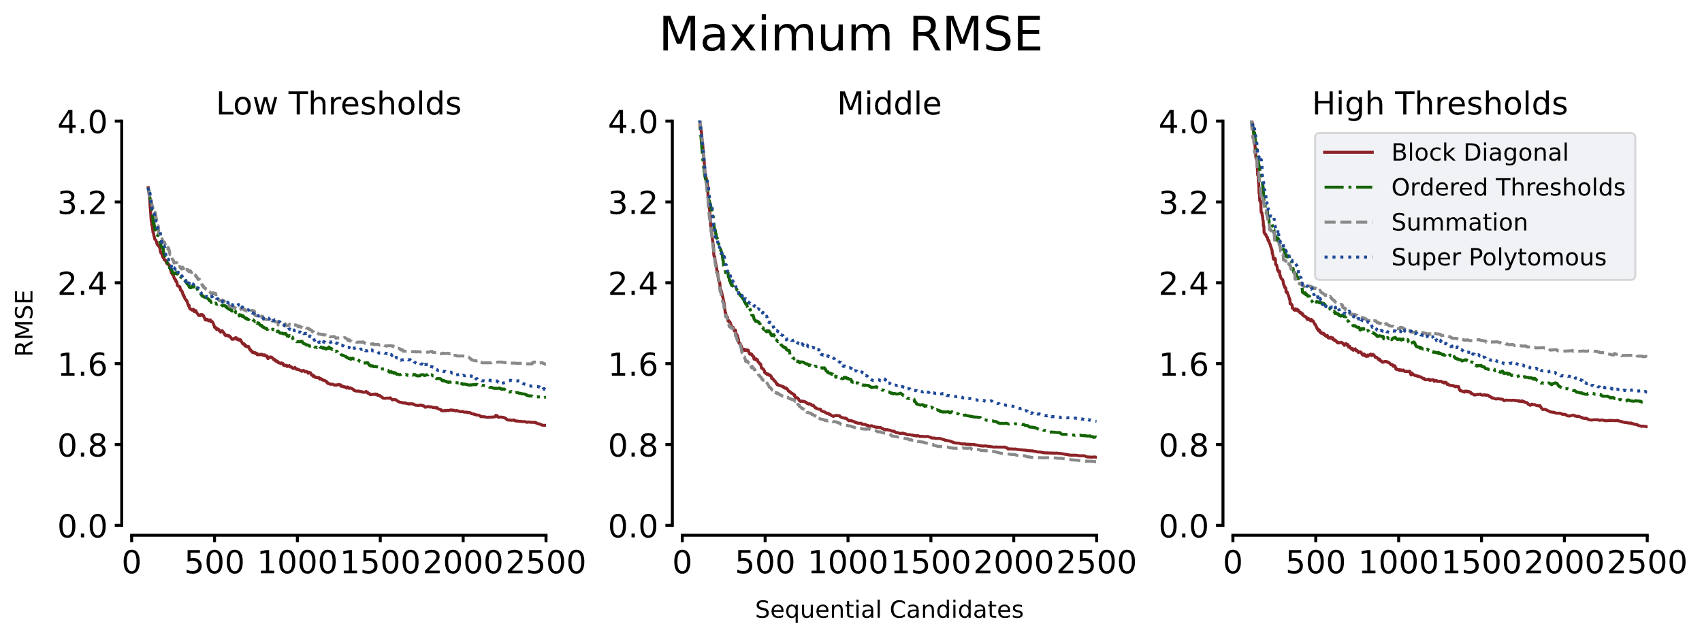
Threshold Level Results
Notes:
These plots show the Maximum RMSE for the smallest, middle, and largest one-third of the thresholds in the EXP item bank separately. Generally, the extreme thresholds would have lower calibration accuracy compared to the middle ones. The phenomenon is especially obvious for Summation. This item set information construct results in very accurate estimates for middle-value thresholds. In the middle plot, summation the grey dashed line is even lower than block diagonal the red solid line. Summation has way worse accuracy for the extreme thresholds, The grey dashed lines are the highest in the low and high thresholds plots. This trait of Summation is undesirable, as we want all thresholds to be calibrated equally well.

Slide 15
Summary
In item set online calibration, all thresholds ought to be estimated equally well.
Four item set Fisher information matrix constructs were developed:
Summation
Block Diagonal
Super Polytomous
Ordered Thresholds
Block Diagonal has the best performance in the simulation study.

Slide 16
Questions & Comments
Please contact zwang@ncsbn.org

Slide 17
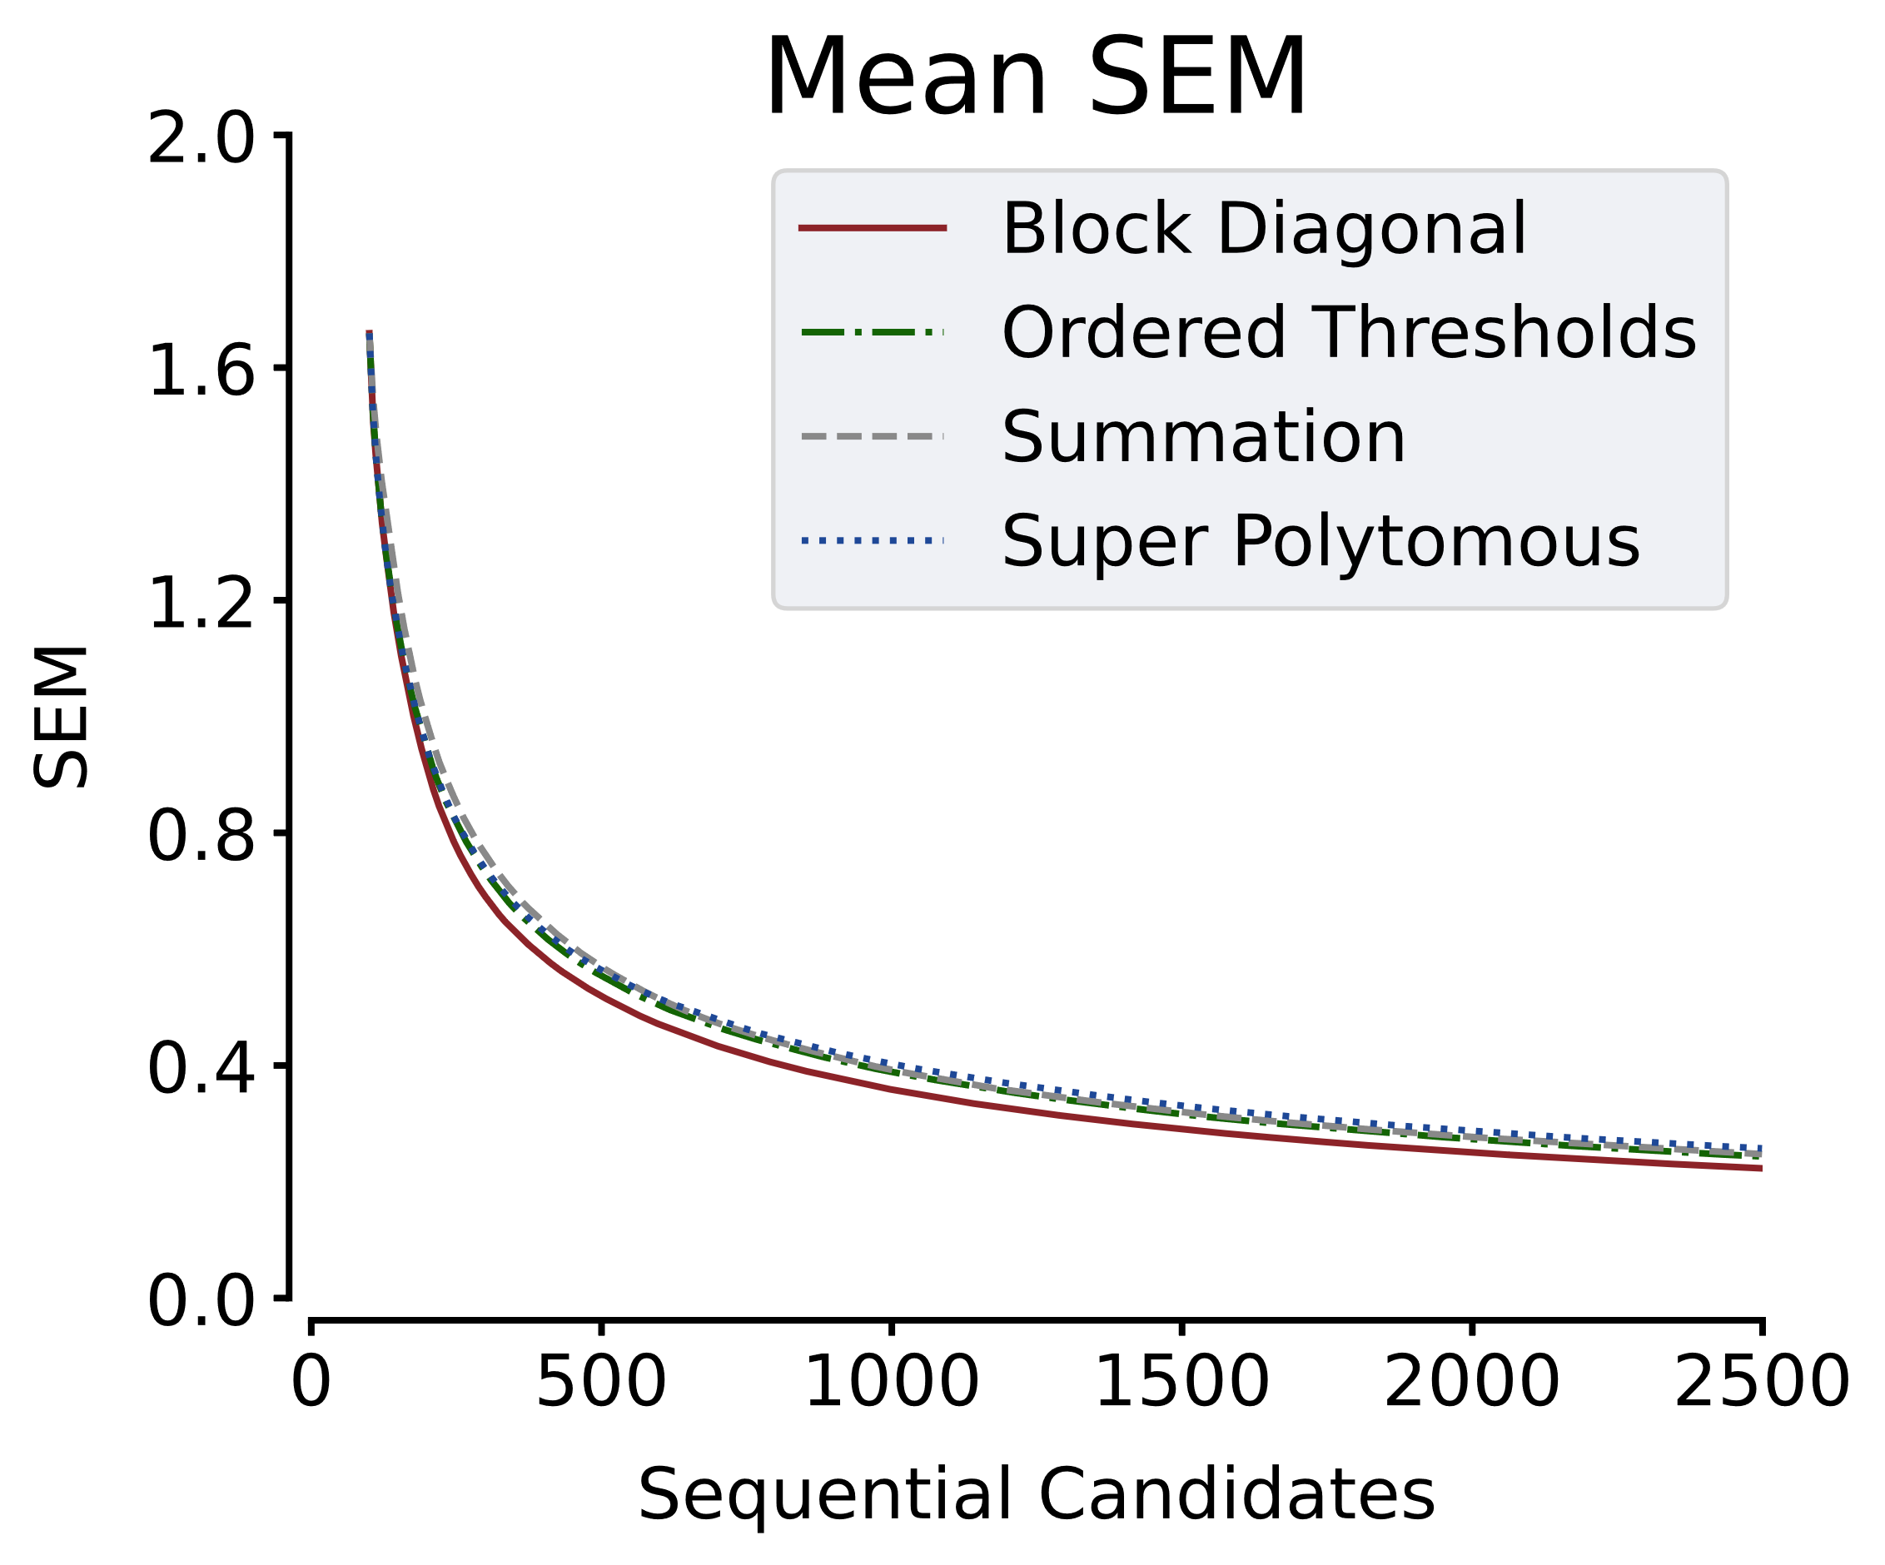
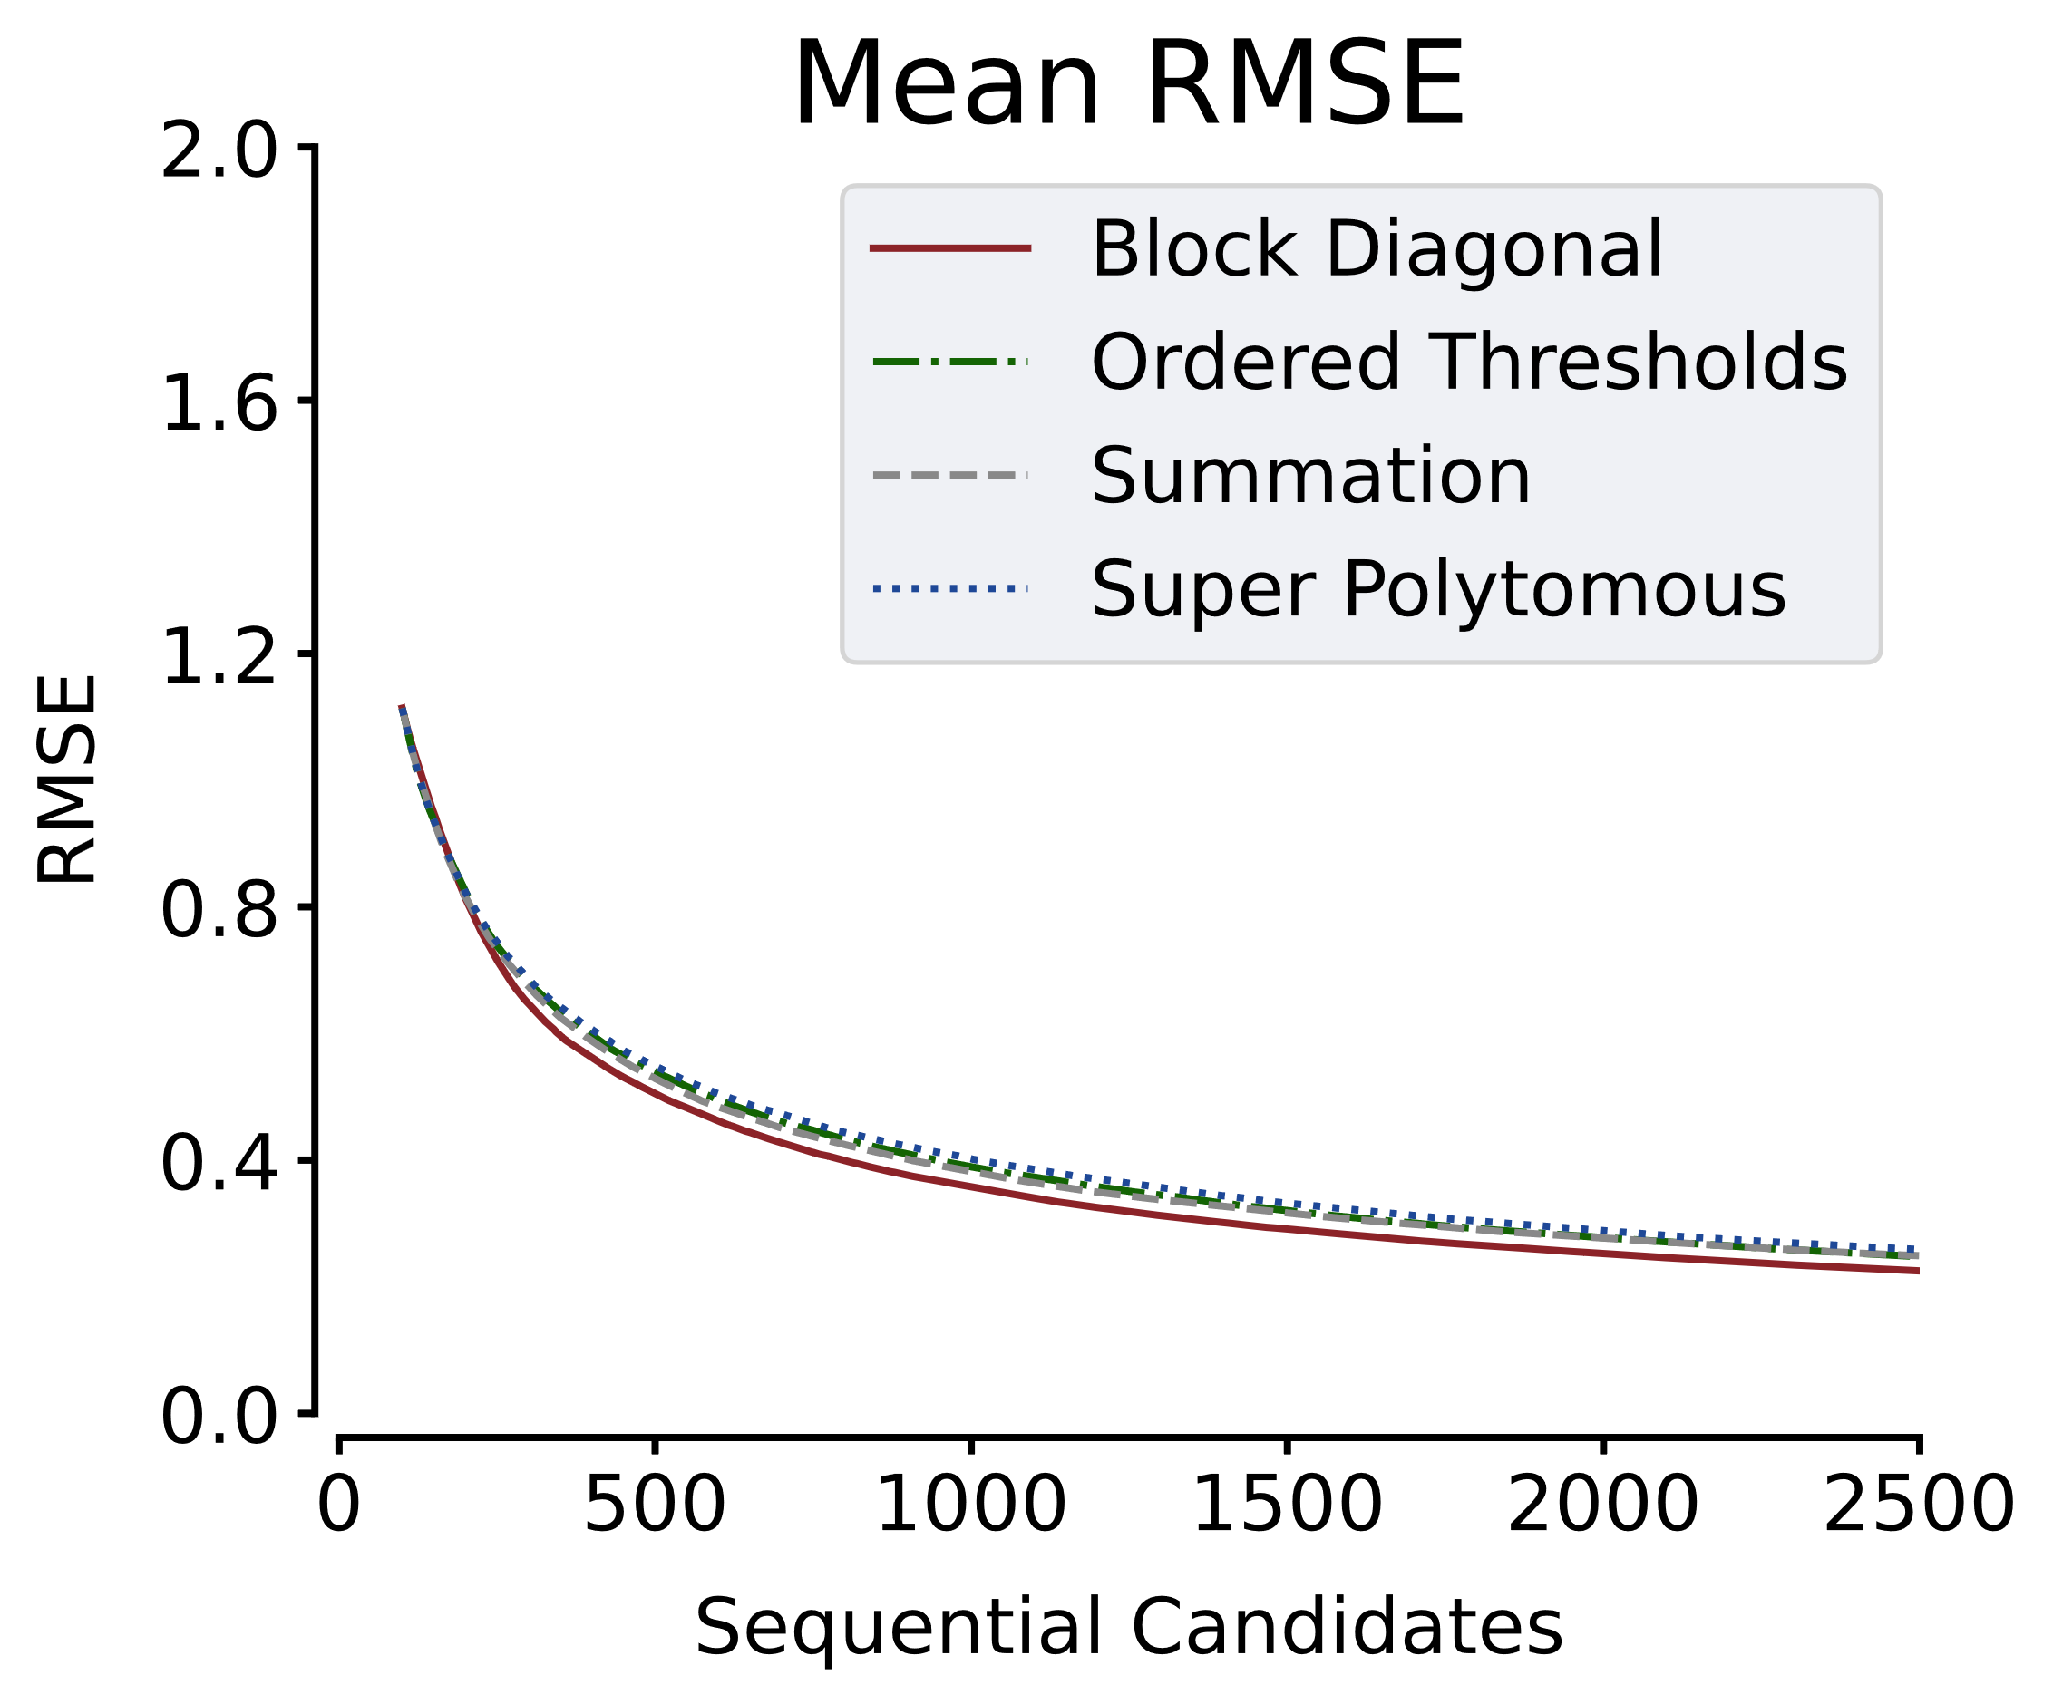
Additional results
Notes:
In terms of mean accuracy

