Slide 1
CAT Potential of PROMIS Depression and Physical Function Item Banks

Slide 2
What is PROMIS?
Patient-Reported Outcomes Measurement Information System
“An original NIH Roadmap program, the goal of this 10-year project was to develop an efficient state-of-the-art assessment system for self-reported health.”
https://commonfund.nih.gov/promis/index

Slide 3
PROMIS – Target Audience
Health-related Quality of Life (HRQOL) - Symptom/functional based not disease/condition based
Who?
  FDA secondary endpoint for labeling claims (e.g., side-effects)
  Healthcare organizations and clinicians for credentialing (e.g., cancer centers are required to provide distress screening for all patients)

Slide 4
PROMIS - Domains
Physical Health
Mental Health
Social Health
Physical Function
Pain Intensity
Pain Interference
Fatigue
Sleep Disturbance
Depression
Anxiety
Ability to Participate in Social Roles & Activities
PROMIS Profile Domains
Physical Behavior
Pain Quality
Sleep-related Impairment
Sexual Function
Gastro-Intestinal Symptoms
Dyspnea
Anger
Cognitive Function
Alcohol Use, Consequences, & Expectancies
Smoking
Substance Use
Psychosocial Illness Impact
Self-efficacy
Satisfaction with Social Roles & Activities
Social Support
Social Isolation
Companionship
PROMIS Additional
Domains
http://www.healthmeasures.net/

Slide 5
PROMIS - Item
Context – “In the past 7 days”
Stem – Focal point
Graded Response Model
No “correct” answer
In the past 7 day
I felt uneasy
Never
Rarely
Sometimes
Often
Always

Slide 6
IRT Model: 2-PL Graded Response Model
In the past 7 day
I felt uneasy
Never
Rarely
Sometimes
Often
Always

Slide 7
PROMIS Item Banks (N= 349)
Average item count 25.8
Median item count 20

Slide 8
PROMIS Administration Options
CATs
Fixed length short-forms

Slide 9
Information as a metric for choosing administration approach
Just because we can administer a PROMIS bank as a CAT,
is it beneficial?

Slide 10
Item Information - Bank

Slide 11
Item Information – Short form

Slide 12
Item Information – Short form

Slide 13
Item Information – Simulate CAT

Slide 14
Item Information – Cumulative

Slide 15
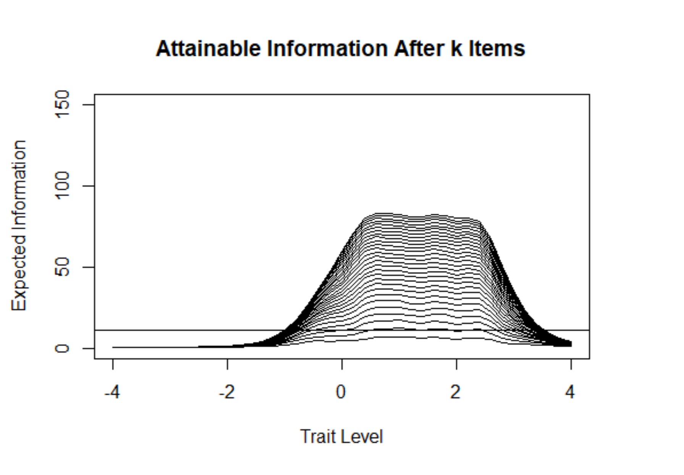
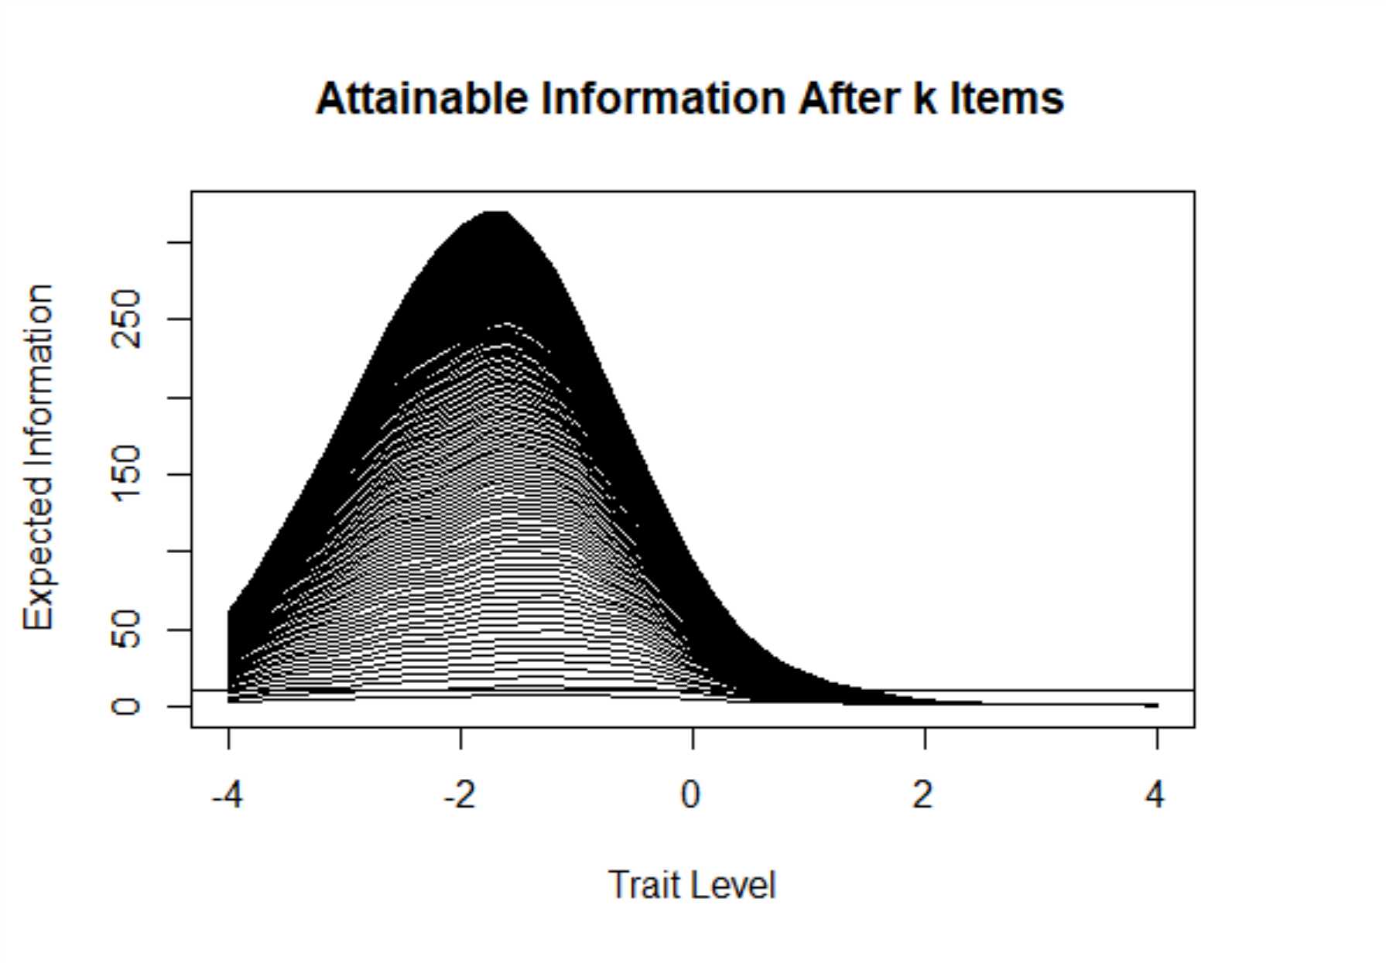
Attainable Information after Best k Items (i.e. Sim CAT) at each Trait Level
Depression (28 items)
Physical Function (165 items)
Notes:
Consider a CAT in which item selection is not fixed can we obtain more information than the fixed length counter part administration formats.
At each level of theta, sort items by information, then sum information to top k items.
This represents an upper limit on the information achievable by a CAT. It represents what could be achieved if we knew in advance the best item for each person. In practice, all participants receive the same first item and trait estimates gradually improve with additional items. So the information produced by an actual CAT will be less than the idealized information presented here, especially for very short tests (e.g., k=2). Still, this may provide a rough guide to what might be achievable with a CAT.

Slide 16
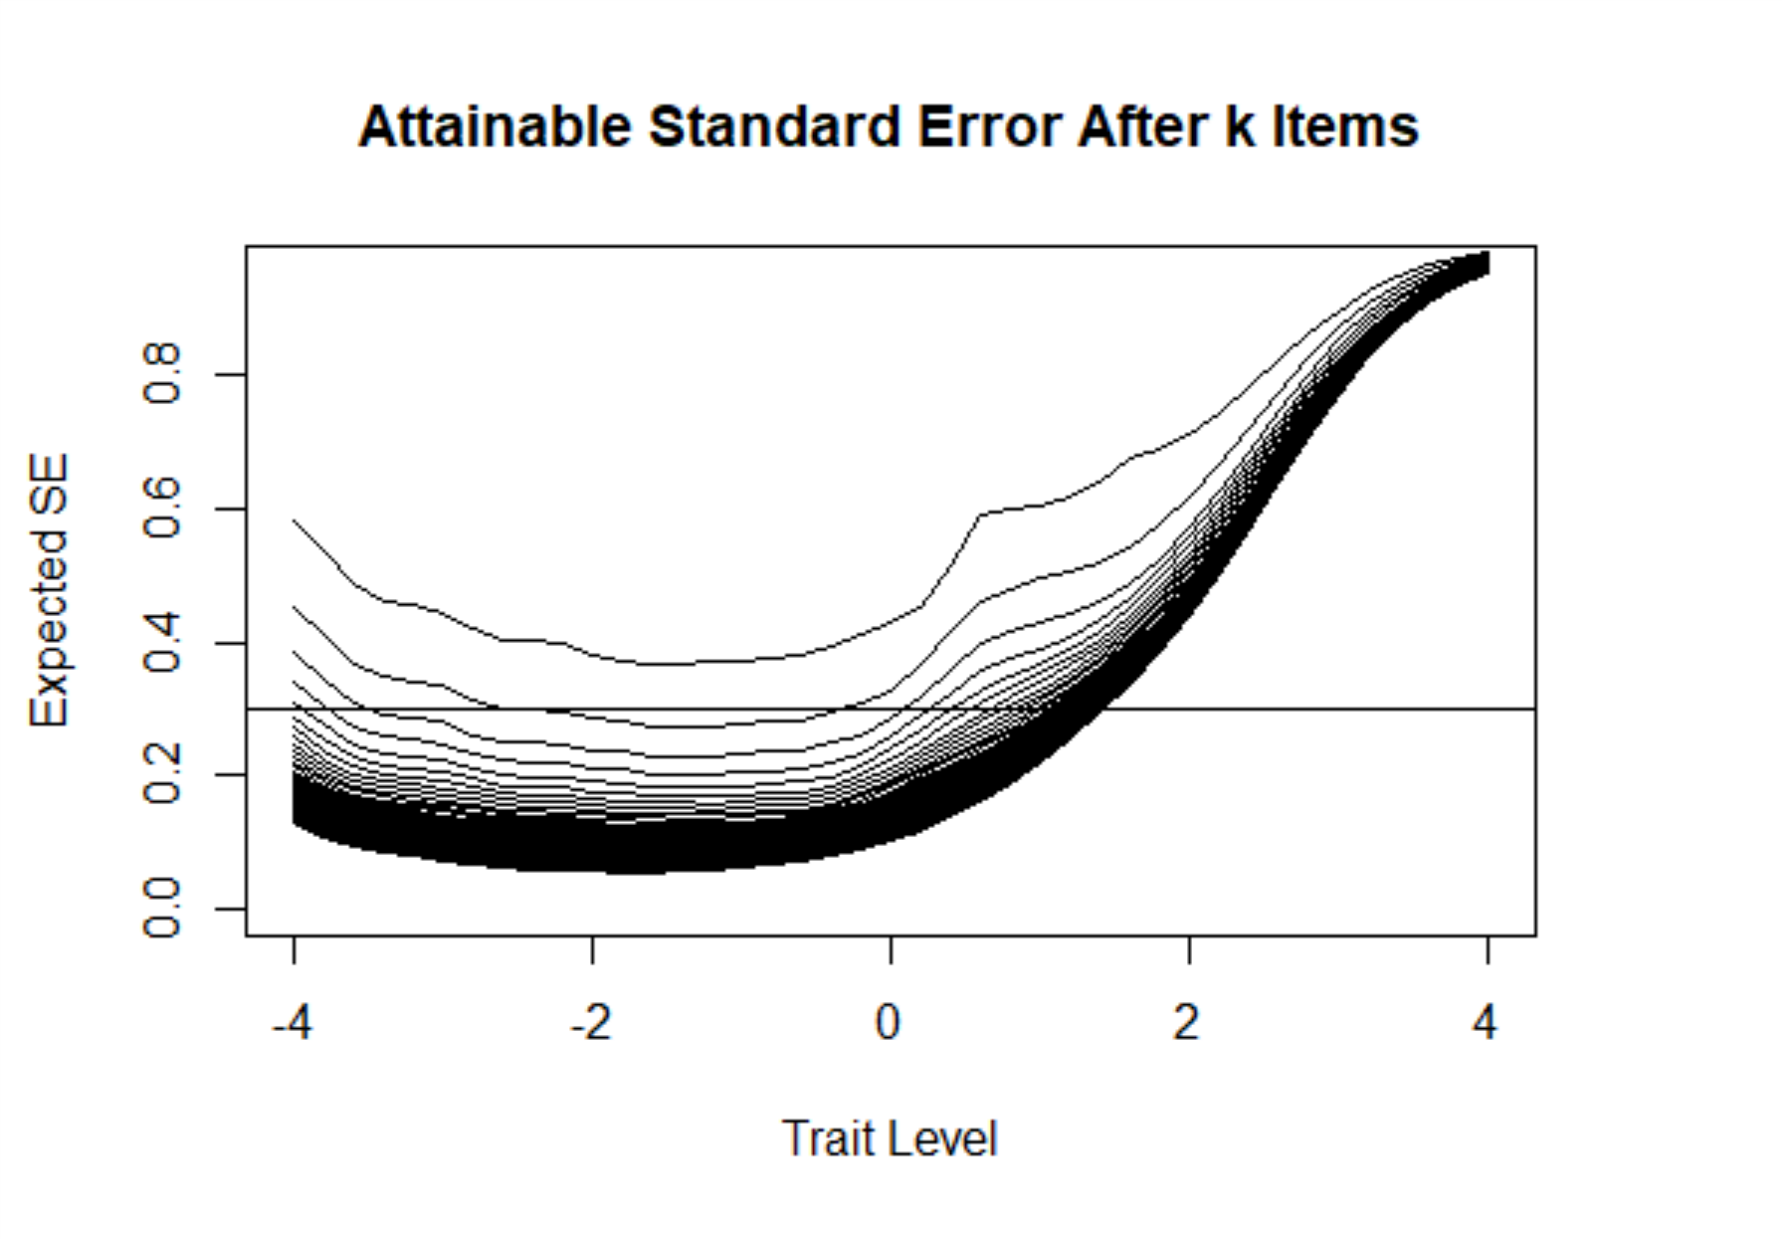
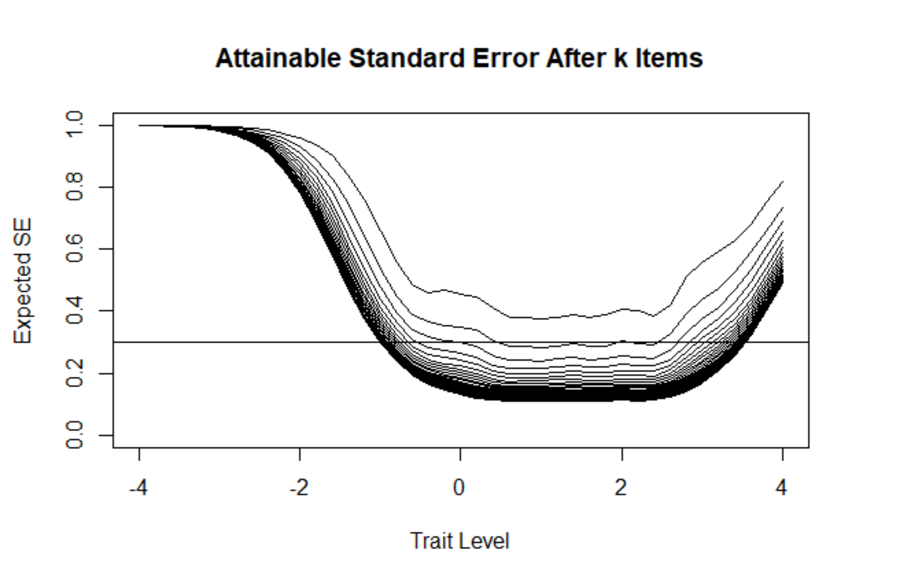
Attainable Standard Error of Measurement
Depression (28 Items)
Physical Function (165 Items)
Notes:
Expected SE = 1/SQRT(Information)

Slide 17
Can we derive a metric to quantify the relative efficiency of administration approaches?
* Just because we can administer a CAT, do we always have to…

Slide 18
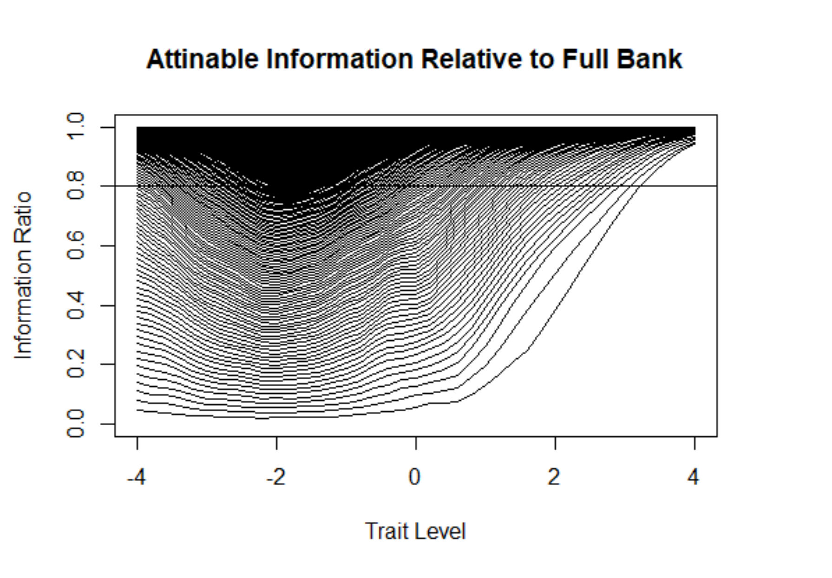
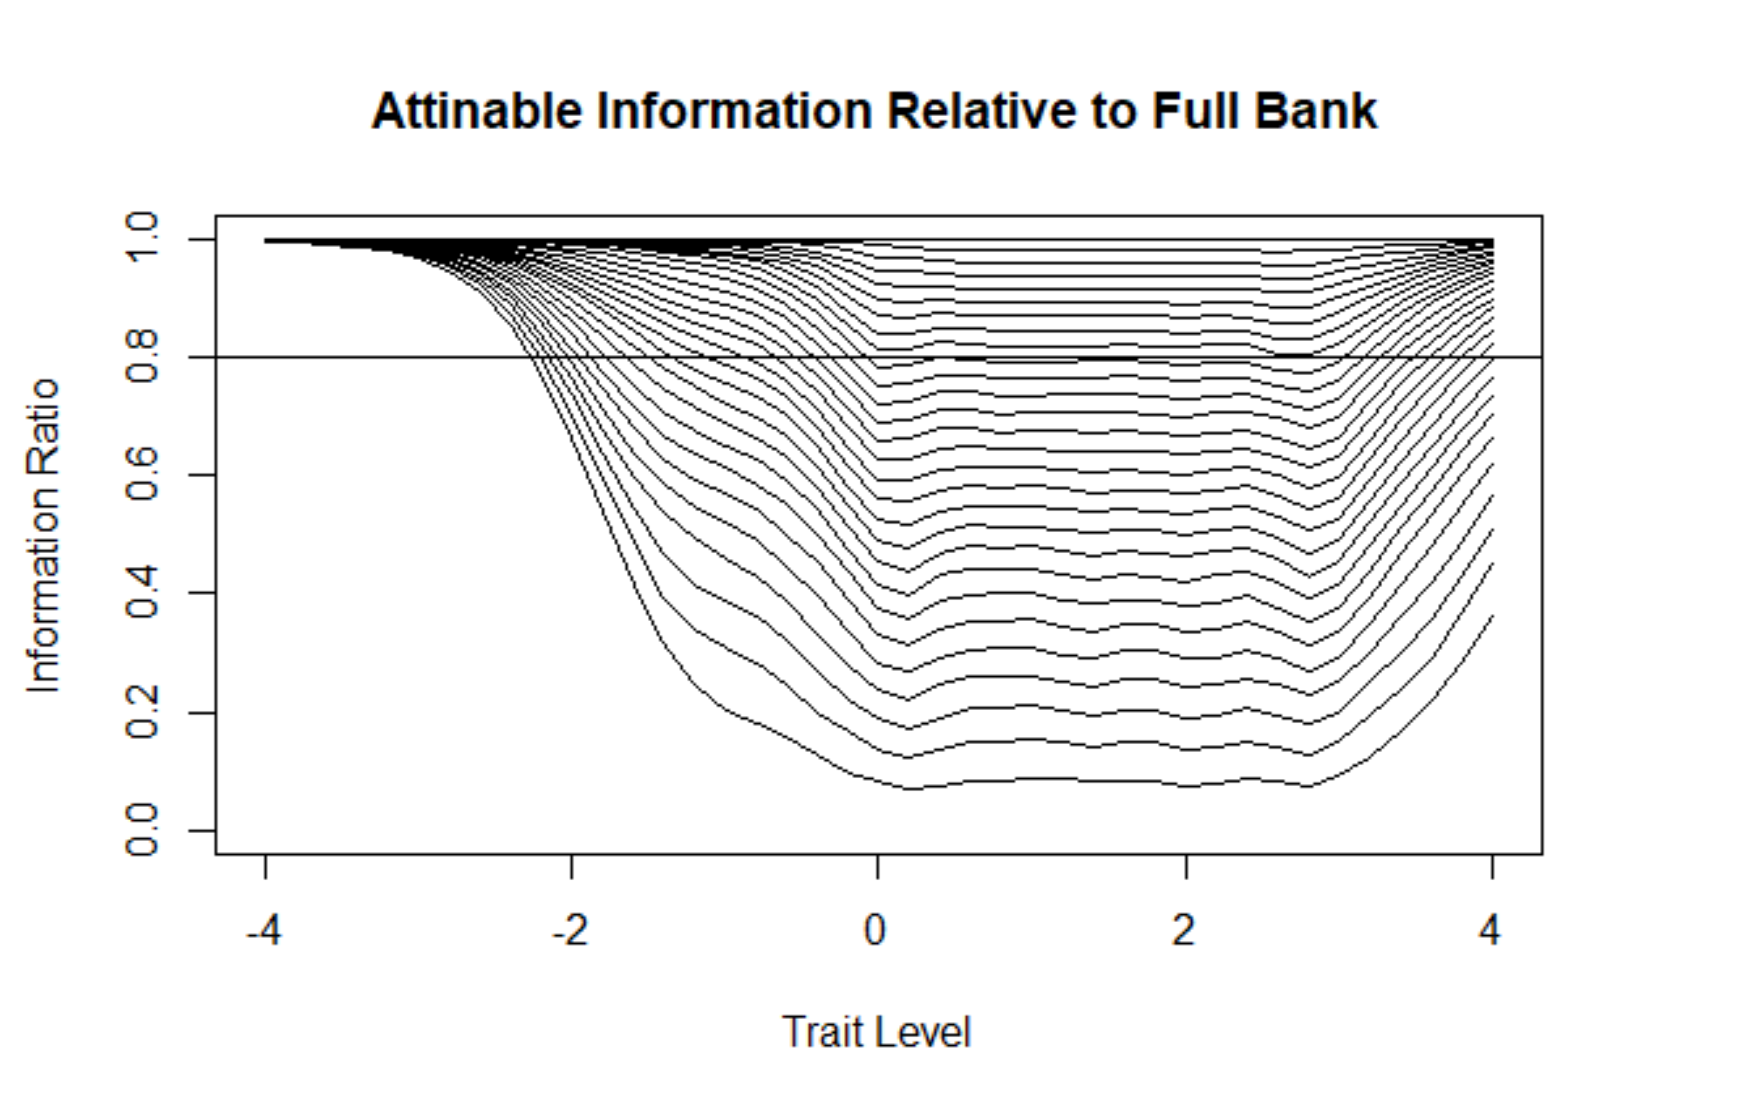
Proportion of Full Bank Information
Depression
Physical Function
Notes:
Ratio of information after k items to full bank.
The first think we considered in determining a metric was a ratio of information between all the items of a bank and items selected during specific administration forms (i.e. simulated CATs or published short-forms). Here you see the ratio increases and approaches one as the number of items are administered. So can we draw a line to demarcate a threshold where a specific administration approach reaches to target an efficiency level. (e.g. In this case example a ratio of .8 is represented.) What would that level be? Here you can see a large portion of items would be needed to reach this level. In fact, In most cases, the item count needed would be prohibited in most clinical settings.

Slide 19
Information comparison between administration approaches

Slide 20
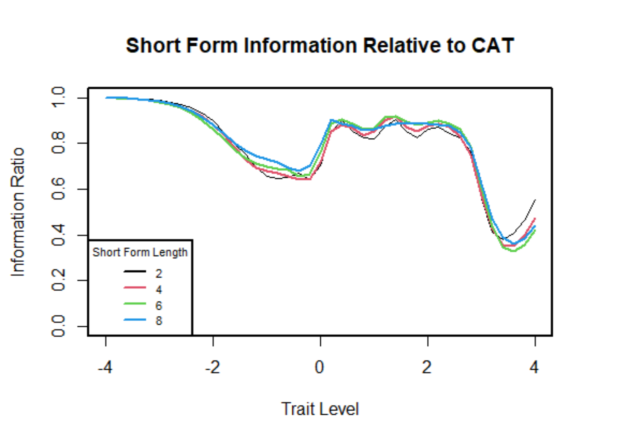
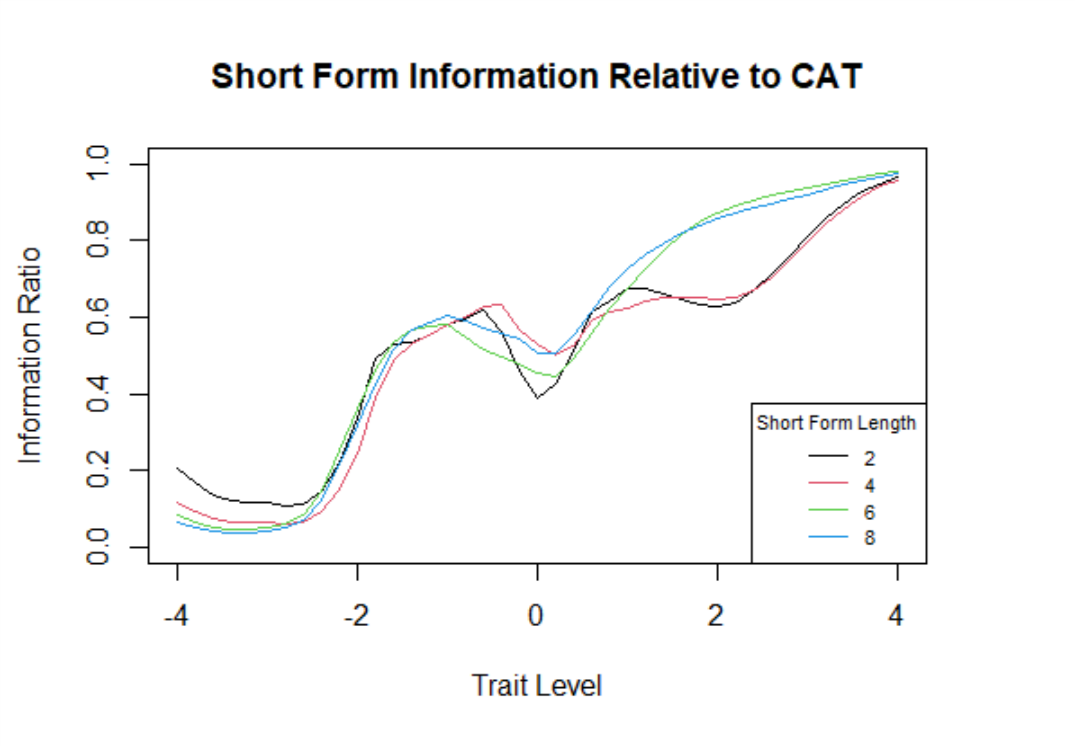
Information of Fixed-Item Short Form Relative to Sim. CAT
Depression
Physical Function
Notes:
So, using a ratio between the full bank and forms of administration did seem to lead us to an obvious approach, we looked into comparisions between adaptively administered items and fixed administered items. As an illustration we first plot information this for 6-item assessments.
Information for short form with k items / Information for the CAT (best k items at each theta). Repeated for k = 2,4,6,8 items.
CAT performs better when the ratio is lower, but at extreme levels no information.
For depression domain, we see a dip in the ratio for the extreme theta value, but for the clinical theta range, we don't see a large difference between forms.
For physical functioning the story is a little different. We see more variation, and longer short forms perform better at the extremes.

Slide 21
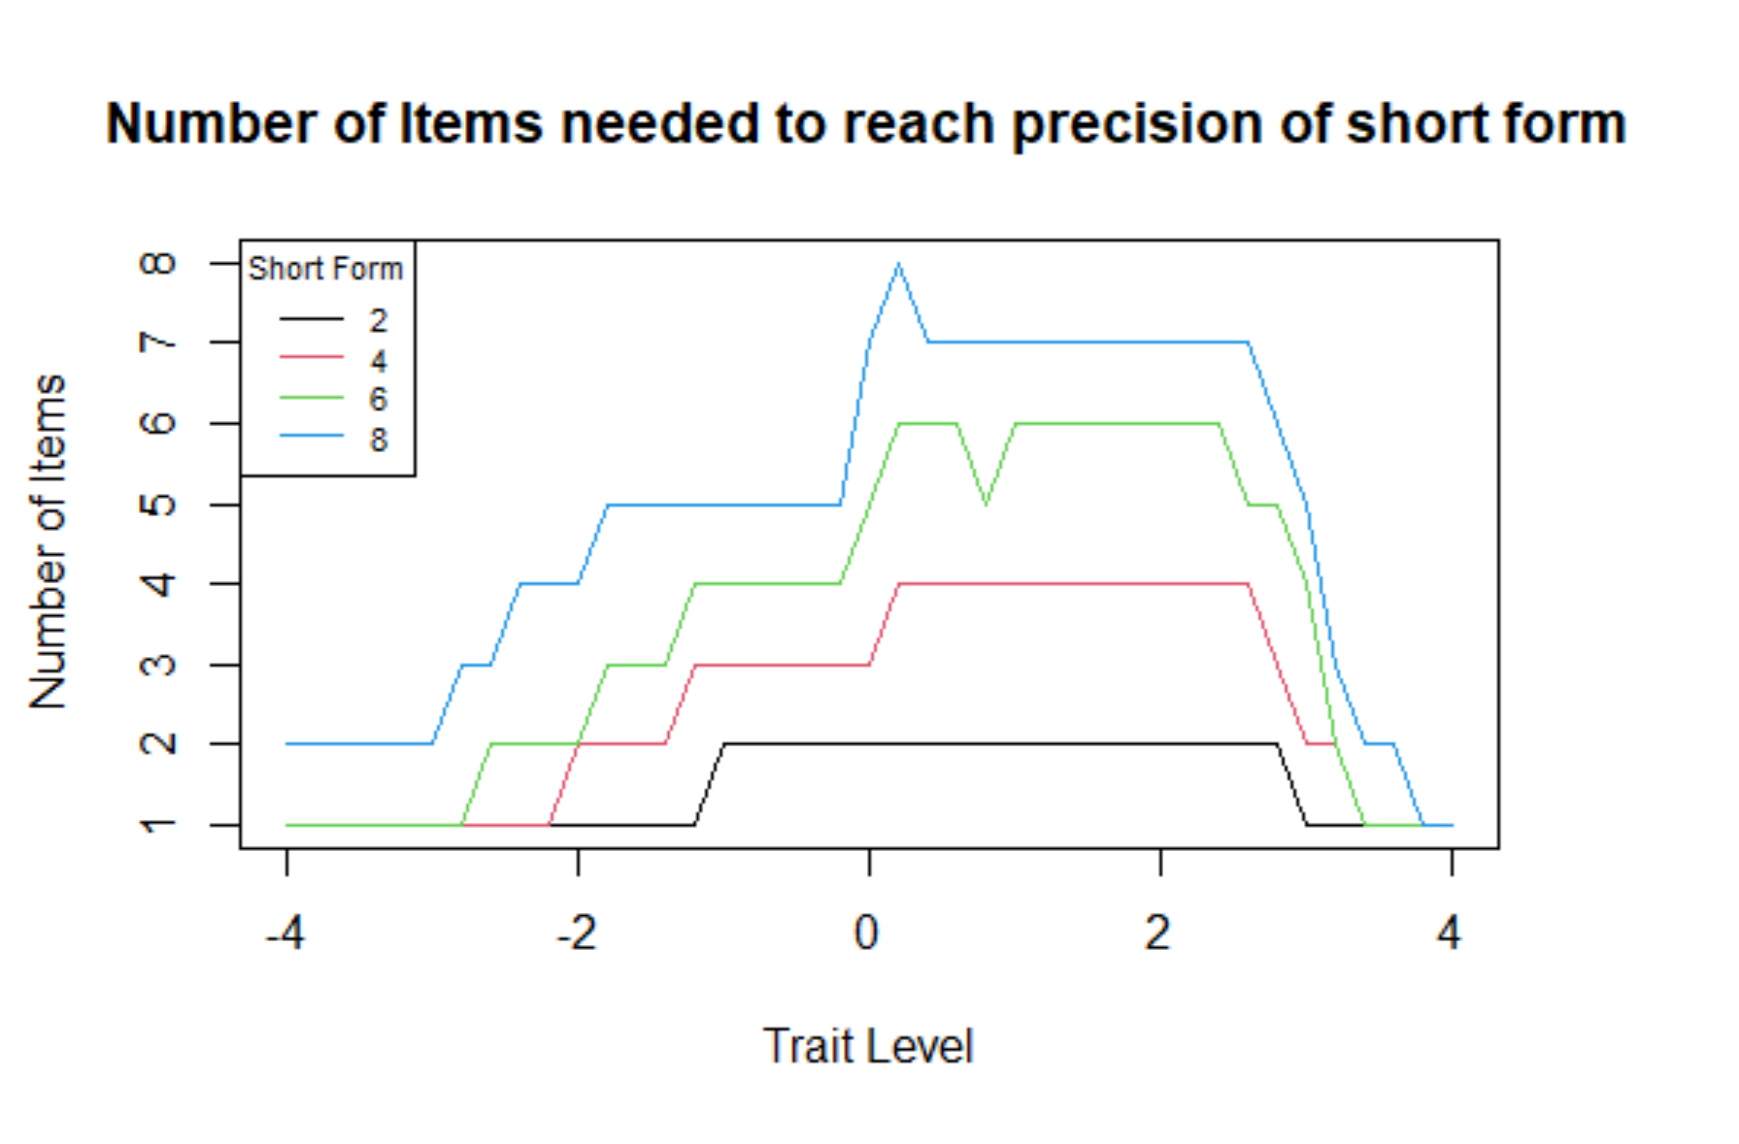
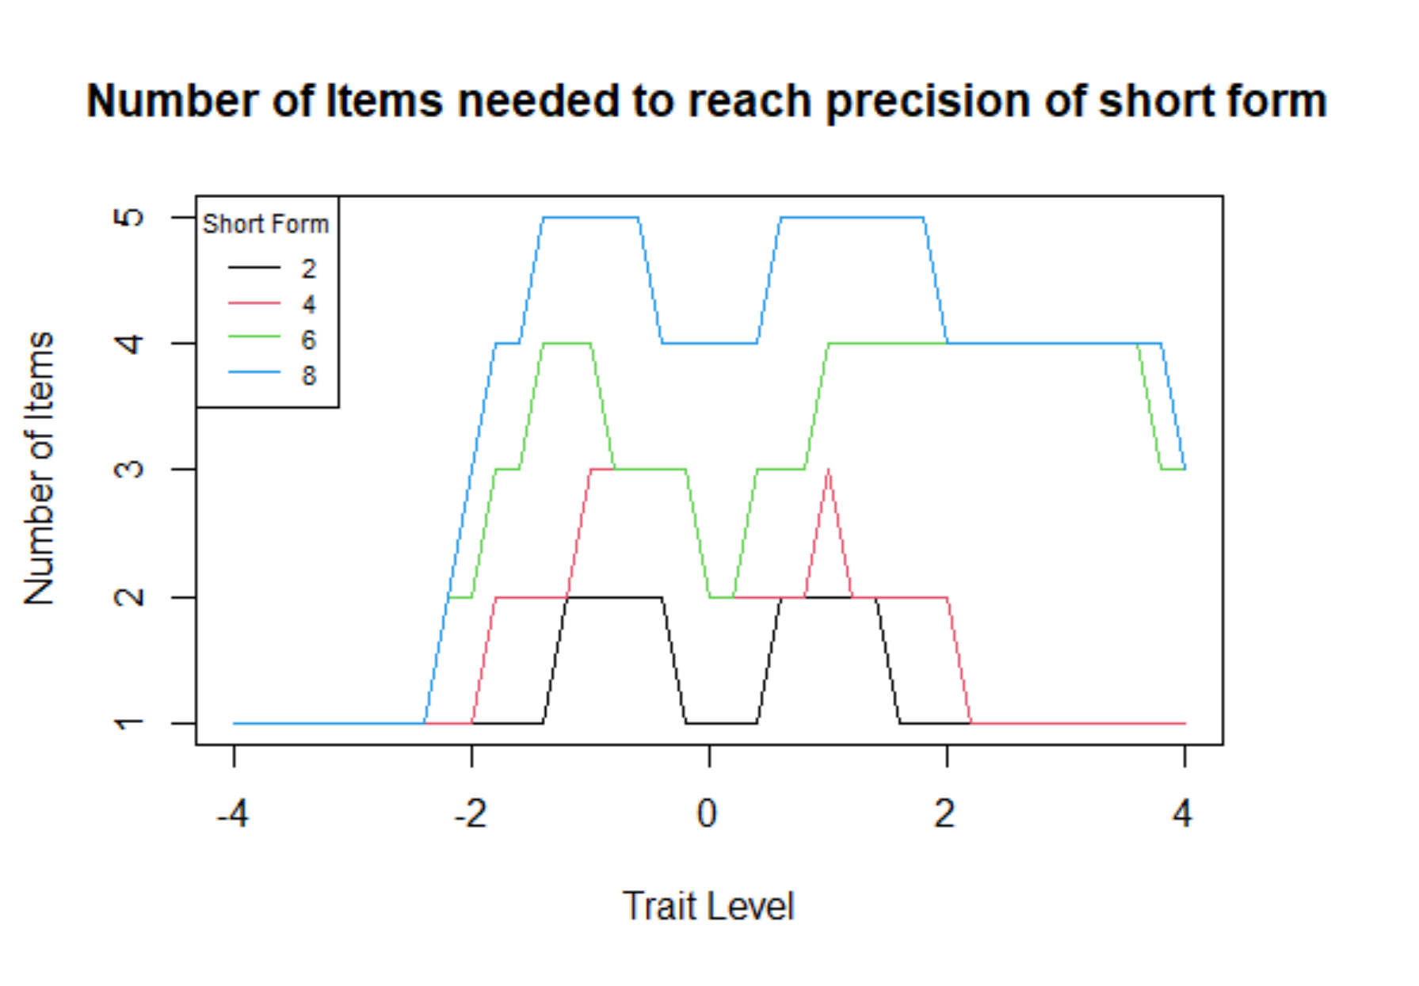
Number of CAT Items Needed to Reach Same Precision as Short Form
Depression
Physical Function
Notes:
Another way of looking at this is to consider items administered and at which level do we reach equivalent precision.
At each theta, determine Information for short form with k items.
Consider a CAT in which item selection is not fixed can we obtain more information than the fixed length counter part administration formats.

Slide 22
Thoughts and/or suggestions ….

Slide 23
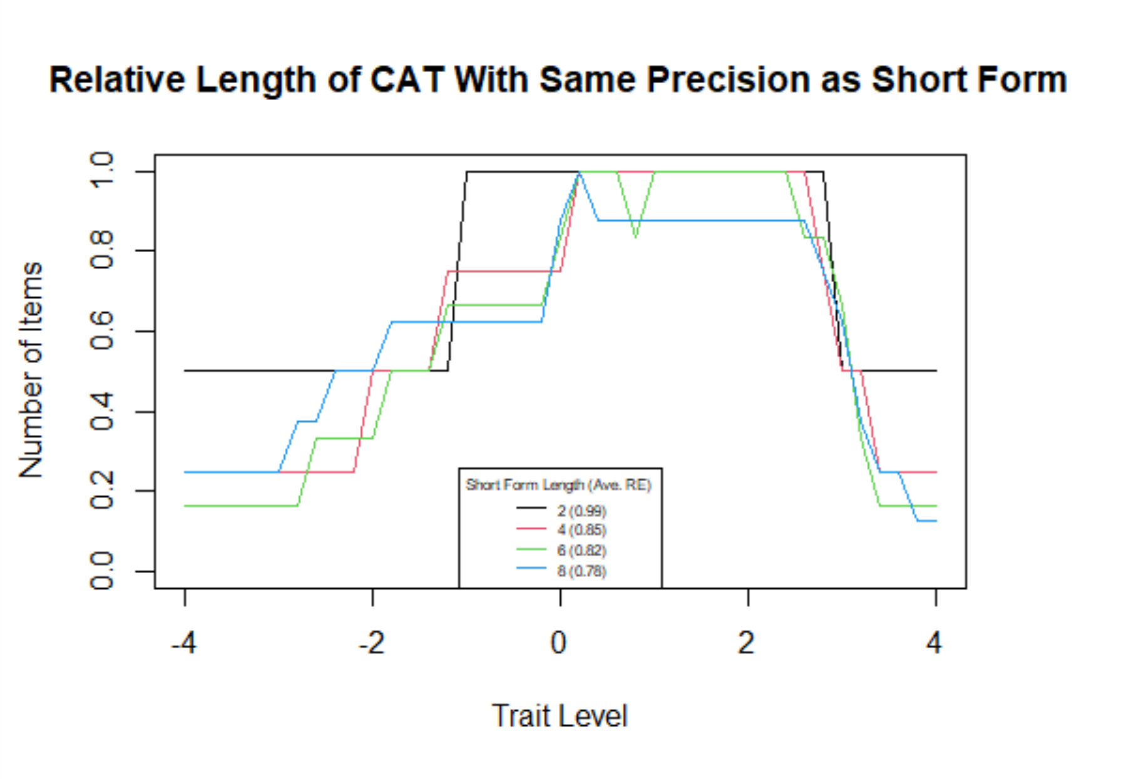
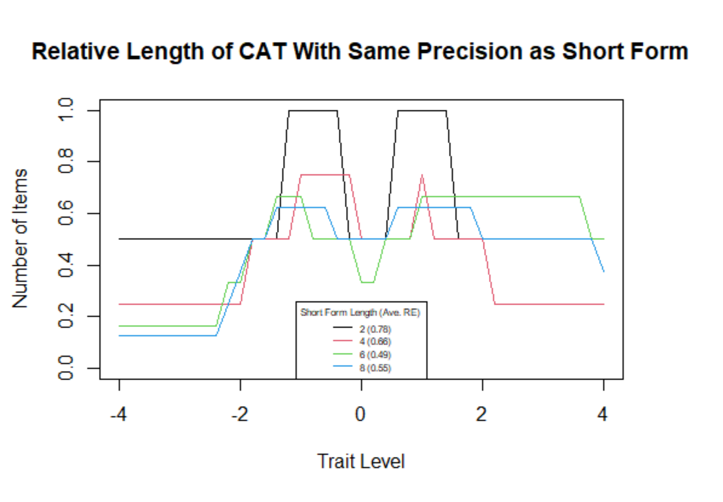
Relative Number of Items for CAT with Same Precision as Short Form
Depression
Physical Function
Notes:
Number of Items represented as a proportion of the short form length. RE = average relative length.
How many items are needed in CAT in order to reach the same SE of the short form. So benefit in the extremes.
In extremes for PF the ration is quite small which mean a large benefit for the CAT, even in the clinical range of -2 to 2, there ratio is less than .8 so still some benefit.

Slide 24
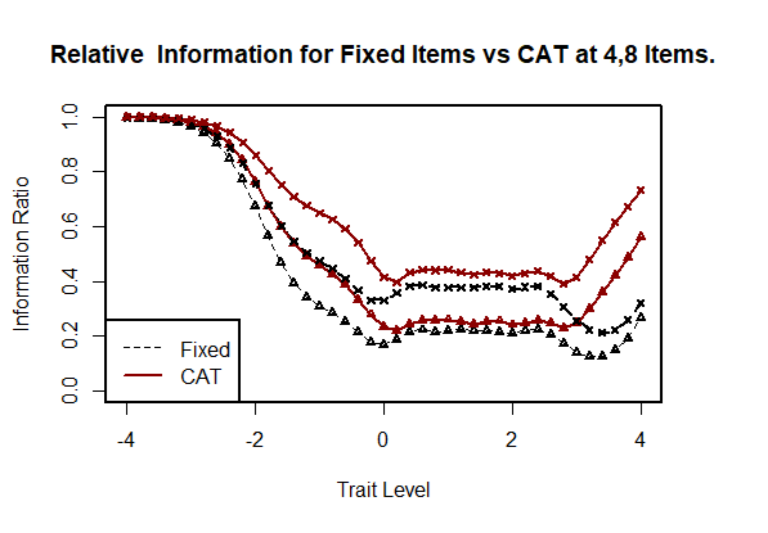
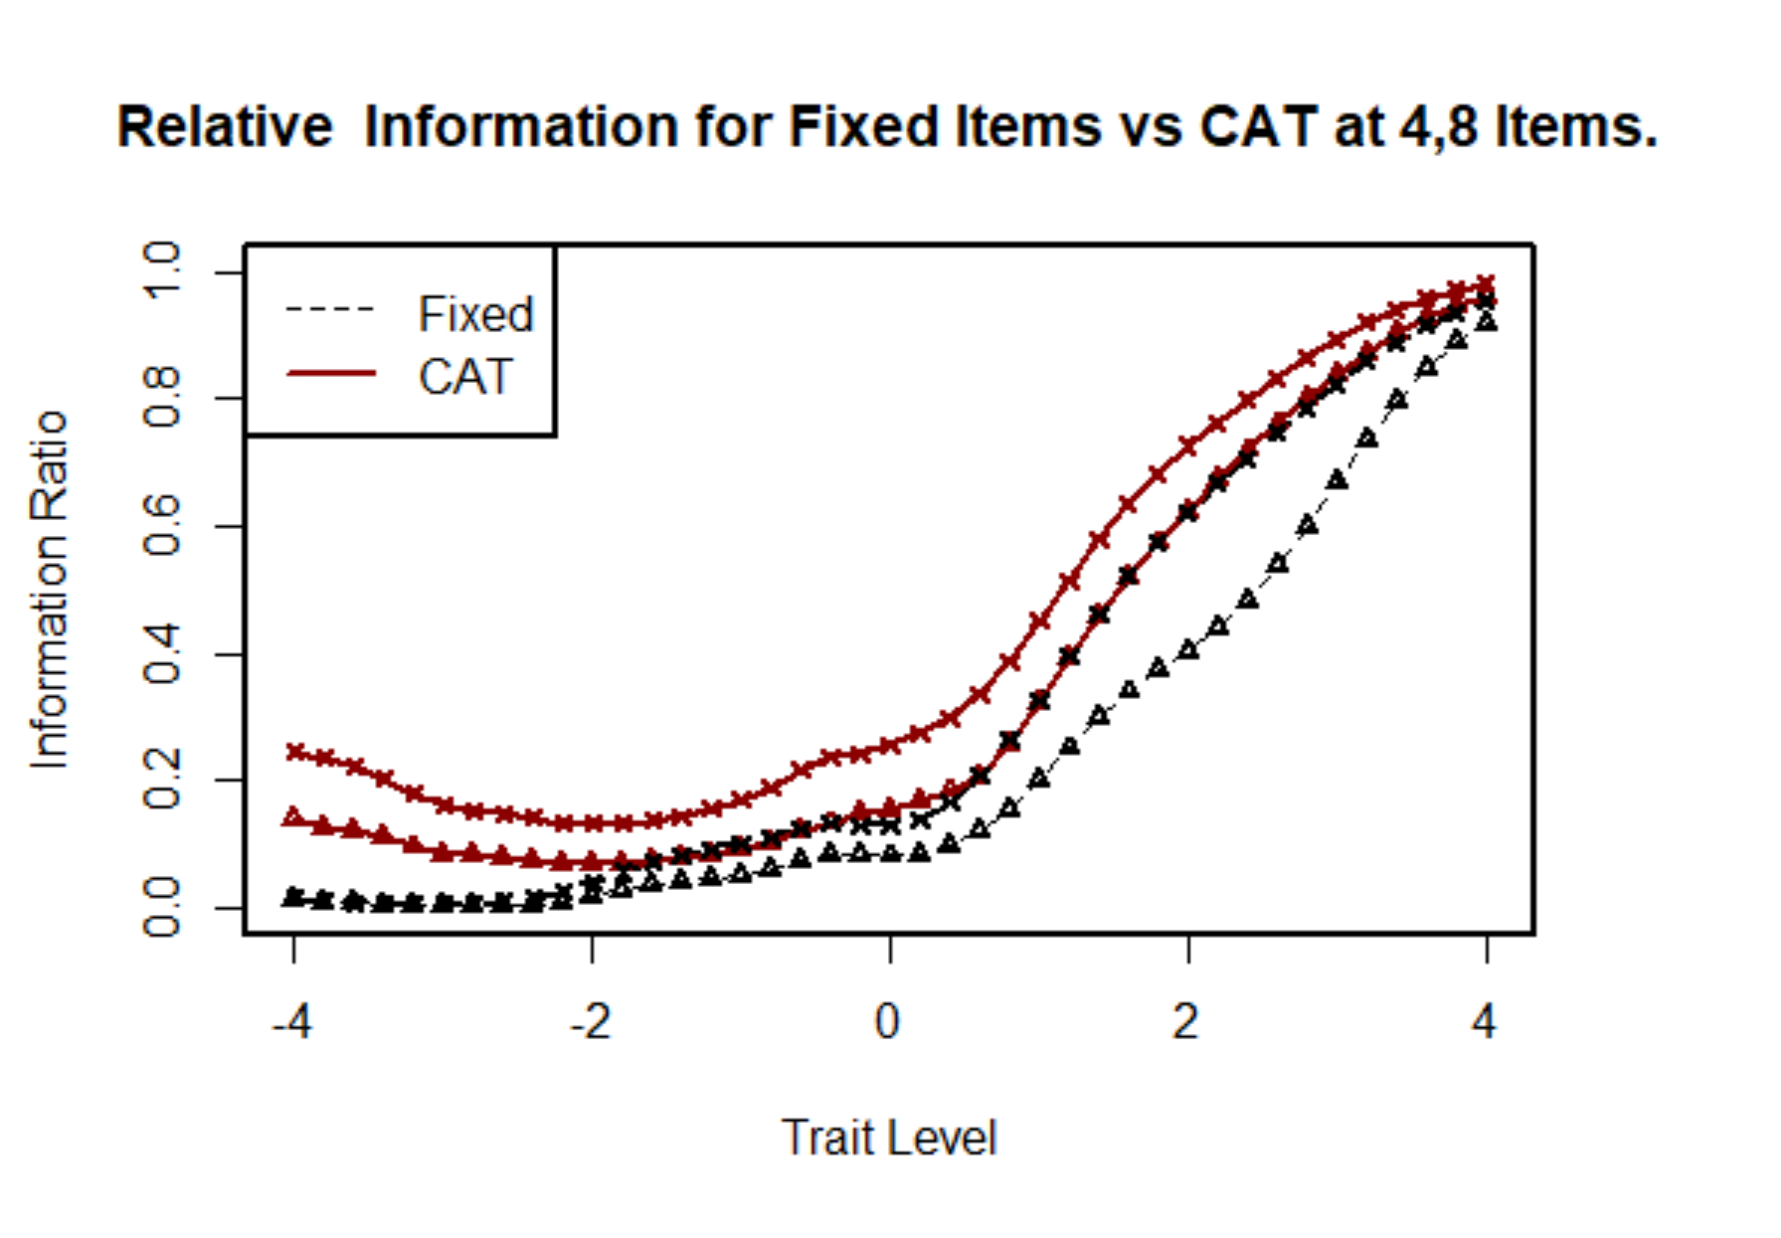
Information Relative to Full Bank: Cat vs. Short form
Depression
Physical Function
Notes:
I don’t think we should use this one. Its difficult to explain.
For CAT: At each theta, I calculated the information for the best k items/full bank information. Repeated this at k = 2,4,6,8
For each short form, I sorted the items based on information at theta = -1 & +1, created a combined list by alternating between the two lists (best item at -1, best item at +1, 2nd best item at -1, second best at +1, …) and removing duplicates. Then selected the top 2,4,6,8 items from this list.
We could replace this with the actual short forms, but it might be useful to also discuss this method for situation where you don’t have pre-existing short forms.

Slide 25
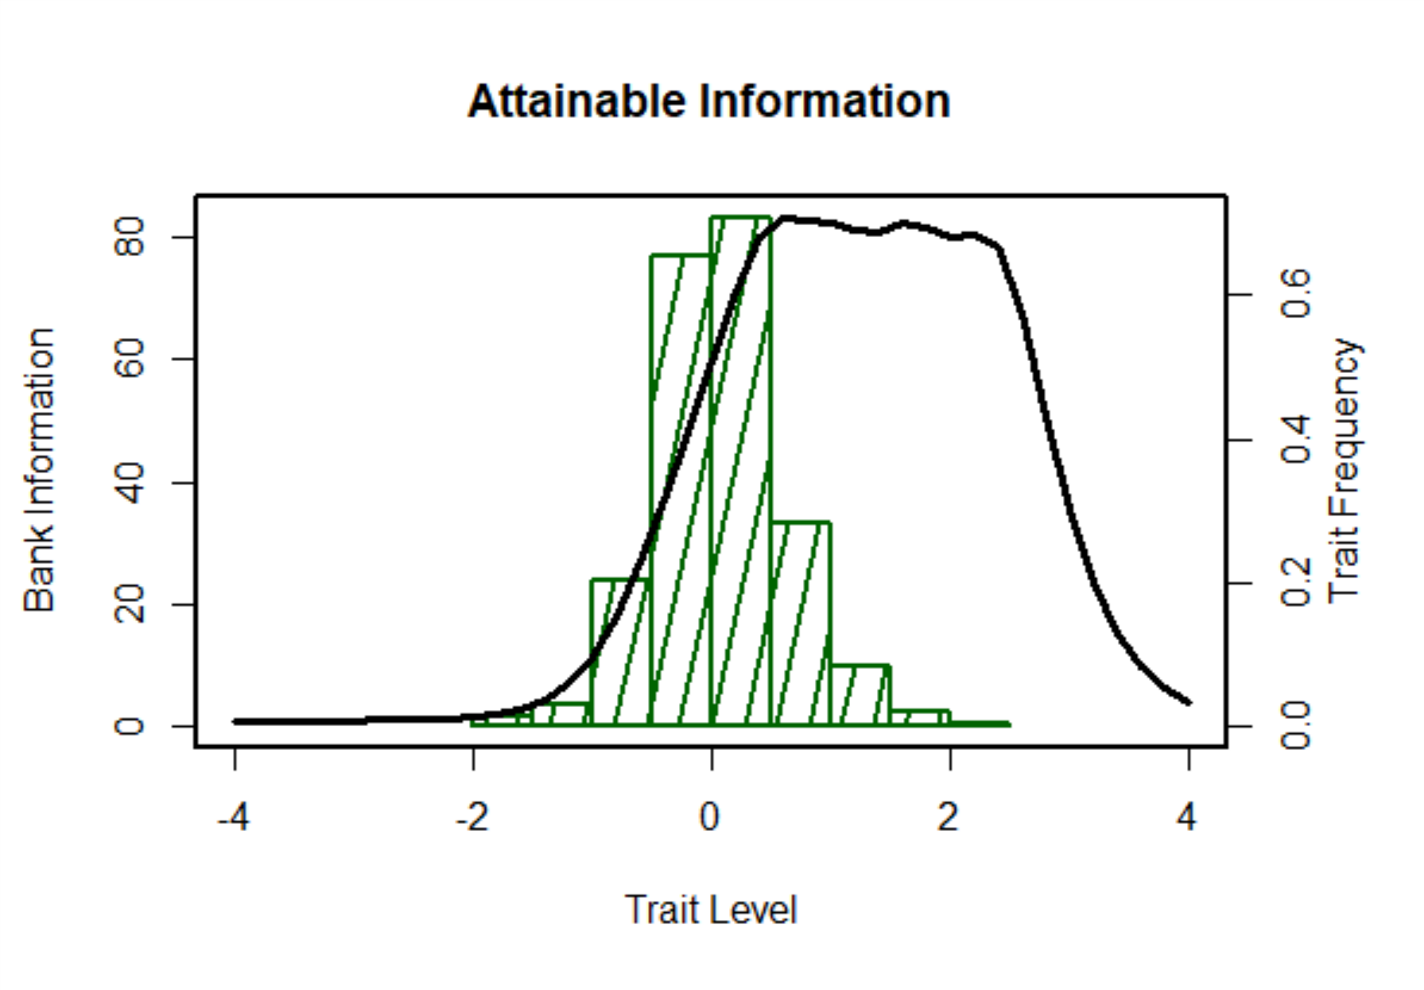
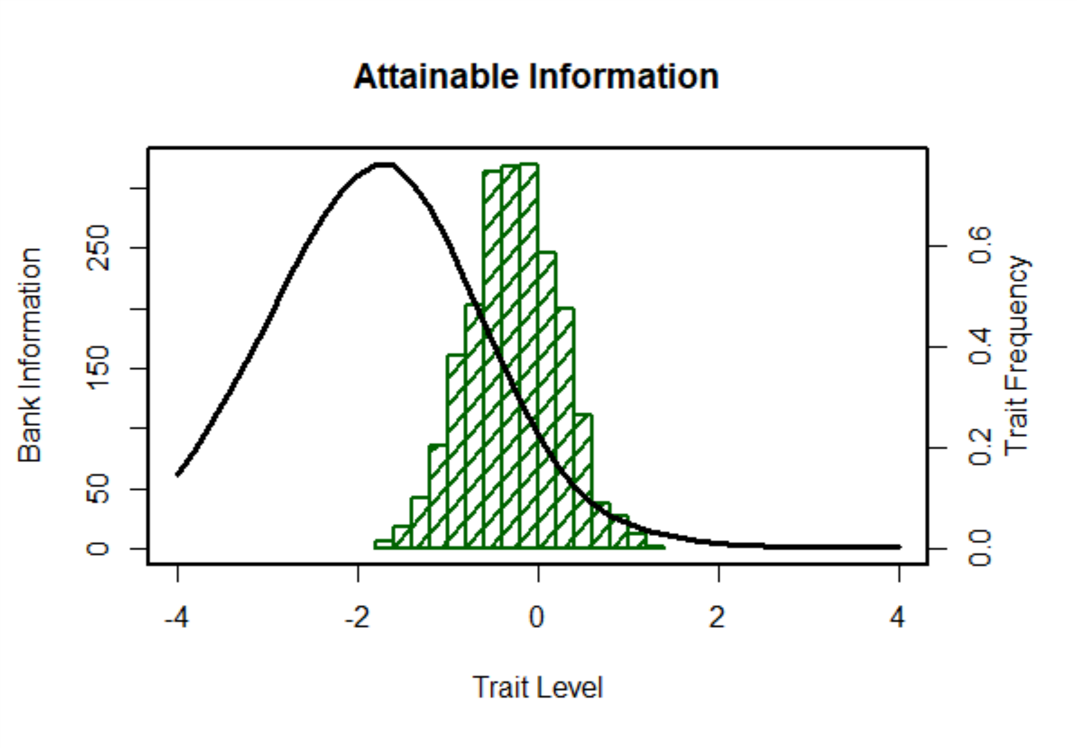
Item Bank Information and Trait Distribution in Orthopedic Patients
Depression (28 items)
Physical Function (165 items)

