Slide 1
On-the-Fly Multistage Testing with Response Time: An Exploratory Study for PISA
Xiuxiu Tang
Doctoral Candidate, Purdue University
Hua-Hua Chang, Ph.D.
Charles R. Hicks Chair Professor, Purdue University
Yi Zheng, Ph.D.
Associate Professor, Arizona State University

Slide 2
Test Designs
Paper and pencil test (P&P)
  Non-computerized, linear (non-adaptive)
Computer-based test (CBT)
  Computerized, linear (non-adaptive)
Computerized adaptive test (CAT)
  Computerized, item-level adaptive,
  assembled on the fly
Traditional / Static
Multistage test (MST)
  Computerized, stage-level adaptive,
  pre-assembled
On-the-fly multistage testing (OMST)
  Computerized, stage-level adaptive,
  assembled on the fly
Computerized / Adaptive

Slide 3
Design of OMST
Zheng & Chang, 2015 APM
Stage 1
Stage 2
Stage 3
Estimate θ
Estimate θ
?
……
……
Under-used bank
Randomization
Well-used bank
Maximum information
Constraint-controlled,
Exposure-controlled
3

Slide 4
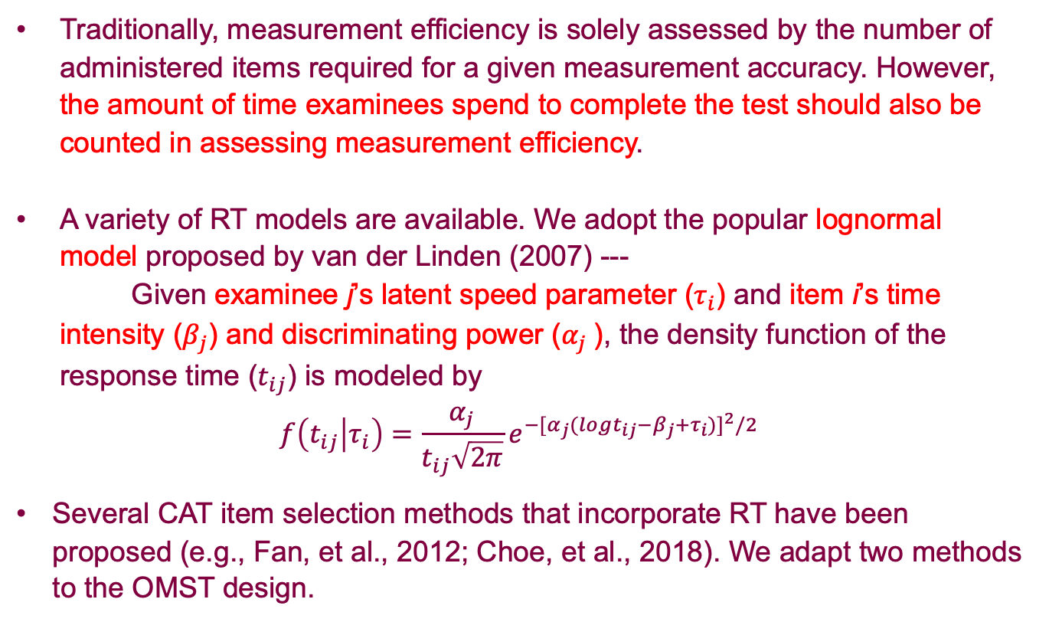
OMST with Response Time (RT)
Traditionally, measurement efficiency is solely assessed by the number of administered items required for a given measurement accuracy. However, the amount of time examinees spend to complete the test should also be counted in assessing measurement efficiency.
A variety of RT models are available. We adopt the popular lognormal model proposed by van der Linden (2007) ---
Given examinee j’s latent speed parameter ($τ_{i}$) and item i’s time intensity ($β_{j}$) and discriminating power ($α_{j}$), the density function of the response time ($t_{ij}$) is modeled by
$$f\left(t_{ij} | τ_{i}\right)=\frac{α_{j}}{t_{ij}\sqrt{2π}}e^{−{[α_{j}(logt_{ij}−β_{j}+τ_{i})]}^{2}/2}$$
Several CAT item selection methods that incorporate RT have been proposed (e.g., Fan, et al., 2012; Choe, et al., 2018). We adapt two methods to the OMST design.

Slide 5
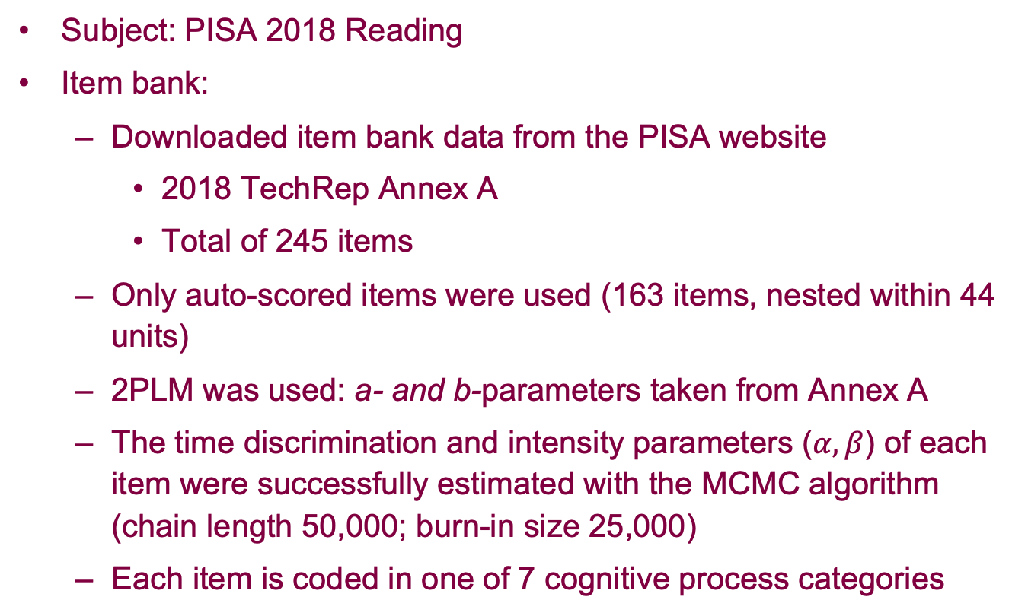
Mimicking PISA Scenarios
Subject: PISA 2018 Reading
Item bank:
  Downloaded item bank data from the PISA website
    2018 TechRep Annex A
    Total of 245 items
  Only auto-scored items were used (163 items, nested within 44 units)
  2PLM was used: a- and b-parameters taken from Annex A
  The time discrimination and intensity parameters ($α, β$) of each item were successfully estimated with the MCMC algorithm (chain length 50,000; burn-in size 25,000)
  Each item is coded in one of 7 cognitive process categories

Slide 6
Methods of Study
Test designs
  The MST design
  The OMST designs
Item selection methods
Simulation design
Evaluation criteria

Slide 7
MST Design
We mimic the design of PISA 2018 Reading MSAT as described in
PISA 2018 Technical Report, Chapter 2, pages 8-9.
Three-stage design (p.8):
Core stage (2 units) --> Stage 1 (3 units) --> Stage 2 (2 units)
All routing paths were constructed following the technical report
(p.9, Figure 2.7, see next slide)
  Routing paths in the standard computer-based MSAT design – Design A – that connect Core --> Stage 1 --> Stage 2
  (64 paths in total, applicable to 75% of students)
All testlets were constructed following Tables 2.4 - 2.6 (p.8), which document the unit IDs in each testlet. (see slide 9)
While PISA 2018 Reading used number-correct score to route examinees between stages, we used the MFI method for routing.

Slide 8
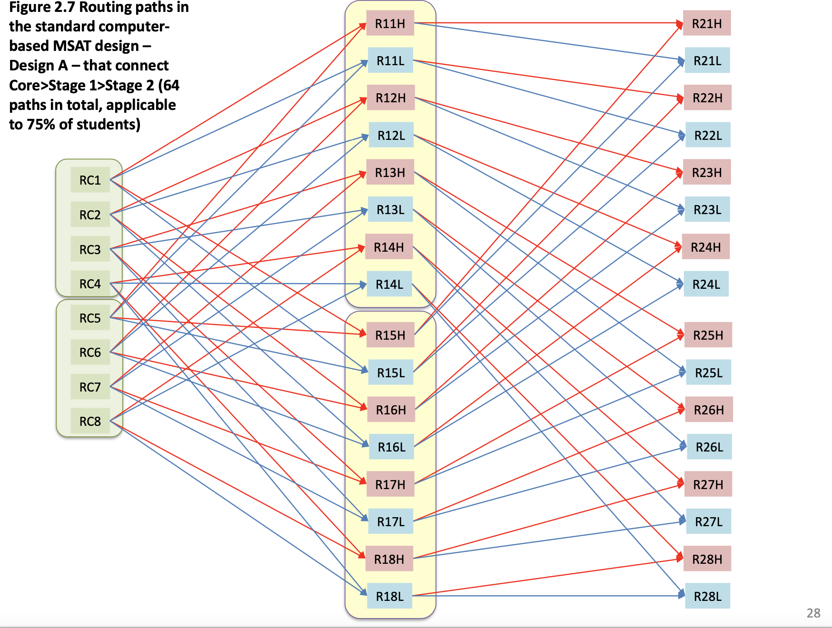

Slide 9
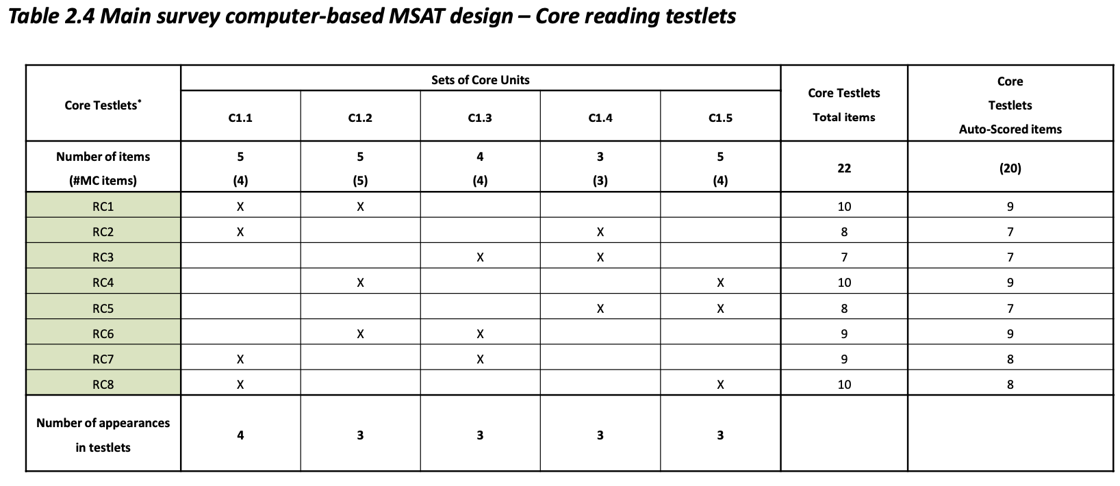
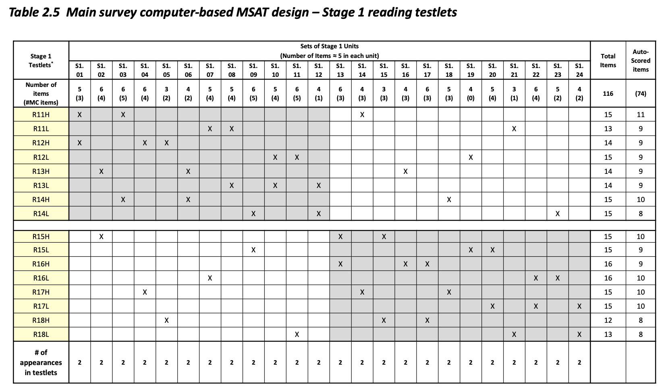
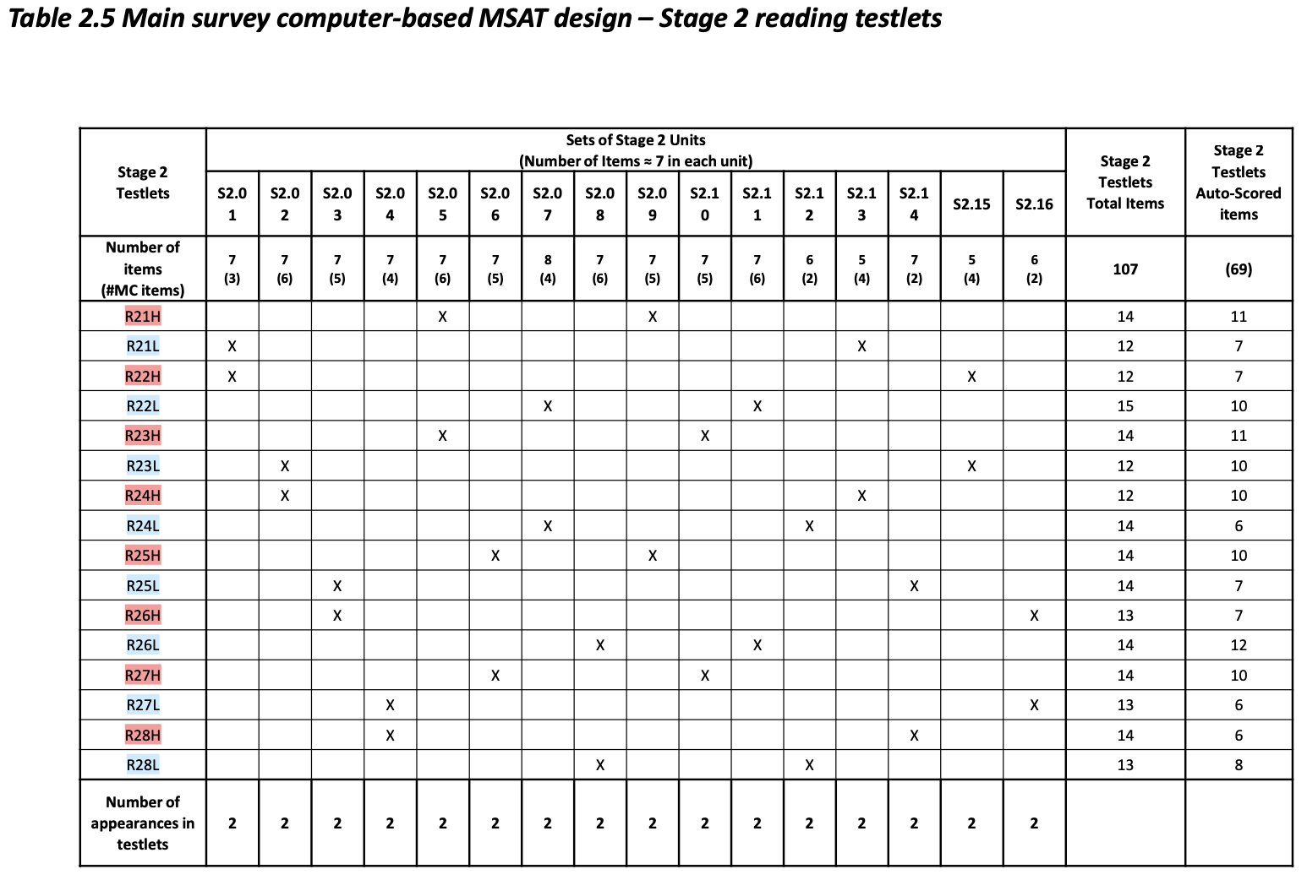

Slide 10
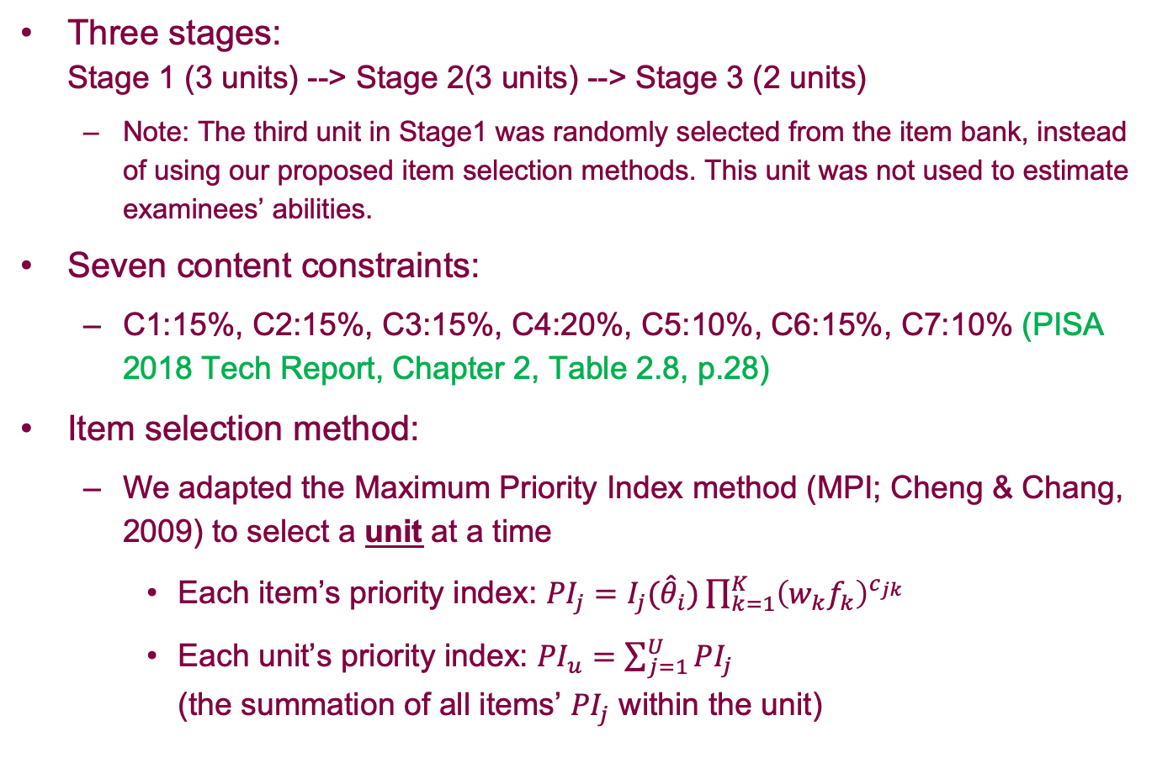
OMST Designs
Three stages:
Stage 1 (3 units) --> Stage 2(3 units) --> Stage 3 (2 units)
  Note: The third unit in Stage1 was randomly selected from the item bank, instead of using our proposed item selection methods. This unit was not used to estimate examinees’ abilities.
Seven content constraints:
  C1:15%, C2:15%, C3:15%, C4:20%, C5:10%, C6:15%, C7:10% (PISA 2018 Tech Report, Chapter 2, Table 2.8, p.28)
Item selection method:
  We adapted the Maximum Priority Index method (MPI; Cheng & Chang, 2009) to select a unit at a time
    Each item’s priority index: ${PI}_{j}=I_{j}({\hat{θ}}_{i})\prod_{k=1}^{K}{{\left(w_{k}f_{k}\right)}^{c_{jk}}}$
    Each unit’s priority index: ${PI}_{u}=\sum_{j=1}^{U}{{PI}_{j}}$
    (the summation of all items’ ${PI}_{j}$ within the unit)

Slide 11
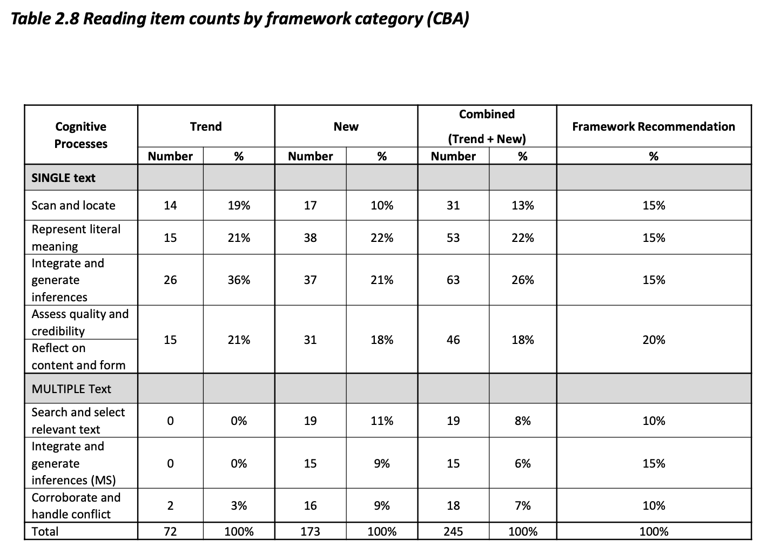

Slide 12
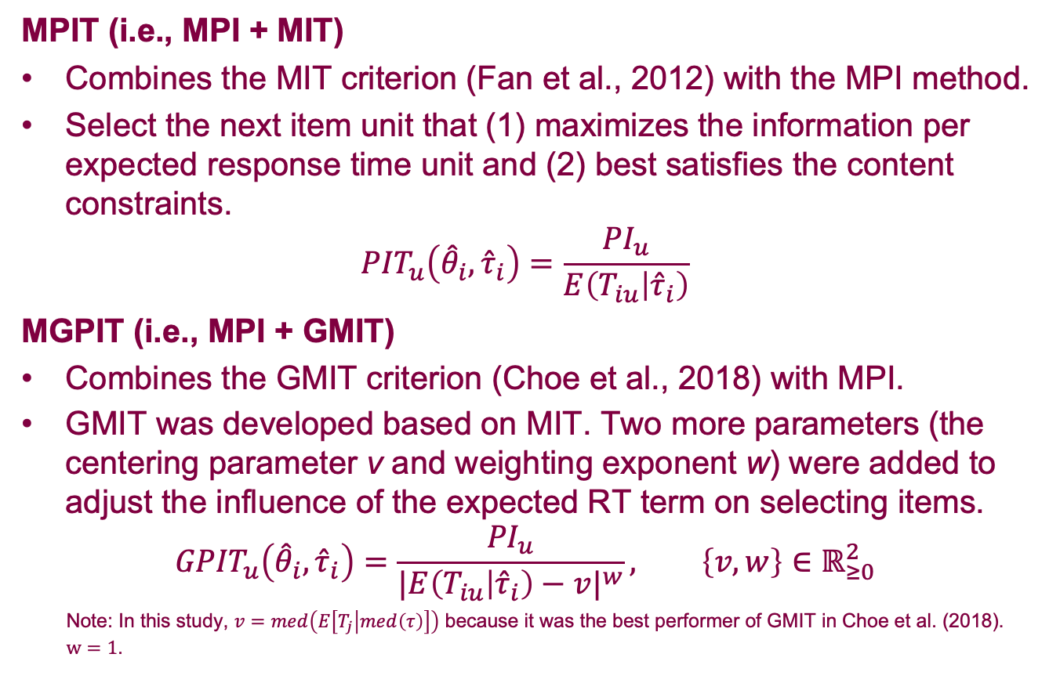
OMST Item Selection Methods Incorporating RT
MPIT (i.e., MPI + MIT)
Combines the MIT criterion (Fan et al., 2012) with the MPI method.
Select the next item unit that (1) maximizes the information per expected response time unit and (2) best satisfies the content constraints.
$${PIT}_{u}\left({\hat{θ}}_{i},{\hat{τ}}_{i}\right)=\frac{{PI}_{u}}{E\left(T_{iu} | {\hat{τ}}_{i}\right)}$$
MGPIT (i.e., MPI + GMIT)
Combines the GMIT criterion (Choe et al., 2018) with MPI.
GMIT was developed based on MIT. Two more parameters (the centering parameter v and weighting exponent w) were added to adjust the influence of the expected RT term on selecting items.
$${GPIT}_{u}\left({\hat{θ}}_{i},{\hat{τ}}_{i}\right)=\frac{{PI}_{u}}{{|E\left(T_{iu} | {\hat{τ}}_{i}\right)−v|}^{w}}, \left\{v,w\right\}∈ℝ_{≥0}^{2}$$
Note: In this study, $v=med\left(E\left[T_{j} | med\left(τ\right)\right]\right)$ because it was the best performer of GMIT in Choe et al. (2018).
$w=1$.

Slide 13
OMST Item Selection Methods with Randomesque
To balance item exposure rates across different units, a “randomesque” component was added to the OMST item selection procedure.
  The next unit is randomly chosen from the top R units with the largest PIT or GPIT values.
We simulated the test with for R = 1, 3, 6, and 10, and found that the design with R = 10 gave the best overall performance.

Slide 14
OMST: Preventing Enemy Items from Appearing in the Same Test
Since no information about enemy items were found from the tech report, unit C1.1 and unit S1.10 were randomly chosen as enemy units, and they contained items from the same cognitive content aera.
Each of the two enemy units contains 4 items:
  Unit C1.1: 2 items on content 2, and 2 items on content 4
  Unit S1.10: 1 item on content 2, 1 item on content 4, and 2 items on content 3.
We added an algorithm to OMST so that if one of the two units appears in a test, the other will not appear in the same test.
Notes:
Enemy items is a psychometric term that refers to two test questions (items) which should not be on the same test version seen by a given examinee.
here are several reasons why two items might be considered enemies:
Too similar: the text of the two items is almost the same
One gives away the answer to the other
The items are on the same topic/answer, even if the text is different.

Slide 15
OMST: A Special Unit to Ensure Sufficient Samples for Item Recalibration
A special unit is added to the end of the routing stage.
This unit is randomly selected for each examinee.
Responses to this unit are not used for scoring --- they are used solely for recalibrating the parameters of all items.
Because this unit is completely randomly selected, with a large total volume of examinees like PISA has, in the end, each unit will accrue a calibration sample that mirrors the population ability distribution.
The recalibration sample distributions will be demonstrated with simulation and compared against that of the MST design.
Notes:
Adaptive computer-based testing require that all scored items have been previously administered and calibrated.
New items get into the mix by presenting them as unscored pretest items.
Once sufficient candidate responses have been obtained, the pretest items are taken offline and calibrated. Then they can be introduced into the used item pool as scored items.

Slide 16
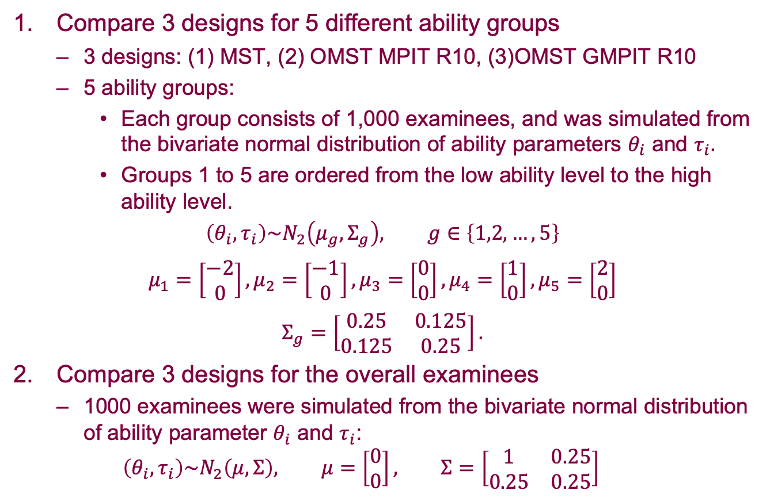
Simulation Design
Compare 3 designs for 5 different ability groups
  3 designs: (1) MST, (2) OMST MPIT R10, (3)OMST GMPIT R10
  5 ability groups:
    Each group consists of 1,000 examinees, and was simulated from the bivariate normal distribution of ability parameters $θ_{i}$ and $τ_{i}.$
    Groups 1 to 5 are ordered from the low ability level to the high ability level.
$$\left(θ_{i}, τ_{i}\right)\sim N_{2}\left(μ_{g},Σ_{g}\right), g∈\left\{1,2,…,5\right\}$$
$$μ_{1}=\left[\begin{matrix}−2 \\ 0\end{matrix}\right], μ_{2}=\left[\begin{matrix}−1 \\ 0\end{matrix}\right], μ_{3}=\left[\begin{matrix}0 \\ 0\end{matrix}\right], μ_{4}=\left[\begin{matrix}1 \\ 0\end{matrix}\right], μ_{5}=\left[\begin{matrix}2 \\ 0\end{matrix}\right]$$
$$Σ_{g}=\left[\begin{matrix}0.25 & 0.125 \\ 0.125 & 0.25\end{matrix}\right].$$
Compare 3 designs for the overall examinees
  1000 examinees were simulated from the bivariate normal distribution of ability parameter $θ_{i}$ and $τ_{i}$:
  $$\left(θ_{i}, τ_{i}\right)\sim N_{2}\left(μ,Σ\right), μ=\left[\begin{matrix}0 \\ 0\end{matrix}\right], Σ=\left[\begin{matrix}1 & 0.25 \\ 0.25 & 0.25\end{matrix}\right]$$

Slide 17
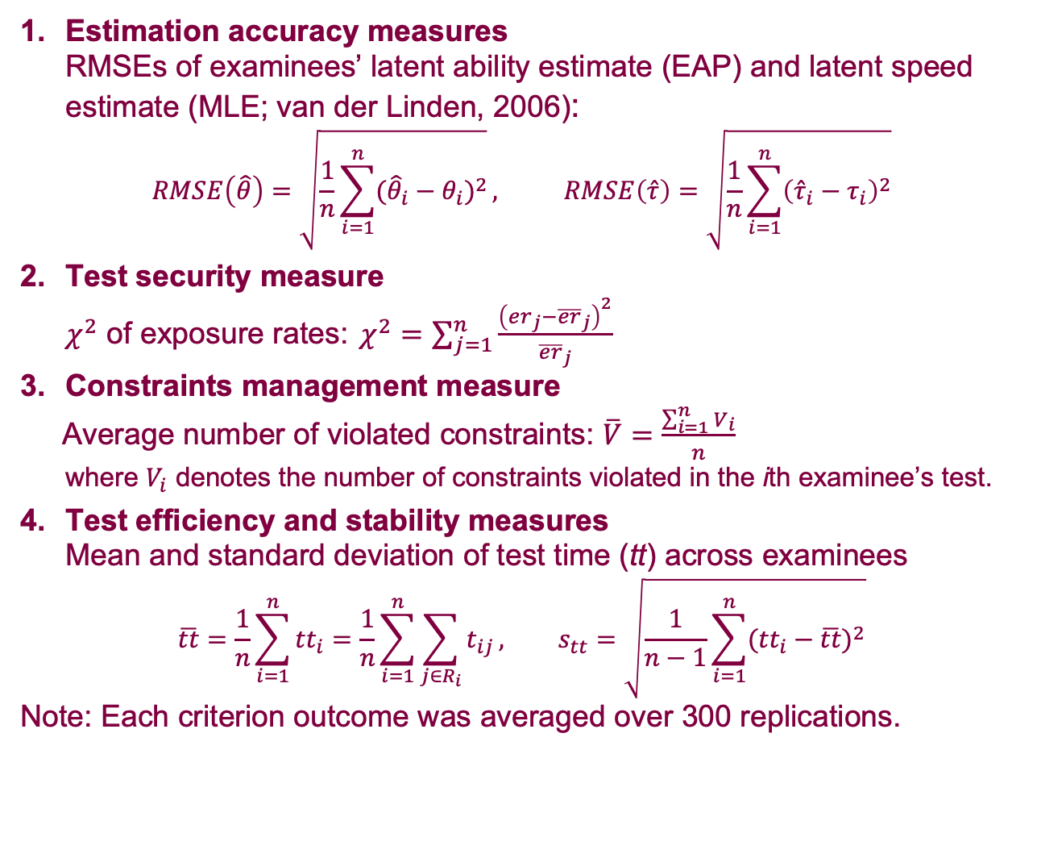
Evaluation Criteria
Estimation accuracy measures
RMSEs of examinees’ latent ability estimate (EAP) and latent speed estimate (MLE; van der Linden, 2006):
$$RMSE\left(\hat{θ}\right)=\sqrt{\frac{1}{n}\sum_{i=1}^{n}{{({\hat{θ}}_{i}−θ_{i})}^{2}}}, RMSE\left(\hat{τ}\right)=\sqrt{\frac{1}{n}\sum_{i=1}^{n}{{\left({\hat{τ}}_{i}−τ_{i}\right)}^{2}}}$$
Test security measure
$χ^{2}$ of exposure rates: $χ^{2}=\sum_{j=1}^{n}{\frac{{\left({er}_{j}−{\overline{er}}_{j}\right)}^{2}}{{\overline{er}}_{j}}}$
Constraints management measure
Average number of violated constraints: $\overline{V}=\frac{\sum_{i=1}^{n}{V_{i}}}{n}$
where $V_{i}$ denotes the number of constraints violated in the ith examinee’s test.
Test efficiency and stability measures
Mean and standard deviation of test time (tt) across examinees
$$\overline{tt}=\frac{1}{n}\sum_{i=1}^{n}{{tt}_{i}}=\frac{1}{n}\sum_{i=1}^{n}{\sum_{j∈R_{i}}{t_{ij}}}, s_{tt}=\sqrt{\frac{1}{n−1}\sum_{i=1}^{n}{{({tt}_{i}−\overline{tt})}^{2}}}$$
Note: Each criterion outcome was averaged over 300 replications.

Slide 18
Conditional Results for 5 Ability Groups
Estimation accuracy:
The MST design is less accurate than the two OMST designs across the 5 ability groups.

Slide 19
Conditional Results for 5 Ability Groups
Test security:
Two OMST designs have more even item exposures for all ability groups, and their performances are almost the same.

Slide 20
Conditional Results for 5 Ability Groups
Constraint control:
MST has the highest average number of violated constraints across all groups.
Although better than MST, both OMST designs resulted in some violations. This is a result of unit-level item selection.

Slide 21
Conditional Results for 5 Ability Groups
Test efficiency:
The OMST designs were able to reduce testing time compared to MST.
Stability:
The OMST designs also have smaller SDs of testing time, which means the time taken by different examinees are more similar to each other in OMST.

Slide 22
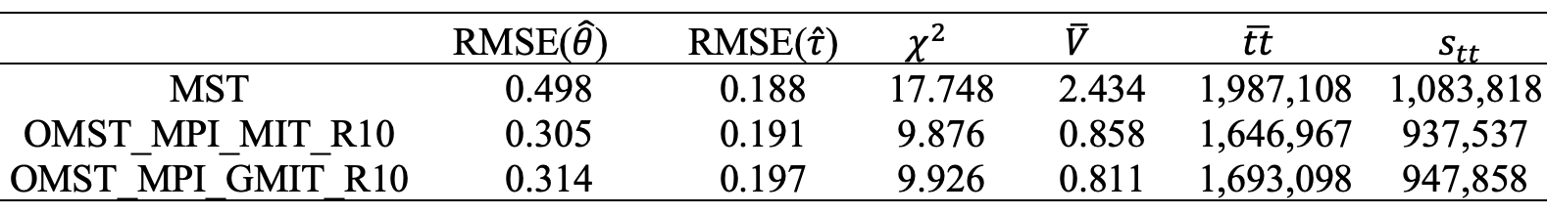
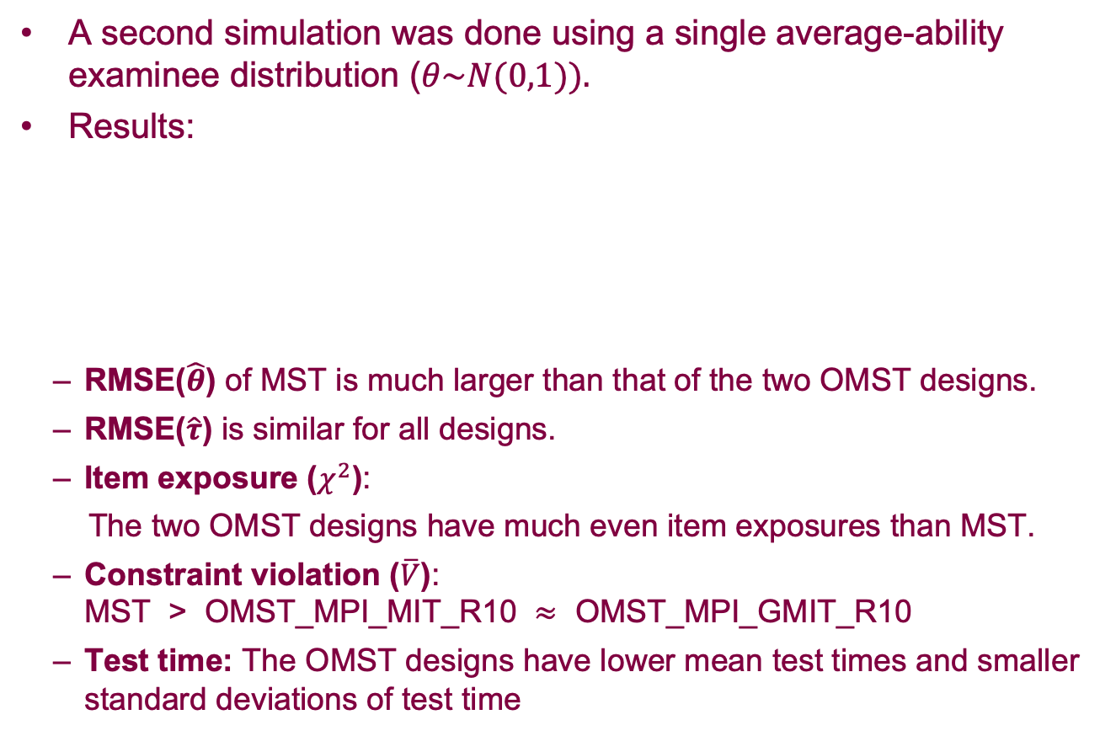
Results for Overall Examinees
A second simulation was done using a single average-ability examinee distribution ($θ\sim N(0,1)).$
Results:
  RMSE($\hat{θ}$) of MST is much larger than that of the two OMST designs.
  RMSE($\hat{τ}$) is similar for all designs.
  Item exposure ($χ^{2}$):
  The two OMST designs have much even item exposures than MST.
  Constraint violation ($\overline{V}$):
  MST > OMST_MPI_MIT_R10 $≈$ OMST_MPI_GMIT_R10
  Test time: The OMST designs have lower mean test times and smaller standard deviations of test time

Slide 23
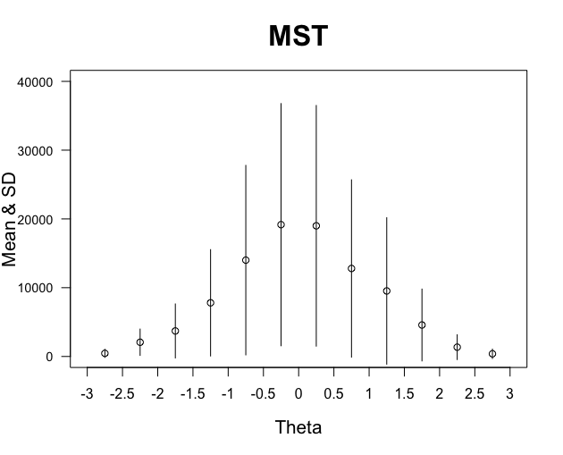
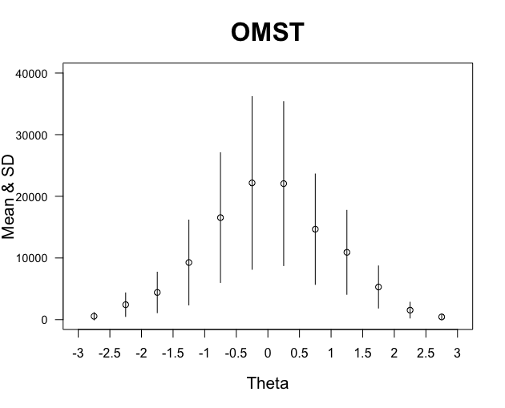
Sample Sizes for Item Parameter Recalibration
In the plots below, within each ability interval:
  Circle: average sample size accrued by a unit, averaged across the 44 units
  Bar: 1 SD of the varied sample sizes across the 44 units
  We mimic PISA 2018’s total number of examinees: 606,627.
Both MST and OMST achieved a distribution of calibration samples that mirrors the overall population distribution.
OMST’s sample sizes are more evenly distributed across 44 units.

Slide 24
Conclusions
The OMST designs resulted in
More accurate estimation of examinees’ abilities than MST.
Shorter test times, as well as more similar test times across examinees, than MST.
A balanced item exposure that is comparable to MST.
Fewer constraints violations than MST.
No enemy items appearing in the same test.
An adequate sample for each item’s parameter recalibration.

Slide 25
Thank you!
Xiuxiu Tang
Doctoral Candidate, Purdue University
tang469@purdue.edu
Hua-Hua Chang, Ph.D.
Charles R. Hicks Chair Professor, Purdue University
chang606@purdue.edu
Yi Zheng, Ph.D.
Associate Professor, Arizona State University
yi.Isabel.zheng@asu.edu

