Slide 1
Misspecification of IRT Models and Its Implications in the Context of Recognition Task Data
Qi (Helen) Huang & Daniel M. Bolt
University of Wisconsin-Madison

Slide 2
Introduction
Traditional item response theory (IRT) models, like the 2PL, are often indiscriminately applied to tests with dichotomously scored items.
However, the wide variety of forms of response process that may underlie such items raise concerns about the universal appropriateness of the traditional logistic/normal functional form.
In this investigation we examine the application of 2PL to an author recognition test (ART) where its appropriateness may be suspect.

Slide 3
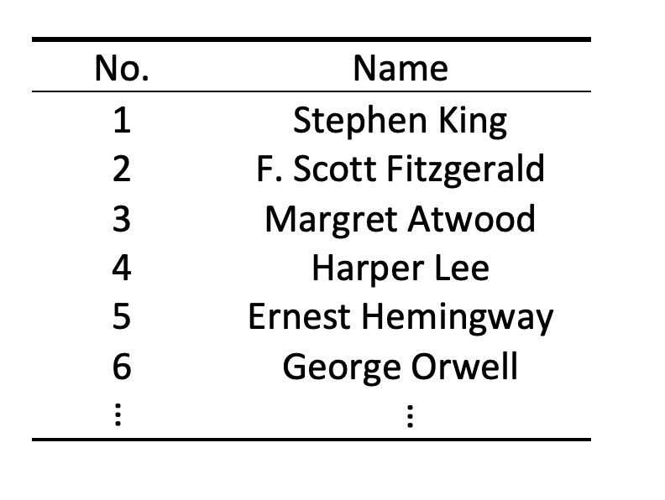
Data: Author Recognition Test (ART¹)
ART is a measure of print exposure that has been used in reading research since 1990s.
Examinees are shown a list of names and asked to identify whether they are real authors or foils.
A penalty is imposed for identifying a foil as an author
100 items (50 authors, 50 foils)
N = 784
McCarron & Kuperman, 2021

Slide 4
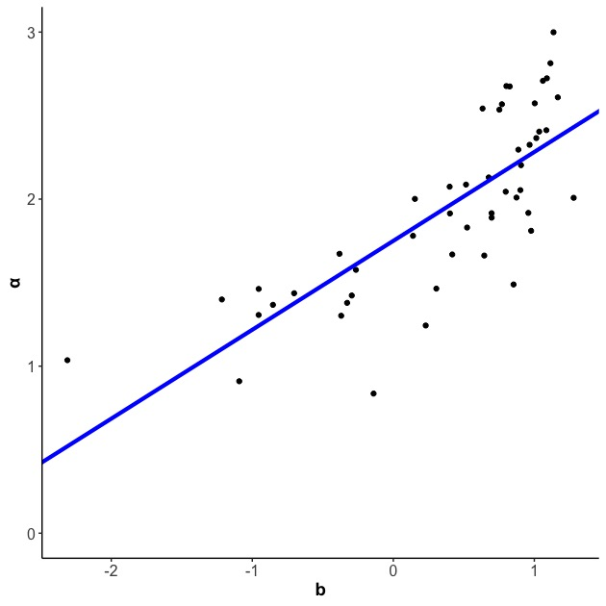
A high positive correlation¹ between the item discrimination ($a_{j}$) and difficulty parameter ($b_{j}$) estimates.
$$cor\left(a, b\right)=0.775$$
scale shrinkage²
A positive correlation is also observed in other versions of ART (e.g., Dutch ART )
Lord, 1984; Yen, 1985

Slide 5
What Induces Such Scale Shrinkage?
------ Presence of Multiple Conjunctively Interacting Latent Response Processes¹
The Actual Response Process:
A single 2PL: $P\left(Y_{ij}=1 | θ_{i }\right)=\frac{e^{a_{j1}(θ_{i}−b_{j1})}}{1+e^{a_{j1}(θ_{i}−b_{j1})}}$
A product of 2PLs:
$$P\left(Y_{ij}=1 | θ_{i }\right)=\frac{e^{a_{j1}(θ_{i}−b_{j1})}}{1+e^{a_{j1}(θ_{i}−b_{j1})}}×…×\frac{e^{a_{jn}(θ_{i}−b_{jn})}}{1+e^{a_{jn}(θ_{i}−b_{jn})}}$$
Lord, 1975; Bolt & Lee, 2018; Bolt & Liao, 2022

Slide 6
What Induces Such Scale Shrinkage in ART?
Theory of Two Conjunctively Interacting Response Components
(An Exposure Component & A Memory Component)
${P(Y}_{ij}=1|θ_{i})$for a true author item
〖𝑃(𝑌〗_𝑖𝑗=1|𝜃_𝑖) for a true author item
1. Examinee $i$ had exposure to the author
1. Examinee 𝑖 had exposure to the author
High reading frequency (i.e., higher $θ$) implies a higher likelihood of encountering the author
High reading frequency (i.e., higher 𝜃) implies a higher likelihood of encountering the author
2. Examinee $i$ remembers the encounter
2. Examinee 𝑖 remembers the encounter
Exposure to more authors (higher $θ$) may even make it more difficult to remember individual author names (a memory effect)
Exposure to more authors (higher 𝜃) may even make it more difficult to remember individual author names (a memory effect)
An Exposure Component
A Memory Component
Notes:
These two components cannot be mixed together, as they may be in opposite direction. Specifically, when you read more frequently, you are more likely to encountering the author, but at same time, it may even make it more difficult to remember individual author names. That’s why they cannot be mixed as one component.

Slide 7
What Induces Such Scale Shrinkage in ART?
Theory of Two Conjunctively Interacting Response Components
(An Exposure Component & A Memory Component)
${P(Y}_{ij}=1|θ_{i})$for a true author item
〖𝑃(𝑌〗_𝑖𝑗=1|𝜃_𝑖) for a true author item
1. Examinee $i$ had exposure to the author
1. Examinee 𝑖 had exposure to the author
High reading frequency (i.e., higher $θ$) implies a higher likelihood of encountering the author
High reading frequency (i.e., higher 𝜃) implies a higher likelihood of encountering the author
2. Examinee $i$ remembers the encounter
2. Examinee 𝑖 remembers the encounter
Exposure to more authors (higher $θ$) may even make it more difficult to remember individual author names (a memory effect)
Exposure to more authors (higher 𝜃) may even make it more difficult to remember individual author names (a memory effect)
An Exposure Component
A Memory Component
$\frac{e^{a_{j1}(θ_{i}−b_{j1})}}{1+e^{a_{j1}(θ_{i}−b_{j1})}}$
$\frac{e^{a_{j2}(θ_{i}−b_{j2})}}{1+e^{a_{j2}(θ_{i}−b_{j2})}}$
$$P\left(Y_{ij}=1 | θ_{i }\right)=$$
$$×$$
Notes:
.

Slide 8
Two-component Response Process
(Exposure & Memory)
Scale Shrinkage
A Simulation Study
An Empirical Study
$$=$$
Lack of Measurement Invariance for Populations of Different Mean Proficiency
Artificial DIF

Slide 9
Simulation: Artificial DIF under Such IRT Misspecification
Dataset 1
Dataset 2
Generating
Model
Two-component
Model
2PL
Latent Distribution
$θ_{reference} \sim N(−0.5, 1)$ ; $θ_{focal} \sim N(0.5, 1)$
Item Parameters
Same across groups (no DIF)
Same across groups (no DIF)
Significant Likelihood-Ratio Test
18 (90% of 20 replications)
0 (0% of 20 replications)
Notes:
30 items, 5000 examinees per group

Slide 10
Empirical Study: Artificial DIF under Such IRT Misspecification
Background:
1. Based on Author Recognition Test (ART)
2. 50 items; N=784
3. Identify two subsamples with different mean ability levels
Table 1. Likelihood Ratio Test Statistics, Empirical Study.
Fitted Model | Log Likelihood | Chi-square | df | p-value
null | -20916.08
alternative | -20865.91 | 100.344 | 50 | 0

Slide 11
Conclusion and Discussion
The application of traditional IRT models to Author Recognition Test (ART) datasets shows evidence of scale shrinkage (i.e., positive correlations between discrimination and difficulty)
The scale shrinkage has a plausible explanation for the ART, as the response process can be viewed as consisting of two conjunctively interacting response components: one related to exposure, and one to memory.
In the presence of such IRT model misspecification, IRT applications (i.e., DIF analysis) can be deleteriously affected.

Slide 12
Thank you very much for your attention!

Slide 13
Notes:
Not necessarily be the memory component, just the most plausible one based on our search of literature. Catalog: Many recognition test are used to measure memory, or at least mention the impact of memory. So memory could also be relevant.
Not fitting two-component model, not have an identification issue. To deal with multiple component response process, recommend LPE

