Slide 1
Recovering Domain Scores From Bifactor IRT Models on a PROMIS Dataset
Sheng Zhang, MS, Tony Lam, MA, & Scott Morris, PhD
The Illinois Institute of Technology
November 4, 2022
Notes:
F

Slide 2
Outline
What is PROMIS?
Bi-Factor Models
Advantages & Disadvantages
Overview of Two Estimation Methods
Rationale for Current Studies
Methods
Study Results
Discussion
Notes:
M

Slide 3
Patient-Reported Outcomes Measurement Information System (PROMIS; Cella et al., 2010)
A collection of fixed-item and computerized adaptive tests (CAT) covering a wide range of person-centered health outcomes
Evaluates physical, mental, and social health in adults and children
Usable with both general & clinical populations
Emotional Distress
Anxiety, Depression, Anger
Notes:
Specific measures within a domain tend to be correlated, e.g., emotional distress domains show high correlations.
PROMIS scales are currently scored independently for each trait, but may be beneficial to represent using a multidimensional model.

Slide 4
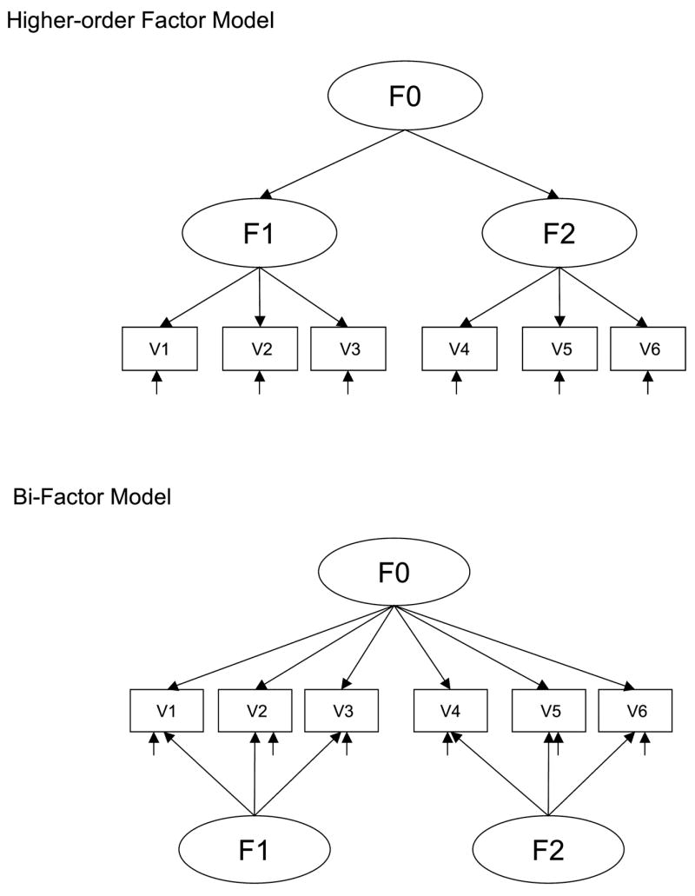
Bi-Factor Models
G
Somewhat similar to higher-order models
Bi-factor models differ from higher-order models in that they are not nested
Components of bi-factor models
A general factor measured by all items
Specific factors measured by sets of items
Orthogonal
Dep
Anx
G
Dep
Anx

Slide 5
Bi-Factor Models: Advantages & Disadvantages
Advantages
Represents broad, multidimensional constructs well
Provides better model fit than hierarchical models
Disadvantages
Specific factors are trickier to interpret
Represents unique subdomain variance only
General factor variance controlled for
Do not represent same construct as unidimensional scale scores
Notes:
e.g., elements of depression that not due to general emotional distress (e.g., hopelessness)
Specific factors less useful for practitioners

Slide 6
Rationale for Current Studies
Examine the viability of applying unidimensional estimation methods to bi-factor models
Allows for CATs to take advantage of psychometric advantages of bi-factor models
Produces more intuitive and interpretable scores for end users
Gives CATs the flexibility to generate scores in either bi-factor or hierarchical models

Slide 7
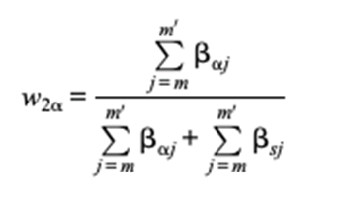
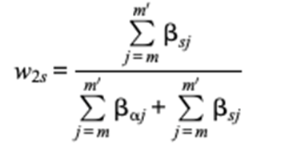
Estimation Methods
Domain score
Composite of general and domain-specific θ
Weighted by relative size of loadings (β) on specific factor
Liu et al. (2018)
Method 1: Wt = specific factor loadings relative to all factors
Method 2: Wt = specific factor loadings relative to general + specific
Method 2 tends to give more weight to the specific factor than Method 1
Notes:
If you focus on the numerator, with weights are the sum of loadings for the general vs. specific factor. Normalized using different denominators (sum of loadings on all factors vs. sum of general + 1 specific factor).

Slide 8
Current Study
Research Questions | Study 1 | Study 2
RQ 1. Recovery of overall and domain scores | √ | √
RQ2. Correlation among domain scores | √ | √
RQ3. Convergent and discriminant validity |  | √
Notes:
RQ1: How do the proposed methods perform on the recovery of overall score and domain score, compared to MIRT methods?
RQ2: How do the proposed methods perform the recovery of correlation between different dimensions?
RQ3: How do the proposed methods perform on predicting the actually well-being outcomes (convergent and discriminant validity)?

Slide 9
Study 1 - Methods
Study 1 compares the effectiveness of two bi-factor models scoring interpretation methods on three PROMIS constructs
Sample: PROMIS wave 1 dataset (Cella et al., 2010), general population sample
Measurements: PROMIS Short form
7 Anxiety items
8 Depression items
5 Anger items

Slide 10
Study 1 - Results
 | General | Anxiety | Depression | Anger
Expected Common Variance | 0.81 | 0.15 | 0.19 | 0.25
Omega Hierarchical | 0.92 | 0.13 | 0.18 | 0.22
Omega | 0.99 | 0.97 | 0.98 | 0.92
Notes:
Scotts comments:
ECV for the general factor is the proportion of common variance explained attributable to the general factor. For the other columns, it is the proportion of common variance in a subscale attributable to the specific factor.
Omega_Hierarchical indicates the reliability of the subscale attributable to true score the specific factor.
Omega is the reliability of the subscale, reflecting both general factor and specific factor as true score variance.
For example, Anxiety has reliabltiy of .97, but most of the reliabilty comes from the general factor, only .13 from the specific factor.
for this domain, there is a strong general factor and the measures have high reliability largely because they all reflect the general factor
Tony’s comments: Explained common variance: common variance explained by the general factor divided by the total common variance
coefficient omega hierarchical (omegaH): a more direct index of general factor strength (sometimes referred to as first-factor saturation) than it is an indicator of degree of unidimensionality per se (i.e., how much common variance is due to the general trait)
values of omegaH can be interpreted as an estimator of how much variance in summed (standardized) scores can be attributed to the single general factor

Slide 11
Study 1 - Results
 | Correlated Model |  |  | Liu's Method 1 |  |  |  | Liu's Method 2
 | ANX | DEP | ANG | General | ANX | DEP | ANG | General | ANX | DEP | ANG
Reliability | 0.95 | 0.95 | 0.90 | 0.93 | 0.95 | 0.94 | 0.95 | 0.93 | 0.86 | 0.86 | 0.84
 |  |  |  | Correlations with Unidimensional Model
 |  |  |  |  | 0.93 | 0.88 | 0.78 |  | 0.97 | 0.98 | 0.98

Slide 12
Study 2 - Methods
Study 2 compares the effectiveness of two bi-factor models scoring interpretation methods on two PROMIS constructs: anxiety and depression.
Sample: General sample with external measures
Measurements:
PROMIS Short form
7 Anxiety items
8 Depression items
Center for Epidemiological Studies-Depression Scale (CES-D; Radloff, 1977)
Mood and Anxiety Symptom Questionnaire (MASQ; Watson et al., 1995)

Slide 13
Study 2 Results
 | General | Anxiety | Depression
Expected Common Variance | 0.85 | 0.06 | 0.23
Omega Hierarchical | 0.91 | 0.04 | 0.22
Omega | 0.99 | 0.97 | 0.98

Slide 14
Study 2 - Results
 | Correlated Model Theta |  |  | Original Theta |  | Liu’s Method 1 |  |  | Liu’s Method 2
 | ANX | DEP | Gen | ANX | DEP | Gen | ANX | DEP | Gen | ANX | DEP
Reliability | 0.92 | 0.92 | 0.90 | 0.30 | 0.58 | 0.93 | 0.95 | 0.93 | 0.93 | 0.91 | 0.91
 |  |  |  | Correlations with External Measures
CES-D |  |  |  | 0.71 | 0.81 |  | 0.75 | 0.81 |  | 0.75 | 0.82
MASQ | . |  |  | 0.79 | 0.68 |  | 0.80 | 0.77 |  | 0.79 | 0.71

Slide 15
Discussion
Bi-factor models evidenced modest reliability gains in some cases, but at the expense of poorer specific factor score recovery
Method 1 gives more weight to the general factor, which improves reliability but weakens divergent validity
Implication: Higher weighting to the general factor seems to weaken divergent validity
Method 2 provides good recovery of unidimensional domain scores, but slightly lower reliability
Implication: The approach that best recovers traits scores does not improve reliability
Future studies should replicate with other domains
Notes:
Current study examined a context with a very strong general factor
Liu et al. (2018) results: Method 2 seemed to produce better reliability , when specific factors were emphasized
For cases where there is a weak general factor, weighting that emphasize specific factors may produce superior results

Slide 16
Thank you! Questions?
Notes:
T

Slide 17
References
Ader, D. N. (2007). Developing the Patient-Reported Outcomes Measurement Information System (PROMIS). Medical Care, 45(Suppl 1), S1–S2. doi:10.1097/01.mlr.0000260537.
Bock, R. D., & Aitkin, M. (1981). Marginal maximum likelihood estimation of item parameters: Application of an EM algorithm. Psychometrika, 46(4), 443 459. https://doi.org/10.1007/BF02293801
Cella, D., Riley, W., Stone, A. A., Rothrock, N., Reeve, B. B., Yount, S., Amtmann, D., D., B., Choi, S., Cook, K. F., et al. (2010). The Patient Reported Outcomes Measurement Information System (PROMIS) developed and tested its first wave of adult self-reported health outcome item banks: 2005-2008. Journal of Clinical Epidemiology 63, 1179-1194.
Daville, C. (1993). Flow as a testing ideal. Rasch Measurement Transactions 7:3.
DeMars, C. E. (2013). A Tutorial on Interpreting Bifactor Model Scores. International Journal of Testing, 13(4), 354–378. doi:10.1080/15305058.2013.7990
Gavett, B. E., Crane, P. K., & Dams-O'Connor, K. (2013). Bi-factor analyses of the Brief Test of Adult Cognition by Telephone. NeuroRehabilitation, 32(2), 253–265.
Gibbons, R. D., & Hedeker, D. R. (1992). Full-information item bifactor analysis. Psychometrika, 57, 423-436.
Gibbons, R. D., Weiss, D. J., Pilkonis, P. A., Frank, E., Moore, T., Kim, J. B., & Kupfer, D. J. (2012). Development of a Computerized Adaptive Test for Depression. Archives of General Psychiatry, 69(11), 1104. doi:10.1001/archgenpsychiatry.

Slide 18
References
Liu, Y., Li, Z., & Liu, H. (2018). Reporting Valid and Reliable Overall Scores and Domain Scores Using Bi-Factor Model. Applied Psychological Measurement, 014662161881309. doi:10.1177/0146621618813093
Pilkonis, P.A., Choi, S.W., Reise, S.P., Stover, A.M., Riley, W.T., & Cella, D. (2011). Item Banks for Measuring Emotional Distress from the Patient-Reported Outcomes Measurement Information System (PROMIS): Depression, Anxiety, and Anger. Assessment, 18(3), 263-283.
Radloff, L. S. (1977). The CES-D scale: A self report depression scale for research in the general population. Applied Psychological Measurements, 1, 385-401.
Reise, S. P., Moore, T. M., & Haviland, M. G. (2010). Bifactor Models and Rotations: Exploring the Extent to Which Multidimensional Data Yield Univocal Scale Scores. Journal of Personality Assessment, 92(6), 544–559. doi:10.1080/00223891.2010.496477
Reeve, B. B., Hays, R. D., Bjorner, J. B., Cook, K. F., Crane, P. K., Teresi, J. A., … Cella, D. (2007). Psychometric Evaluation and Calibration of Health-Related Quality of Life Item Banks. Medical Care, 45(Suppl 1), S22–S31. doi:10.1097/01.mlr.0000250483.
Rudner, L. M. (1998). An online, interactive, computer adaptive testing tutorial. Retrieved April 16, 2015, from http://EdRes.org/scripts/cat
Watson, D., et al., Testing a tripartite model: I. Evaluating the convergent and discriminant validity of anxiety and depression symptom scales. J Abnorm Psychol, 1995. 104(1): p. 3-14.
Wainer, H. (Ed.) (2000). Computerized adaptive testing. A primer. Second edition. Hilsdale, NJ: Lawrence Erlbaum Associates
Yao, L. H. (2010). Reporting valid and reliable overall scores and domain scores. Journal of Educational Measurement, 47, 339-360.

