Slide 1
Evaluating Alpha/Beta/Gamma Change with Ordinal Confirmatory Factor Analysis
Sean C. Wright
Illinois Institute of Technology, APTMetrics
Scott B. Morris
Illinois Institute of Technology
Daniel A. Gandara
Illinois Institute of Technology,
Indeed

Slide 2
Measurement Invariance
Assessing whether a measure is associated with the same construct in the same manner
  Affects interpretation of measures across groups or time
  Rule out that any differences observed are not due to measure
Any subjective measure (e.g., self-report) may function differently by group, condition, or a combination of both
  Threat to the internal validity of the study
  Rule out whether any observe effect is due to measurement artifacts
Common to establish in cross-sectional, multi-group studies
  In research: consistency of measures; In practice: fairness of assessments
  Less commonly established in longitudinal research

Slide 3
Alpha, Beta, and Gamma (“ABG”) Change
Golembiewski, Billingsley, & Yeager (1976) first argued for the need to test for longitudinal ME/I in organizational research
  Alpha Change: ‘true’ change
  Beta Change: subjective recalibration of the response scale
  Gamma Change: fundamental reconceptualization of measured construct(s)
Establishing a lack of beta and gamma change suggests alpha change
  Can more confidently interpret any observed change
  Differences over time are not due to changes in interpretations of measures
Notes:
Example of gamma change: Employees responding to questionnaire about sexual harassment before and after undergoing sexual harassment training; they may expand the number of indicators that they associate with harassment post-training
Example of beta change: Measuring self-efficacy in using a newly trained skill pre- and pos-training; trainees may shift what they understand to be “average” proficiency due to training
BRIEFLY: Mention that several methods have been devised over time to assess this, including the use of additional measures, factor rotation methods, and Confirmatory Factor Analysis (use as a segue into next slide)

Slide 4
Confirmatory Factor Analysis and ME/I
Define a model that links measured indicators to unmeasured latent factors and defines several parameters compared across groups/time:
  pattern of factor loadings across items
  magnitude of relationship between items and factors
  variance and covariance of latent factors
  means of latent factors
Constraints are placed on different sets of parameters and goodness of model fit is compared between more- and less-constrained models
  Nested model comparisons in sequence
  Change in model fit between models challenges assumption of ME/I

Slide 5

Gamma Change via CFA (Configural)
Lack of common pattern of factor loadings over time ($δ^{g}≠ δ^{g′}$)
e₁
e₂
e₃
e₄
e₅
e₁
e₂
e₃
e₄
e₅
X_{1a}
X_{2a}
X_{3a}
X_{4a}
X_{5a}
X_{1b}
X_{2b}
X_{3b}
X_{4b}
X_{5b}
Meta-Cognition _{1a}
Meta-Cognition _{1b}
Time 1
Time 2

Slide 6

Gamma Change via CFA (Latent Covariance)
Lack of equal factor covariance over time ($Φ_{jj}^{g}≠Φ_{jj}^{g′}$)
e₁
e₂
e₃
e₄
e₁
e₂
e₃
e₄
X_{1a}
X_{2a}
X_{3a}
X_{4a}
X_{1b}
X_{2b}
X_{3b}
X_{4b}
Meta-Cognition_{1a}
Self-Regulation_{2a}
Meta-Cognition_{1b}
Self-Regulation_{2b}
Cov(1_{a} , 2_{a}) = 0.7
Cov(1_{b} , 2_{b}) = 0.3
Time 1
Time 2

Slide 7
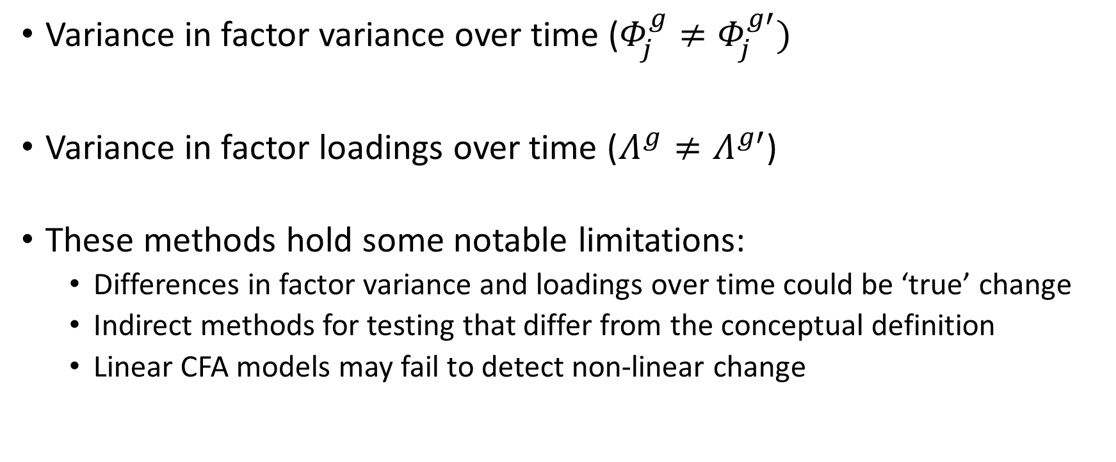
Beta Change via CFA (Latent Variance & Metric)
Variance in factor variance over time ($Φ_{j}^{g}≠Φ_{j}^{g′})$
Variance in factor loadings over time ($Λ^{g}≠Λ^{g′}$)
These methods hold some notable limitations:
  Differences in factor variance and loadings over time could be ‘true’ change
  Indirect methods for testing that differ from the conceptual definition
  Linear CFA models may fail to detect non-linear change

Slide 8
IRT and Differential Item Functioning (DIF)
IRT models define the probability of a response to a given item as a function of individuals’ level of an underlying trait (theta, θ)
  Discrimination parameter (a; slope of a item response curve)
  Difficulty parameter (b; location of response curve relative to θ)
  Each item has 1 a parameter and 1 or more b parameters
DIF is assessed by comparing level of parameters across groups/time
Reference Group/Time 1
Focal Group/Time 2
-3
3
θ
Notes:
Keep my discussion here at a high level
As you finish discussing this, mention that this presents an opportunity to look at Beta change in a way that aligns more directly with the conceptual definition and does not share the same limitations as CFA

Slide 9
Conceptual Beta Change and IRT Models
Shift in the space between points on the response continuum over time
k_{1a}
k_{2a}
k_{3a}
k_{4a}
k_{5a}
-3
3
Time 1
k_{1b}
k_{2b}
k_{3b}
k_{4b}
k_{5b}
-3
3
θ
Time 1
-3
3
Time 2
Time 2

Slide 10
Proposed Methodology
Adapt ME/I analysis for use with Ordinal CFA (“OCFA”)
  Likert-type data are more accurately defined as ordered categorical data
  Allows for the assessment of equality in response category thresholds
Interpret OCFA results via IRT-based DIF analysis
  Graded Response Model (GRM; Samejima, 1969) equivalent to a unidimensional OCFA model
  OCFA parameters can be converted into IRT GRM parameters
  Parameter estimates generated account for correlated residuals and factors over time as specified in OCFA model(s)
Notes:
OCFA model parameters are conceptually equivalent to IRT
Factor loadings ≈ discrimination parameter (‘a’)
Item response thresholds ≈ difficulty/location parameters (‘b’)

Slide 11
Proposed Methodology
Step 1: Omnibus test (equal variance-covariance matrices)
Step 2: Configural baseline model (Gamma)
  Can a common factor structure be defined at both time points?
  Assess model fit via standard indices (χ², CFI, RMSEA)
Step 3: Factor Covariance Invariance (Gamma)
  Only applicable in multi-dimensional models
  Assess model fit via significance of Δχ²
Step 4: Metric Invariance (Beta)
  Are factor loadings equal across time?
  Assess via significance of Δχ²
Step 5: Threshold Invariance (Beta)
  Are response category thresholds the same across time?
  Assess via significance of Δχ²
Notes:
Mention that gamma change cannot be interpreted via a unidimensional GRM. There are likely opportunities to test via multidimensional models, but those introduce additional complications and details that go beyond today’s discussion

Slide 12
Proposed Methodology
Plot Item Response Function
  Boundary Response Function
  Category Response Function
  Expected Score Function
Evaluate magnitude and significance of DIF using IRT-based DIF statistics
  DFIT
  DIF effect size measures (Meade, 2010)
Notes:
Mention that by plotting the curves in an IRT model, you can get some indication of the magnitude of beta change, which OCFA does not provide

Slide 13
Illustrated Example
Self-regulation subscale adapted from a measure developed by Pintrich & DeGroot (1990)
  10 of 12 original items evaluated (2 reverse coded items omitted)
  5-point scale
  Administered to college students over the course of an 18-week course
Model fit statistics.
Model | χ² | df | Δχ² | Δdf | p | CFI | RMSEA | (CI) | SRMR
Configural Model | 383.213 | 159 | -- |  | -- | 0.914 | 0.093 | (0.081-0.105) | 0.073
Metric Model | 361.164 | 168 | 14.73 | 9 | 0.10 | 0.926 | 0.084 | (0.072-0.096) | 0.078
Equal Thresholds | 451.329 | 201 | 129.71 | 33 | <.0001 | 0.904 | 0.087 | (0.077-0.098) | 0.080
Notes:
The measure primarily looks at individuals learning strategies and motivation to learn
Chisquare estimates here are based on mean and variance adjusted Weighted Least Squares (WLSMV) making direct comparison of chisquares complicated and requiring the difference test to account for the scaling applied

Slide 14
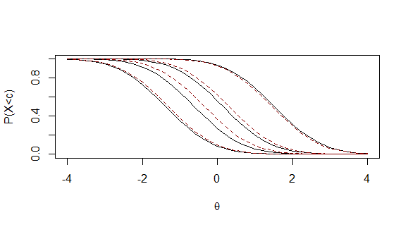
Example: Boundary Response Function
I try to change the way I read in order to fit the material I’m reading and the writer’s style.
Time 1
Time 2

Slide 15
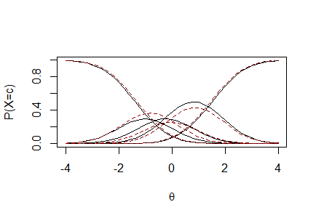
Example: Category Response Function
I try to change the way I read in order to fit the material I’m reading and the writer’s style.
Time 1
Time 2

Slide 16
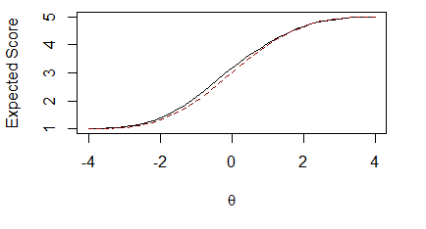
Example: Expected Score Function
I try to change the way I read in order to fit the material I’m reading and the writer’s style.
Time 1
Time 2

Slide 17
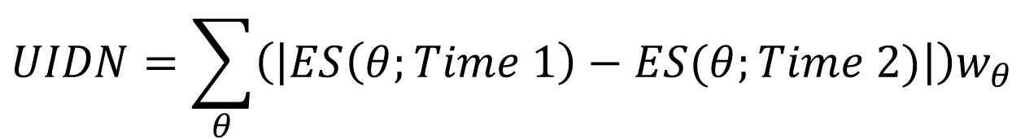
Effect Size
Meade (2010) Unsigned Item Difference in Normal Distribution
  Average absolute difference between expected score
For Item 11, UIDN = 0.12
$$UIDN=\sum_{θ}{\left(\left|ES\left(θ;Time 1\right)−ES(θ;Time 2)\right|\right)w_{θ}}$$
Notes:
W_theta weights the differences by the standard normal distribution
0.12 indicates that on a 5-point scale, difference is about 1/10 of a point – a small difference

Slide 18
Next Steps
Perform analyses with a Monte Carlo simulation to assess power, identify potential limitations and constraints
Evaluate magnitude and significance of beta change using established DIF indices such as NCDIF
Evaluate magnitude of beta change in the context of alternative effect size measures

