Slide 1
Rating Scale Analysis Using Ideal Point Response Process
Christopher Gallagher
Georgi P. Yankov
&
Michael J. Zickar
Department of Psychology
Bowling Green State University

Slide 2
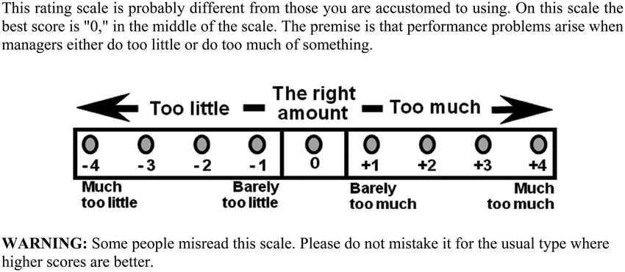
Rationale
Recently, Vergauwe, Wille, Hofmans, Kaiser & De Fruyt (2017) introduced a “new” rating scale called too little/too much (TLTM) for rating behavioral items.

Slide 3
Rationale
Vergauwe et al. (2017):
argued that dominance items preclude us from discovering curvilinear relationships (cf. Carter, Dalal, Boyce, O’Connell, Kung & Delgado, 2014).
measured leadership behaviors because too little or too much leadership is undesirable (Too-Much-of-a-Good-Thing – TMGT) for outcomes such as OCB and LMX.
proposed to modify the rating scale, not laboriously create ideal point items (e.g. Thurstonian method) and score them (needs knowledge of GGUM and large sample sizes).

Slide 4
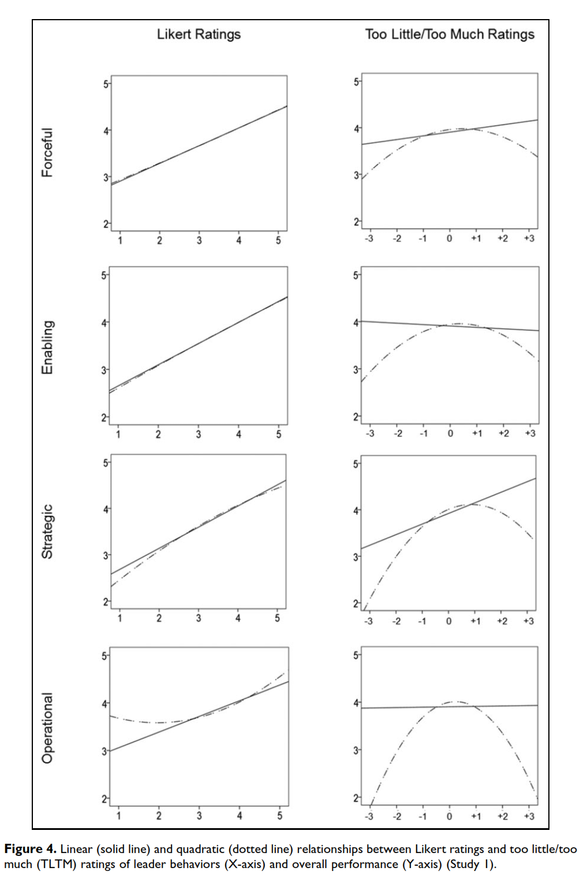
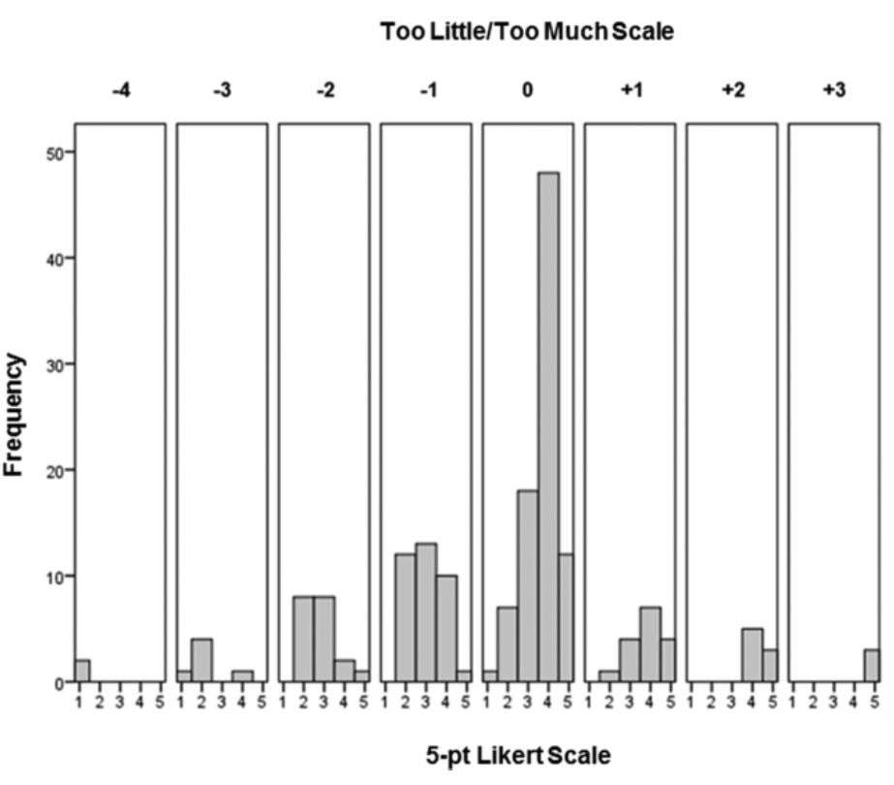
Rationale

Slide 5
Our Studies
Explored another behavioral construct – OCB.
Because Dalal’s (2005) meta-analysis argued that Likert rating scales might obscure OCB’s relationship with other constructs (e.g., CWB), we used a frequency scale (Never to Multiple times per day).
Fitted a dominance model (Graded Response Model) and an ideal-response model (Generalized Graded Unfolding Model) on OCB administered with a TLTM and a frequency rating scale to see if the items will “fold”.

Slide 6
Design
Samples
Sample 1: 419 working adults (Age=32; SD=14.7; 57% Female) recruited by students for class credit.
Sample 2: 699 MTurk workers (Age=35.8; SD=10.7, 52% Female)
Measures
Study 1 and 2: 20-item OCB scale (Spector, Bauer & Fox, 2010)
E.g. “Took time to advise, coach, or mentor a co-worker.”
Study 2: Microbreaks scale (Kim, Park & Headrick, 2018)
E.g. “Reading books, newspapers, or magazines for personal learning or entertainment.”

Slide 7
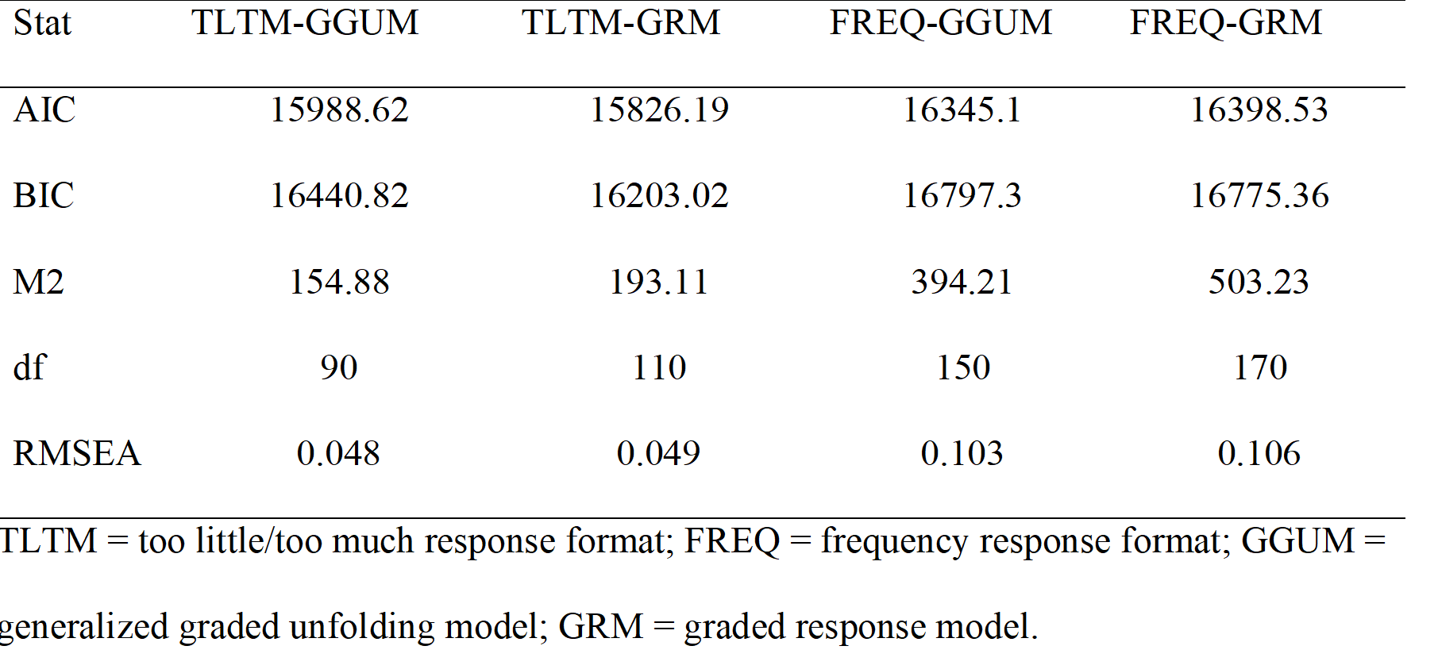
Results Study 1
Fit of the models
Number of well-fitting items (s-X²; Orlando & Thissen, 2003): TLTM-GGUM (8), TLTM-GRM (7), FREQ-GGUM (2), FREQ-GRM (2).

Slide 8
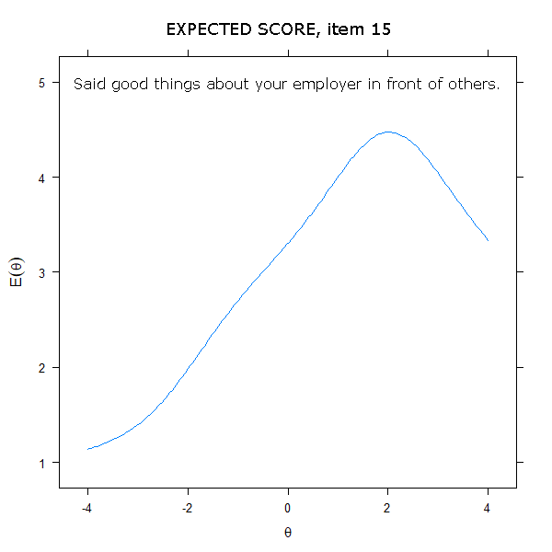
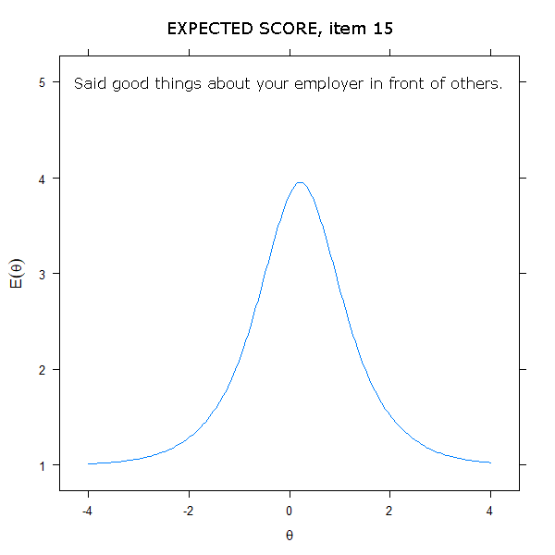
Results Study 1
Expected score across latent trait for item 15 under GGUM. Left: TLTM rating scale. Right: Frequency scale.

Slide 9
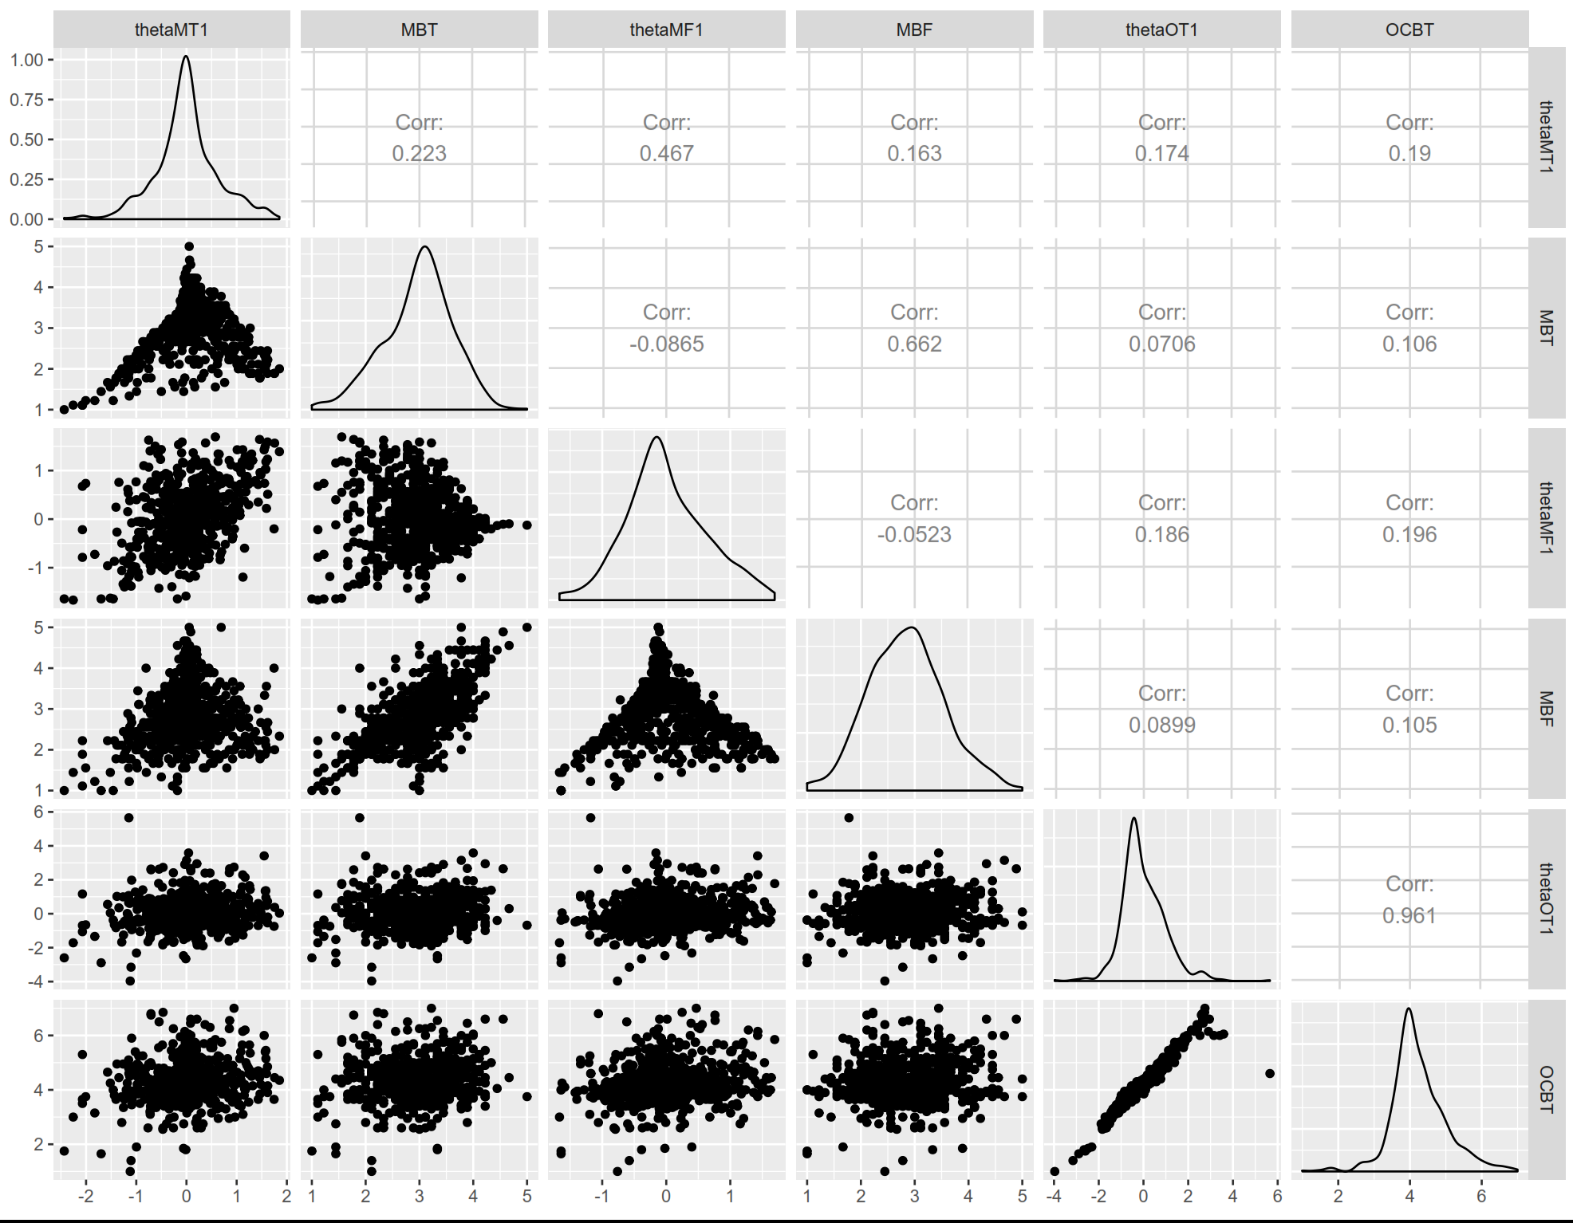
Results Study 2
The pinnacles in the OCB TMTL theta and averaged score distributions is outside of the 10th – 90th percentile of the theta distribution, and therefore not following ideal point assumptions (Roberts & Shim, 2008)
Notes:
the locations of the items are too far away from the observed people to make any difference even when you estimate person scores

Slide 10
Results Study 2: Fit for Microbreaks
model | AIC | BIC | logLik
FREQ GRM | 17131 | 17336 | -8520
FREQ GGUM | 17271 | 17516 | -8581
TLTM GRM | 16785 | 16990 | -8347
TLTM GGUM | 16858 | 17104 | -8375
Information criteria slightly favor the simpler model, GRM.
Notes:
X2-based fit stats omitted due to some conflicting evidence on their usefulness vis-à-vis GGUM, but they follow this basic pattern.

Slide 11
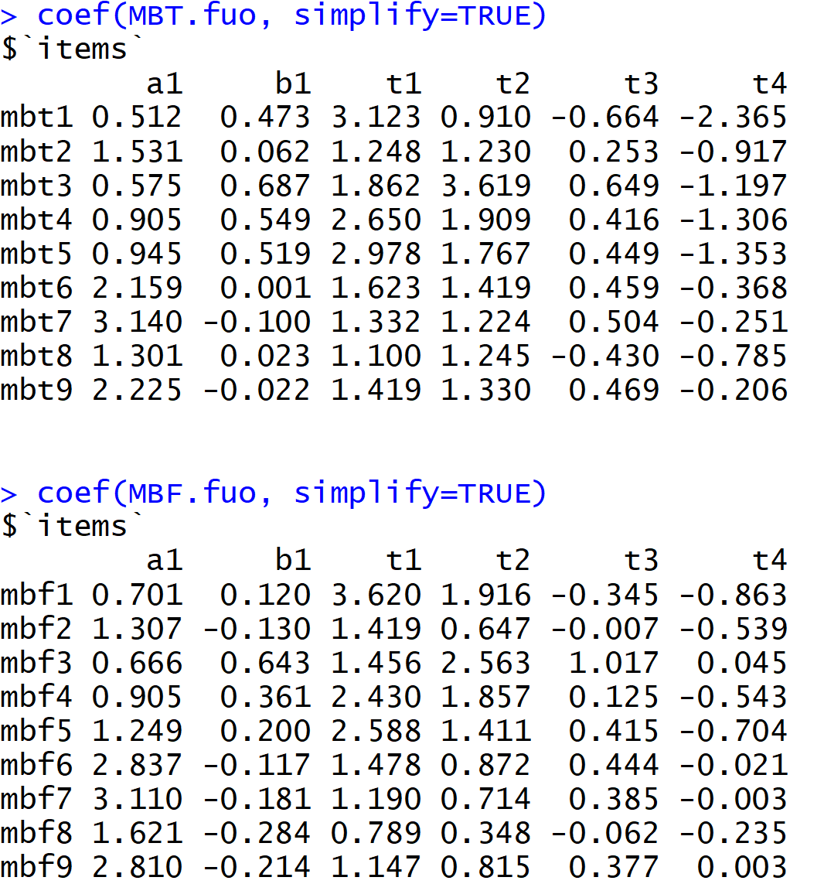
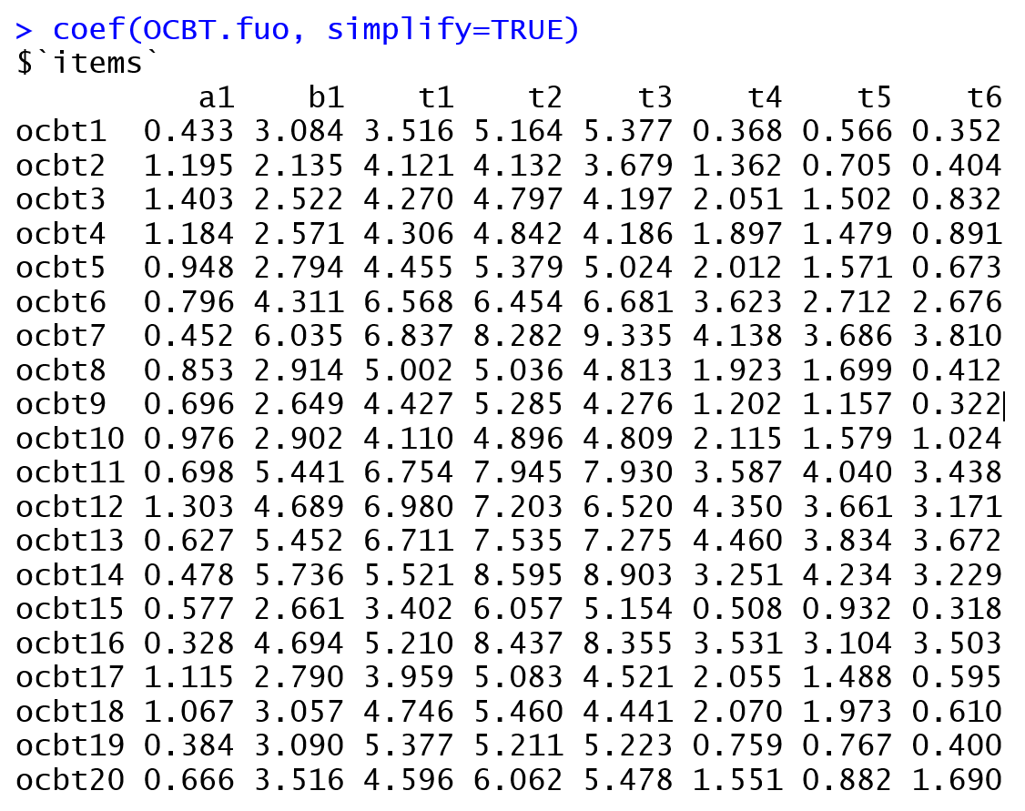
Results Study 2
VS.

Slide 12
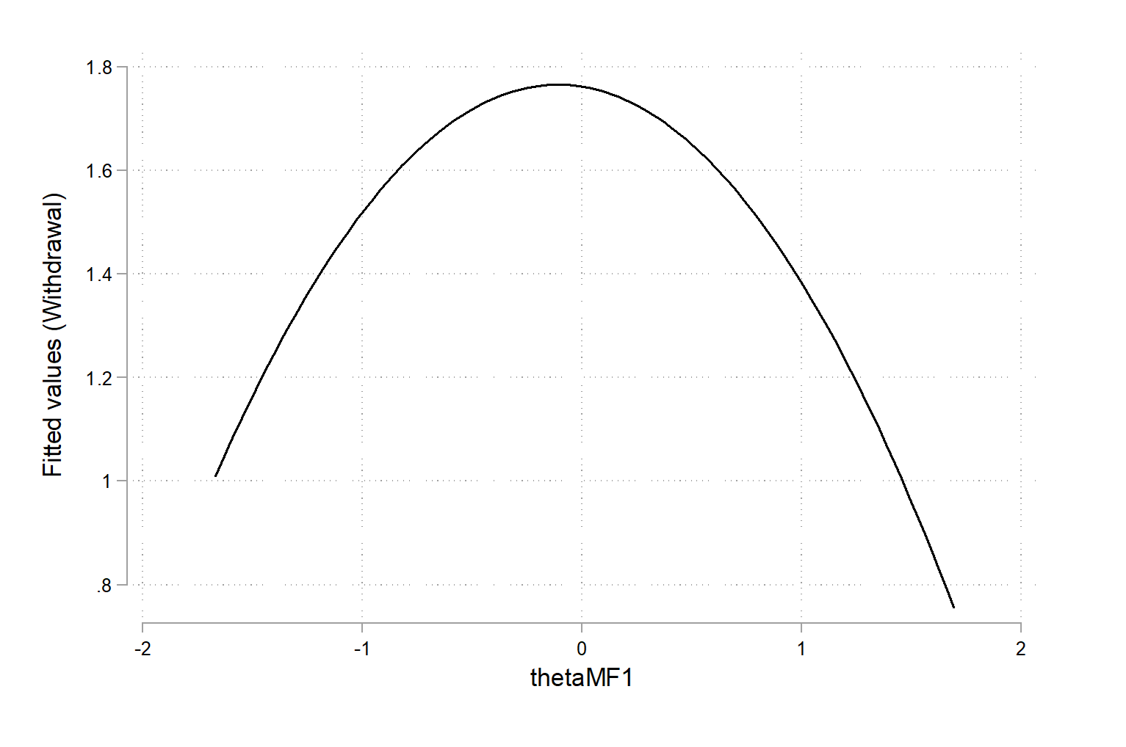
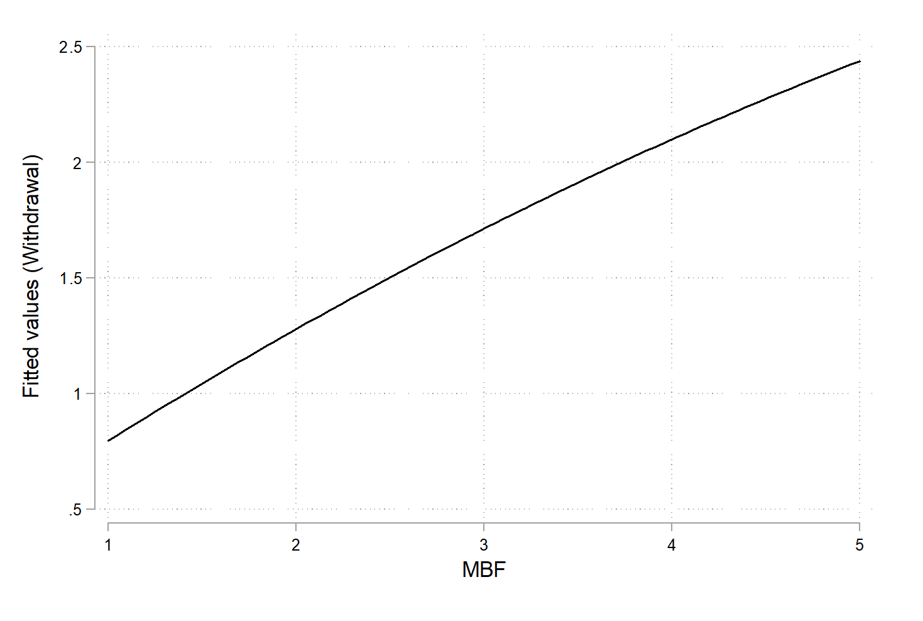
Study 2: Predicting Withdrawal from work
VS.
Regressing Withdrawal onto Microbreaks for the frequency rating scale. Left: predictor is the quadratic GGUM modelled theta (b=-.31; p<.001). Right: predictor is the GGUM modelled scale average (b=.55; p<.001).

Slide 13
Takeaways
Inducing ideal point response process is not dependent on the scale used. In Study 1, the TLTM scale “folds” the items just as much as the frequency scale.
Ideal response processes are dependent on the construct measured. In Study 2, Microbreaks “folds” but not OCB.
We should explore typical behavior (not only personality or attitudes) under the ideal point model.
Potential for Type 3 errors (Carter et al., 2018)

Slide 14
THANK YOU FROM !

