Slide 1
Comparison of Item Selection Criteria in Multidimensional Computer Adaptive Testing with the Graded Response Items
Scott B. Morris
Matthew Lauritzen
Sheng Zhang
Illinois Institute of Technology
Michael Bass
Richard Neapolitan
Northwestern University
Ideas in Testing 2018
This work was supported by the National Library of Medicine of the National Institutes of Health, R01LM011962.

Slide 2
Multidimensional CAT
Computer Adaptive Testing (CAT)
High precision with shorter test; reduce burden on examinees
Long history in educational testing & professional licensure
Recent increase with self-report scales (e.g., patient-reported outcomes)
New applications require
Likert-type (polytomous) response scale
Multidimensional models
Multiple item selection rules have been created for MCAT
(Mulder & van der Linden, 2009; Segall, 2010; Wang & Chang, 2011)
Little guidance on which methods are most effective with polytomous items

Slide 3
PROMIS Emotional Distress MCAT
Anxiety
Depress
Anger
I1
I2
I3
I4
I5
I6
I7
I8
I9

Slide 4
Simulation Procedure
Step 1: Item Bank
Generate true item parameters
Step 2: MCAT Calibration
Generate responses for 5000 simulated examinees
Estimate item parameters in IRTPRO
MCAT used estimated item parameters
Examinee responses based on true item parameters
Step 4: True Trait Levels
1000 simulated examinees
Correlated multivariate uniform distribution (-3 to 3)
Step 3: Potential Response Table
Generate table of potential response to each item for each examinee
Step 4: MCAT
Administer items according to each item selection method
Pull responses as needed from potential response table

Slide 5
Item Selection Methods
Maximize Determinant of Fisher Information Matrix
Maximize Posterior-Weighed Average of FI (Fisher Distribution)
Minimize Sum of Posterior Variance (Expected Variance)
Maximize Kullback-Leibler Information (KL)
Maximize Change in Shannon Entropy (Information Gain)

Slide 6
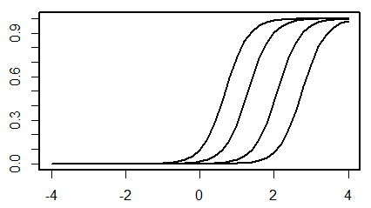
Item Bank Characteristics
5-Cateogry Response Scale
Range of item parameters informed by the empirical distribution of a and b parameters from 355 items (Graded Response Model)
PROMIS emotional and physical functioning banks (Cella et al., 2011)
Item parameters sampling from a uniform distribution with range specified by the condition
a parameter
Item mid-point (average of the 4 b parameters)
Spacing between adjacent b parameters

Slide 7
Item Bank Conditions Examined
Item Characteristics
Discrimination (a) Parameters
Narrow Range: 2.5 – 3.0
Wide Range: 1.5 – 3.5
Category Spacing
Difference between adjacent categories
Narrow Spacing: .50 - .75
Wide Spacing: .75 to 1.0
Bank Depth
Sparse: 15 items per dimension
Deep: 45 items per dimension
Dimensionality
2D vs. 3D
Total of 48 Conditions x 5 Item Selection Methods x 1000 Examinees

Slide 8
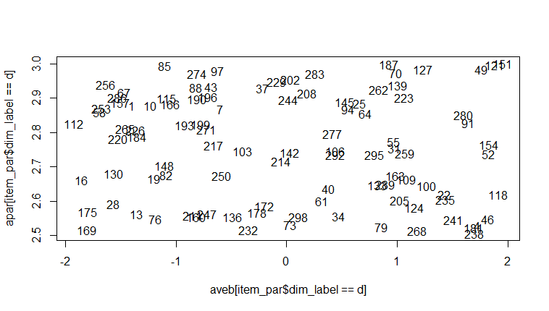
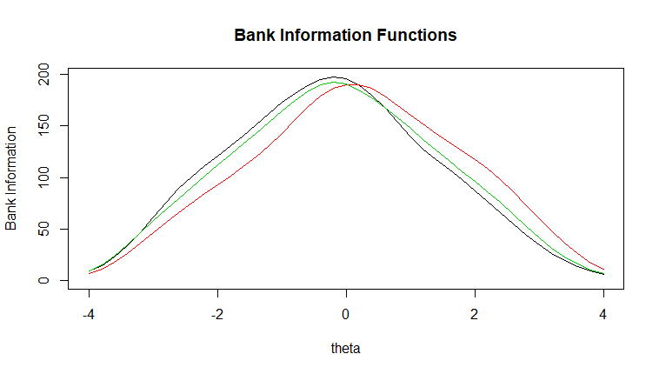
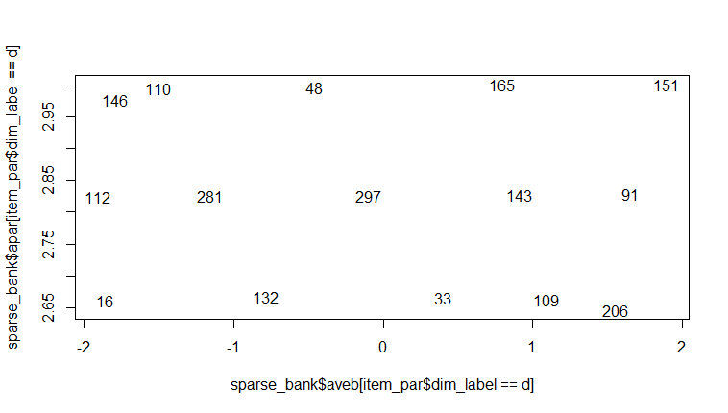
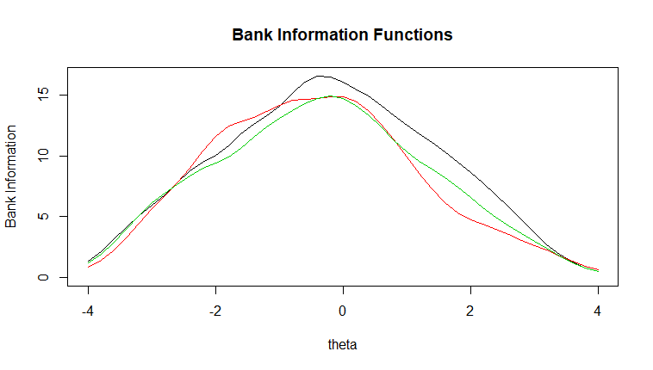
Example: Deep & Sparse Banks

Slide 9
Outcome Measures
RMSE per dimension
Convergence plots
RMSE by position in the MCAT (i.e., after 1, 2, 3… items administered)
How quickly does RMSE improve with additional items?
Average number of items to achieve RMSE < 0.3
Can choice of method result in a shorter test?
Computation Time
Average time needed to select next item
$$RMSE=\sqrt{\frac{\sum_{Persons}{\sum_{Dim}{{\left(\hat{θ}−θ\right)}^{2}}}}{{N_{Dim}N}_{Persons}}}$$

Slide 10
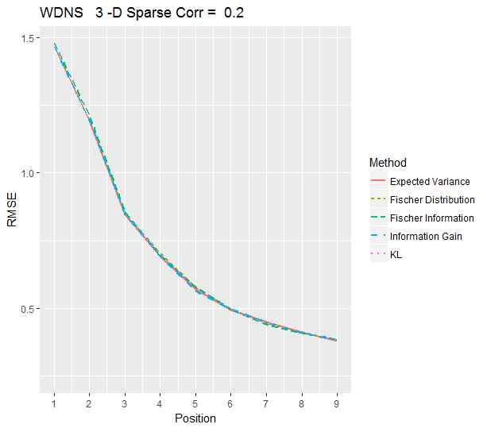
Results: RMSE convergence
In about half the conditions, differences among methods were trivial
Example:
3D MCAT, r = 0.2
Sparse Bank
Wide Discrimination Range
Narrow Category Spacing

Slide 11
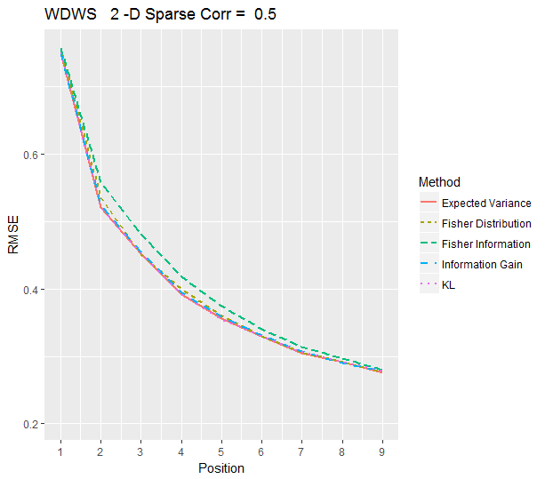
Results: RMSE Convergence
When differences were found, Fisher Information tended to converge more slowly
Largely disappeared by the time measurement precision reached desirable level
Example
2D MCAT, r = 0.5
Sparse Bank
Wide Discrimination Range
Wide Category Spacing

Slide 12
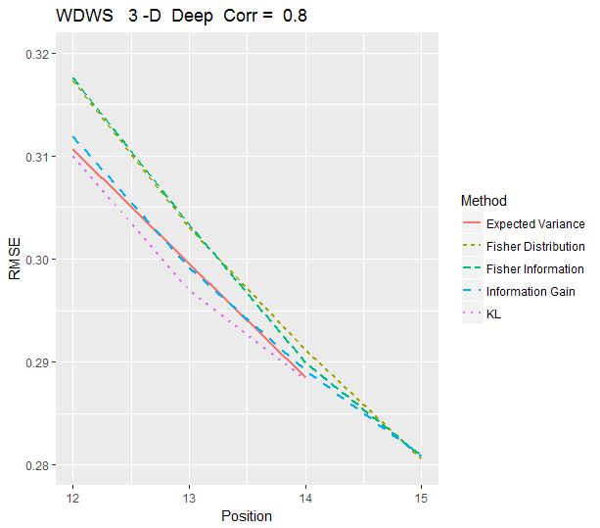
Results: RMSE Convergence
Although differences after 9 items were very small, Fisher Information continued to lag behind other methods
Fisher Distribution also sometimes showed slightly higher RMSE
Sometimes required an additional item to reach RMSE < 0.3
Example
3D MCAT, r = 0.8
Deep Bank
Wide Discrimination Range
Wide Category Spacing

Slide 13
Item Selection Method and Test Length
Number of items to reach RMSE < 0.3
No difference in over 50% of conditions
When differences were found
Never more 1 item
Fisher Information almost always among the worst
Fisher Distribution among worst in 50% of conditions
KL almost always among the best
Expected Variance and Information Gain usually among best (70-80%)

Slide 14
Computation Time (deep bank)
Notes:
Time it took the MCAT to select the next item

Slide 15
Conclusions
All item selection methods perform similarly
Never more than one additional item (on average)
Small but consistent differences
Fisher Information slightly less efficient
KL Information among most efficient
Small improvements in precision may not justify substantial increase in computational complexity (time to select next item)
Likely to become worse with higher dimensionality
KL Information provided good balance of high efficiency with only modest increase in computation time

