Slide 1
Apples to oranges? The use of mobile for pre-employment testing
Ideas In Testing Research Seminar
Erin Wood
Kelsey Stephens
November 13,2015
Notes:
ECW

Slide 2
Pre-Employment Testing is Important!
*79%
Notes:
KMS
Begin today’s presentation by making the case that pre-employment testing is important!
In fact, best in class organizations are 79% more likely to use assessments compared to their lagging counterparts.
Best in class defined by exceeding expectations employees, # of key positions with successors, improvement in hiring manager satisfaction
Use assessments for
Using data in the hiring decision
Develop and find skills to support organizational growth

Slide 3
Why Mobile?
Notes:
KMS
As a society, we have become reliant upon our smart phones – we have and use them then on vacation, at concerts, out with friends, and on first dates.
The discussion of mobile usage as it relates to pre-employment testing is a hot topic.
The Society for Industrial and Organizational Psychology rated mobile testing as this year’s number one trend. Therefore, it is increasingly important to understand how technology is changing the science and practice of testing. Industrial/Organizational psychologists will continue working to design assessments that are valid and reliable, no matter the platform in which they are delivered. Ideally, our research will help to spearhead the findings that will arm I/O psychologists in this endeavor to keep testing consistent, fair, and reliable.
When we use the term mobile in this presentation, we are referring to a device that is:
A handheld tablet or smartphone device
Usually smaller than a laptop
Screen size not a standard measure – probably more about interface
Usually doesn’t have an attached keyboard
SIOP #1 Trend
As technology continues to expand and develop, mobile assessments will infiltrate human resource systems. It is increasingly important for organizations to understand how technology, including social media and social collaboration, is changing the science and practice of selection, recruitment, performance management, engagement, and learning. I-O psychologists will continue working to design assessments that are valid and reliable regardless of how and where they are delivered.

Slide 4
Why Mobile?
Survey:
Who has the largest number of mobile devices?
Notes:
ECW
Tons of people have smartphones
This number is relatively evenly spread across demographic groups
Cell phone dependency
Younger adults — 15% of Americans ages 18-29 are heavily dependent on a smartphone for online access
Those with low household incomes and levels of educational attainment — Some 13% of Americans with an annual household income of less than $30,000 per year are smartphone-dependent. Just 1% of Americans from households earning more than $75,000 per year rely on their smartphones to a similar degree for online access.
Non-whites — 12% of African Americans and 13% of Latinos are smartphone-dependent, compared with 4% of whites.
Who is using mobile devices to complete assessments?
Small but increasing number of candidates using mobile devices
≈2-5%
Some groups more likely to complete assessments on mobile:
African-Americans, Hispanics, Women, Younger applicants

Slide 5
Literature Summary
Impact of device type:
Does not seem to impact test properties
Can impact performance for some tests
Can negatively impact candidate experience
Small but meaningful % of people using mobile for testing
There are many questions left to answer!
Notes:
ECW
How does mobile testing impact test performance?
Personality → no difference
But they did take longer to complete
Cognitive → significant differences
Mobile scores are lower
This effect was greater for verbal then numerical
SJT → small, but potentially practical difference
Mobile users score ½ SD lower

Slide 6
PAN Research
PAN’s database
More than 500 tests
Range of test types
Test takers across
industries and occupations
Tests chosen based on availability of mobile testing data in the population of testers
Notes:
KMS
Erin and I come from an organization, known as PAN, or Performance Assessment Network, that houses a database of more than 500 tests; ranging from cognitive ability to personality and from skills tests to 360 degree feedback assessments.
This allows us to access a data mine of test results spread across different industries and occupations.
For the current research, we investigated the scoring trends from tests that have sufficient availability of mobile testing data in the population of test takers

Slide 7
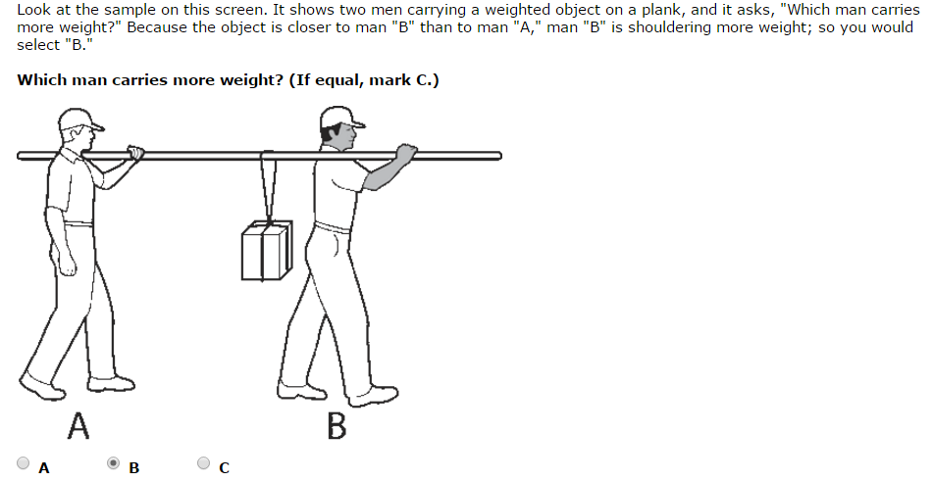
Goal of Study
Examine applicant test data to measure:
Effect of device type for image heavy tests
Examine reason behind scoring differences on timed, cognitively-loaded tests
Notes:
KMS
There were two main goals of this study:
Investigate the effects that device type can have for image heavy tests
By image heavy tests, we are referring to tests that have a large number of items that include an image, such as this
The second goal was to examine the reason behind scoring differences on timed, cognitive-loaded tests
Previous research has shown that test takers score lower on these types of test—but we sought out to find out the underlying reason for the score differentiation; specifically, is there a difference in scores due to mobile test takers getting more items incorrect, or are they simply not finishing the test in time?
Contribution:
Consider scoring differences for mechanical aptitude and work attitudes tools
Seek to confirm findings about scoring for personality and cognitive measures
Seek to confirm findings about time to complete for untimed tests

Slide 8
Hypothesis 1
Notes:
KMS
Here’s a visual representation of our first hypothesis—you can see that we predict those test takers who take the test on a nonmobile device (laptop or desktop computer) will score higher than those who complete the test on a mobile device
H1: Test Scores on Image Heavy Tests
Mobile testers < Nonmobile Testers

Slide 9
Hypothesis 2
Notes:
KMS
Our second hypothesis predicts that test takers who complete a test on a nonmobile device will answer more questions than will their mobile device counterparts.
H2: Items Completed within Time Limit
Mobile testers < Nonmobile Testers

Slide 10
Measures
3 Mechanical Aptitude measures
Test A:
68 items
30 minutes timed
Test B:
45 items
20 minutes timed
Test C:
32 items
8 minutes timed
Test | Cases | % Mobile
Test A | 9036 | 5% (494)
Test B | 3157 | 4% (123)
Test C | 1058 | 11% (105)
Notes:
ECW
Personality
#1 16PF
16 scales, 185 items, 40 minutes untimed, multiple choice (yes, no, ?)
#2 WPI
16, scales 167 rating scale items
Mechanical Aptitude
#1 Bennet Mechanical
68 multiple choice items, 30 minute time limit
#2 PPM – mechanical understanding
32 multiple choice items with an 8 minute time limit
Cognitive Ability
#1 Watson Glaser Form A
80 multiple choice items with a 60 minutes time limit
#2 Watson Glaser II
40 multiple choice items with a 30 minute time limit
Work Attitudes
ESQII
14 scales, 27 forced choice items with a 15 minute time limit

Slide 11
Analyses
Calculate Cohen’s d for effect size
Number of items answered correctly
Number of items answered
Graphical representation of items answered
Notes:
ECW

Slide 12
Results for Hypothesis 1: Score Difference by Device Type
 | Mean Raw Score | Mean Difference | Cohens d
Test A (68 items)
Mobile | 41.32
Nonmobile | 46.33 | 9.36 | -.54
Test B (45 items)
Mobile | 32.62
Nonmobile | 33.93 | 6.29 | -.21
Test C (32 items)
Mobile | 10.37
Nonmobile | 12.62 | 5.68 | -.40
Notes:
KMS
Here’s an overview of our findings related to our first hypothesis.
Cohen’s d statistic provides us with a standardized measure of mean difference.
Recall that when interpreting the magnitude of Cohen’s d coefficients, we can think of correlations of .2 to be a small effect; .5 to be a medium effect, and .8 to be a large effect.
We can interpret these findings such that those who took Test A on a mobile device scored an average of 9.36 points lower than those who took Test A on a nonmobile device, introducing a medium negative effect.
Example: a value of d=0.50 indicates that the treatment changed the mean by half a standard deviation.

Slide 13
Results for Hypothesis 2: Items Completed by Device Type
Test A (68 items) | Items Answered | Difference | Cohens d
Mobile | 62.61
Nonmobile | 66.00 | 5.67 | -.56
Notes:
ECW

Slide 14
Results for Hypothesis 2: Items Completed by Device Type
Test B (45 items) | Items Answered | Difference | Cohens d
Mobile | 43.46
Nonmobile | 44.48 | 2.19 | -.47
Notes:
ECW

Slide 15
Results for Hypothesis 2: Items Completed by Device Type
Test B (32 items) | Items Answered | Difference | Cohens d
Mobile | 20.36
Nonmobile | 21.97 | 5.74 | -.28
Notes:
ECW

Slide 16
Results
Hypotheses 1: Supported
Mobile testers score lower than nonmobile testers on image heavy tests
Hypothesis 2: Supported
Mobile testers answer fewer questions before running out of time than nonmobile testers
Notes:
KMS
The results of our analyses indicate that both of our hypotheses were supported. This means that mobile test takers scored lower on image heavy tests and that mobile testers scored lower because they ran out of time sooner than those who took the tests on a nonmobile device.

Slide 17
Summary
Device type negatively impacts:
Test performance when images are present
Number of items testers can complete
Test administrators should consider and address this in high stakes testing situations
Standards for mobile optimization
Best interface, scrolling limitations, etc.
Notes:
ECW
Limitations:
Insubstantial demographic data to measure group differences
Exact time measurements
Screen size measurements
Some small sample sizes
More work needs to be done comparing trends between demographic groups
More work needs to be done to parse apart differences between phone and tablet
Technology is continuously changing
Research goes out of date quickly
Test time differences – need a more exact way to measure this – would also be good to measure the effect in cognitively loaded situation
Standards for mobile optimization
interface (browser vs. app)
Scrolling rules
Recommendations
Control content according to best practices
For tests that should be proctored, make sure they are so that mobile doesn’t effect candidate scoring
Consider what assessments are appropriate for mobile testing in a high-stakes testing situation – since there is some evidence that mobile testing increases cognitive load, this could negatively impact mobile testers unfairly
Consider the effects of time limitation –
Different devices have different latencies – time to load, scroll, move from page to page
Control content according to best practices
Consider the effects of time limitation
Use warnings where appropriate
Web-enable assessments on mobile friendly and optimized platforms
Try it to see what it looks like!
Monitor your own data for trends

Slide 18
Thank you!
Questions?
ewood@panpowered.com
kstephens@panpowered.com

Slide 19
References
Arthur, W, Jr., Doverspike, D., Munoz, G. J., Taylor, J. E., and Carr, A. E. (2014). The use of mobile devices in high-stakes remotely delivered assessments and testing. International Journal of Selection and Assessment, 22(2), 113-123.
Gutierrez, S. L., & Meyer, J. M. (2013). Assessments on the go: Applicant reactions to mobile testing. In N. A. Morelli(Chair), Mobile devices in talent assessment: Where are we now? Symposium conducted at the 28th Annual Conference of the Society for Industrial and Organizational Psychology, Houston, TX.
Gutierrez, S.L., & Sanderson, K. (2015). Applicant Reactions: What we know about testing on the go. In H. S. Payne (Chair), Future of Assessment: Reactions to Innovative Formats and Delivery Modes. Symposium conducted at the 30th Annual Conference of the Society for Industrial and Organizational Psychology, Philadelphia, PA.
Kinney, T. B., Lawrence, A. D., & Chang, L. (2014). Understanding the mobile experience: Data across device and industry. Poster presented at the 29th Annual Conference of the Society for Industrial and Organizational Psychology, Honolulu, HI.
Morelli, N. A., Mahan, R. P., and Illingsworth, A. J. (2014). Establishing the measurement equivalence of online selection assessments delivered on mobile versus nonmobile devices. International Journal of Selection and Assessment, 22(2), 124-138.
Smeltzer, S. (2013). Mobile internet testing: Applicant reactions to mobile internet testing. Master's Thesis. Retrieved from ProQuest. 154893.

