Slide 1
CAT with ideal-point: Practical issues in applying GGUM to employment CAT
Alan D. Mead

Slide 2
Some background
This talk arose from a project to create an adaptive personality assessment for employment testing
The adaptive assessment was to use an ideal-point IRT model (which is described soon) called GGUM
We hit some difficulties…
The remaining slides…
  Introduce some key issues about personality
  Contrast ideal-point and dominance IRT models
  Present four problems that we encountered

Slide 3
Likert Personality items
Typical personality items (Conscientiousness):
  “I like order.” (+ worded)
  “I avoid my duties.” (- worded)
Likert response scale
  1 = Strongly Disagree; 2 = Disagree
  3 = Neutral (or Neither)
  4 = Agree; 5 = Strongly Agree
Personality is widely used for employment testing
  Conscientiousness is universally predictive (all other things being equal, being lazy, disorganized, dishonest, etc. never increases performance)
  Conscientiousness is a common cultural trait
  Personality testing is less likely to create legal issues

Slide 4
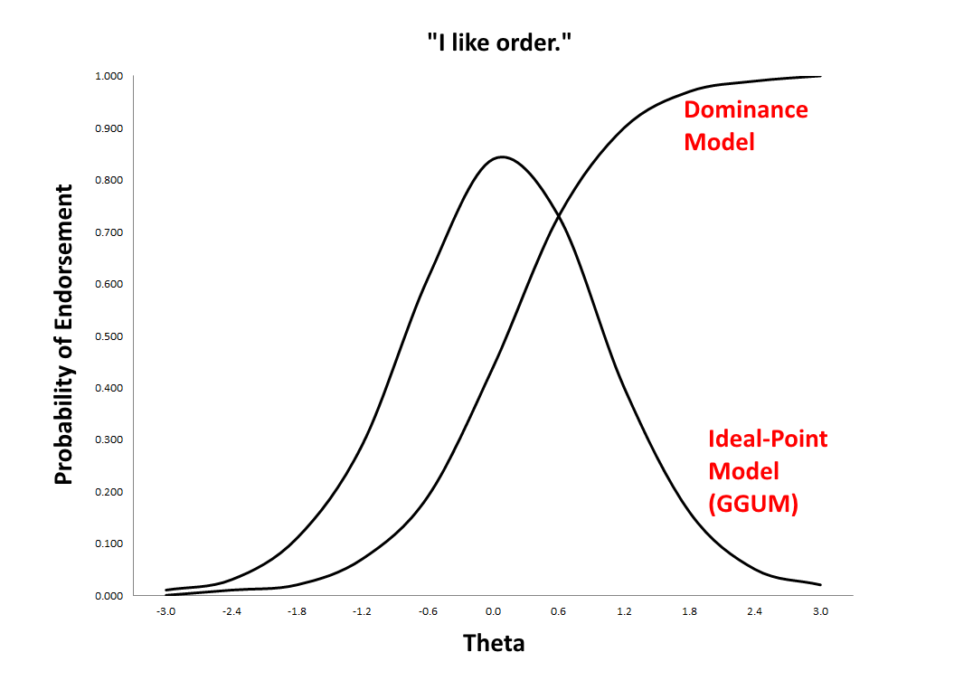
Modeling personality items using Dominance and Ideal-Point IRT Models

Slide 5
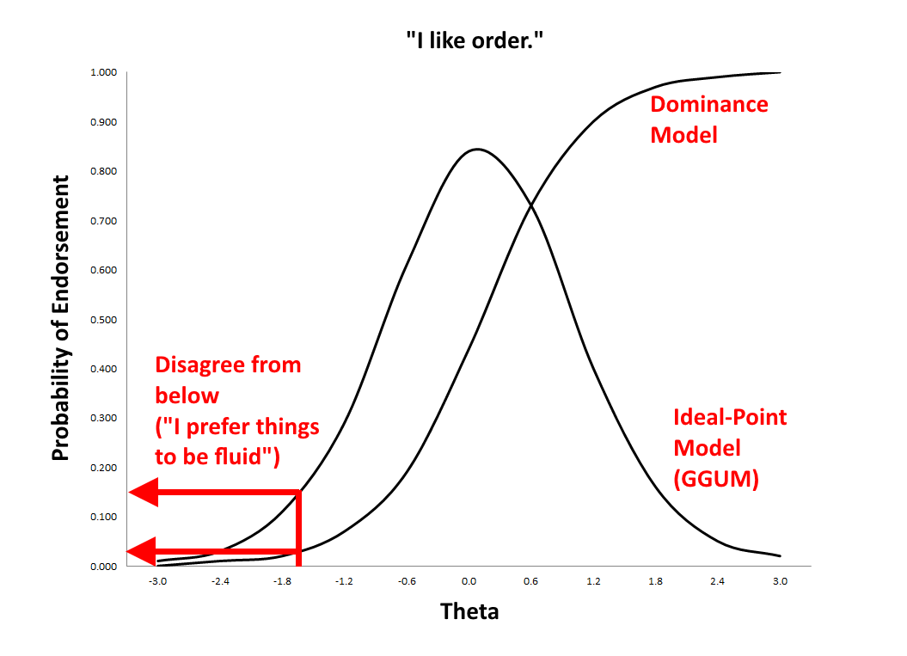
Low Theta produces Disagreement (from below)

Slide 6
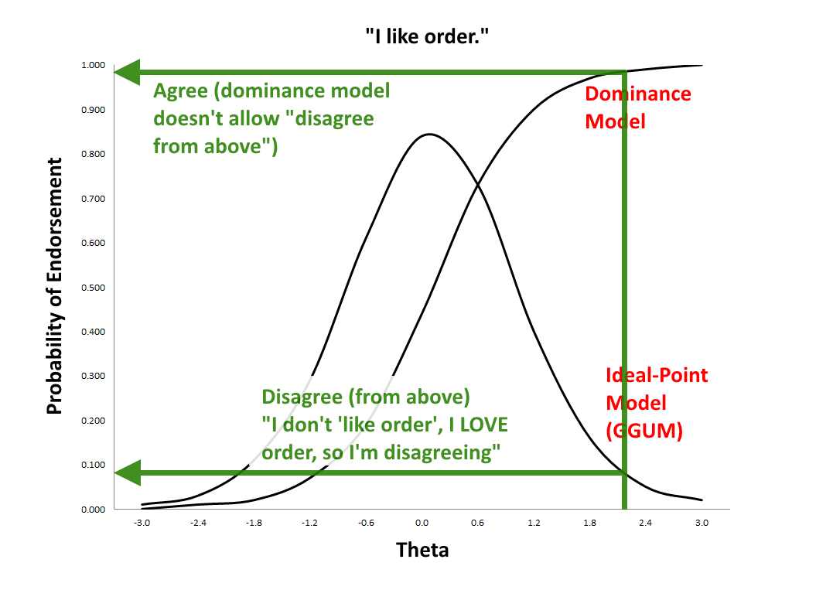
High Theta produces Disagreement from above for Ideal-Point Models

Slide 7
Most Psychometric/Analytic methods assume a dominance response process
Most traditional IRT models: 1PL, 2PL, 3PL, PCM/GPCM, GRM/GGRM, etc.
Correlation, regression, EFA, CFA (of items) all assume linear IRF’s
  CTT item-total correlations wouldn’t indicate quality of ideal-point items
  Thus, (strongly) ideal-point items will have been removed from any well-developed Likert scale
Drasgow, Stark, Chernyshenko, & their colleagues have argued that personality items are better modeled using ideal-point models
An interesting fact: Ideal-point models can easily fit dominance data, but not vice-versa

Slide 8
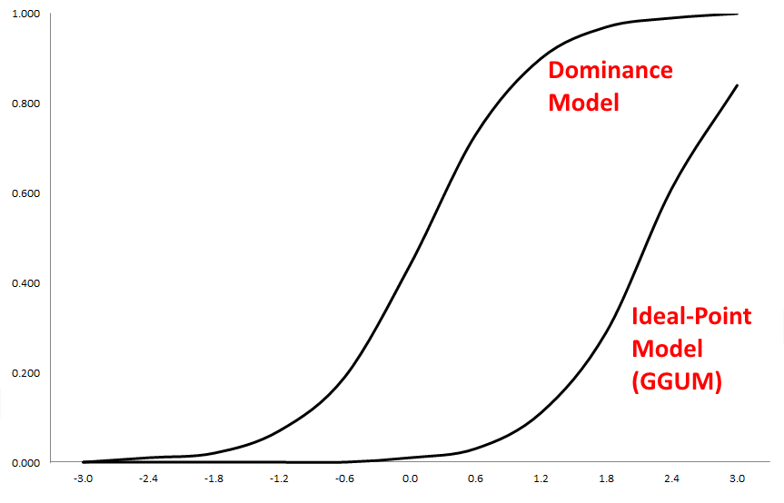
Ideal-Point models are versatile

Slide 9
Problem #1: Estimation
Roberts’ generalized graded unfolding model (GGUM) is most commonly applied in I-O settings
Roberts has released estimation software (GGUM2004)
  JML (a MML version is in the works)
  Finicky
    Huang & Mead, 2014 lost 16% of items (26 of 161) because GGUM estimation failed to converge
    Tedious to iteratively run-rerun analysis after deleting items
  Poor robustness under MCAR missing data
    Ensure pilot data is block sparse (not randomly missing)
Solution: None (maybe MCMC estimation) but also not a “show-stopper”

Slide 10
Problem #2: Metric directionality
There is no ambiguity of direction in dominance estimation
About 50% of the time, GGUM2004 estimates the reverse trait
  EG: Extraversion scale where θ<0 indicates Extraversion and θ>0 indicates Introversion)
Solution: After estimation, carefully check extremity parameters of positively- and negatively-worded items
  A reversal is easy to spot; the parameter estimates are easy to transform
  There’s also an estimation setting where you can pick an item to indicate the intended direction of theta

Slide 11
Problem #3: No published source for GGUM Item information function
Which makes maximum information CAT a problem…
In the simulations I’ve done, I approximated information as the squared of the slope parameter
  That’s not as ridiculous as it sounds for Likert items, which tend to have much broader ranges of information than dichotomous items
Solution: TBD

Slide 12
Problem #4: Perfect disagreement
Perfect disagreement isn’t a problem for dominance models
  If the perfect disagreement were after scoring, such responses would always indicate a low trait score for dominance models
  A candidate who responds disagree to all items would have some kind of intermediate score with a dominance model because about half of the items are reverse-scored
However, under GGUM, perfect disagreement could imply a very high or very low theta
Will candidates who disagree to all items get a very high theta-hat? Potential exam security problem

Slide 13
Simulation
N=500 examinees; 7-item CAT; EAP scoring
Conditions:
  Normal responding
    Estimated reliability (ρ²_{XT}) = 0.85
    Theta-hat range: -2.6 to +2.2
      Reasonably normal, mode = 0
  Respond “strongly disagree” to all items
    Estimated reliability (ρ²_{XT}) = 0.01
    Theta-hat range: -2.0 to +2.9
      Mode = +2.9
      69% >= 0; 33% >= 2.5
Conclusion: This is a serious security issue for ideal-point Likert CAT

Slide 14
Nathan Carter’s solution
Override the CAT algorithm to force a 3-item testlet:
  1 easy to endorse (δ <= -2.0) item
  1 medium to endorse (-0.5 <= δ <= +0.5) item
  1 hard to endorse (δ >= +2.0) item
Administer remaining 4 items as usual
Results:
  Theta-hat range -2.5 to +2.3; M = 0.03; 50.6% <= 0
  1% of scores >= 2.0
  Including testlet does not reduce reliability (0.86 with testlet, 0.80 without testlet for normal responders; N=1500)
Solution: Testlet is very effective in solving this problem and doesn’t seem to create additional problems

Slide 15
Overall Conclusions
Ideal-point CAT has a surprising number of problems
We identified work-arounds for most problems
  Still need a good solution for item information
Even so, the additional work makes Ideal-Point CAT harder
I worry that there is some pattern that we haven’t anticipated that can cause trouble
Although I have an intellectual curiosity about ideal point models, I haven’t yet seen a situation where they produce dramatically better results than dominance models

Slide 16
Thank you!
For comments or questions, please contact me:
amead@alanmead.org

