Slide 1
A COMPARISON OF DIFFERENT METHODS OF DETECTING INATTENTIVE RESPONDENTS
Avi Fleischer M.S.

Slide 2
Overview
Issues with inattention
Models of inattention
Factors influencing inattention
Respondent interest
Detecting inattentive respondents
Recent research
Present study
Study design

Slide 3
Introduction
Issues with inattentive
Impacts data
Factor structure
Reliability
Validity
Impacts self-report surveys
Using personality

Slide 4
Issues with inattentive respondents
Reliability issues
Unforeseen impact up or down
Factor loading (Schmitt & Stults, 1985; Woods, 2006)
Harder to interpret
Creates multiple false domains

Slide 5
Factors influencing responses inattentiveness
Respondent interest
Subject matter
Presentation of survey
Processing speed
Environmental distractions
Test Length
Number of response options

Slide 6
Recent research
Huang et al (2012)
Overview
Findings
Meade & Craig (2012)
Overview
Findings
Recommendations

Slide 7
Present study
Issues addressed
Goals
How it improves on past research
New item type Fleischer type
Less distracting
Study design
Two-with in subject conditions for attentiveness
Three between subject conditions (item type)

Slide 8
Methods for detecting inattentive respondents
Psychometric combination
Total time
Bogus items
Nonsensical items
Instruction based items
Fleischer Type- created by using a known valid survey item and then adding a modifier like “never” or “always” to elicit extreme responses

Slide 9
Hypotheses
H1: There will be a difference in the perception and reaction to the different item detection types.
H2: The identification of inattentive responders will be most accurate using either the Fleischer method or response time.
H3:The Fleischer type and response time detection methods for data removal will yield the greatest improvement in reliability compared to all other methods.

Slide 10
Participants
A total of 1429 participants were recruited, of those 1141remained after the data cleaning with participants from Google AdWords (n = 389), Craigslist (n = 563), and MTurk (n = 190).
Mturk paid $0.50
Adwords & Craigslist received free personality profile.
Male= 24% Female=61% Unidentified=15%
AfAm=4.7 Asian=4.8% Hispanic =7.15% Native American= 1.29% Caucasian 59.5% Multiple 4.6% and unidmetified 17.9%
Cleaning: more than 1 inattentive, less than 10% completed, less than 15 min

Slide 11
Method
Attentive Conditions: Attentive, Inattentive
Item Conditions: Fleischer type, nonsensical, instructional
Equal distribution to item conditions
Procedure
Bogus item pilot
Inattentive Collection through MTURK
Given one set of instructions to answer inattentively
Attentive Collection through CL, Adwords
Given the survey and instructions to answer attentively. Then given the same survey again instructions to answer inattentively .
All participants were given the post-questionnaire after completing the survey.

Slide 13
Measures and data tampering
Measures
Personality: 100-item IPIP
Self reports of diligence, job performance, satisfaction, academic achievement
Response time
Flagged items
Psychometric consistency
Bogus item scales
Data tampering- data was tampered with to create samples with 5%, 10% and 20% inattentive respondents.

Slide 14
Personality scale descriptive

Slide 15
Hypothesis 1 Results
H1: The one-way ANOVA on the average flagging rate for each detection type was significant, F(2; 948) = 135:86, p < :001. The effect of item type was strong, with η² = .22.

Slide 16
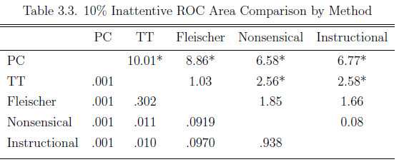
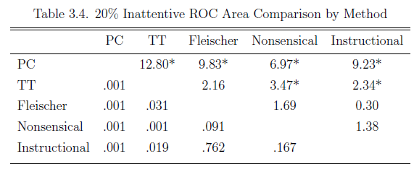
Hypothesis 2 Hanley Mcneil

Slide 17
Hypothesis 3
Examined using Feldt et al 1987 method.
Partially supported
Improvements for Psychometric consistency, but not a real improvement.
Most improvement happened at 20%
Those with the improvements were closer to the scale mean (ie. 3).

Slide 18
Implications
Fleischer type is viewed as less obtrusive.
Optimal identification through total time and Fleischer type. Though not always sig but always better.
Psychometric consistency may not be as useful as once thought.
Reliability increase depends on the mean and SD
Total time and Fleischer were the most useful
Fleischer type can be used during data collection and after where as total time is only useable after data collection.

Slide 19
Limitations and future research
Limitations
Attentiveness can be instructed is not a guarantee.
Respondents did not adhere to second set of instructions.
Future research
Examine aptitude testing.
Compare to other new web analytic measures.
Comparisons at different levels of inattention during the testing.
Look at organizational surveys.

