Slide 1

Measurement, Control, and Stability of Multiple Response Styles
Using Reverse Coded Items
Eric Tomlinson
Daniel Bolt
University of Wisconsin-Madison
Ideas in Testing Research Seminar | October 11, 2013

Slide 2
Introduction and Definitions
Response Styles: systematic tendencies in how respondents use the score categories of a rating scale regardless of item content.
Extreme Response Style (ERS): tendency to use extreme endpoints of rating scale.
Disacquiescence Response Style (DRS): tendency to select disagreement ratings to items.

Slide 3
Introduction and Definitions
Why is it important to consider response styles?
  Threat to the validity of individual scale scores
  Bias introduced from systematic response style differences across groups of respondents (see Van Vaerenbergh and Thomas, 2012)
  Bias in estimation of trait correlations

Slide 4
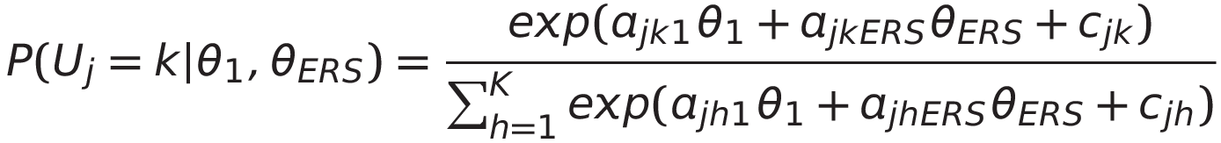
IRT Model for Detection and Control of Response Styles
Account for response styles through continuous latent trait variables and model how substantive and response style traits simultaneously influence response category selection (Bolt and Johnson, 2009; Bolt and Newton, 2011)
j=items; k=category; K=total number of categories
Estimate in LatentGold software
a parameters for substantive trait (θ₁) fixed at equally spaced intervals (-3, -1, 1, 3) and for ERS trait (θ_{ERS}) at (1, -1, -1, 1).
Use information criterion—AIC, BIC, AIC3, CAIC—to compare models and constraints

Slide 5
IRT Models for Detection and Control
Appealing features of IRT models:
On a conceptual level, the method considers a response selection as a function both of the substantive trait level and a response style tendency
Functionally, the model can estimate both the substantive trait level(s) and response style to account for their simultaneous influence on response selection.
Previously noted limitation:
The Bolt & Johnson model has detected and controlled for one response style (ERS) only.
Limitation largely due to data rather than of model, so we attempt to model using data with reverse coded items to statistically detect and control for multiple response styles.

Slide 6
TIMSS Dataset
2007 Trends in International Mathematics and Science Study
Responses from 7,377 United States eighth graders
8-item “Enjoyment of Science” scale and 8-item “Enjoyment of Math” scale
Response categories:
    1=strongly agree
    2=agree
    3=disagree
    4=strongly disagree
Attitudinal scales similar in structure to PISA, but with 3 of 8 items in each scale being reverse worded.

Slide 7
TIMSS Enjoyment Scale Items
Enjoyment of Science
1) I usually do well in science.
2) I would like to take more science.
3) Science is more difficult for me than for many of my classmates.
4) I enjoy learning science.
5) Science is not one of my strengths.
6) I learn things quickly in science.
7) Science is boring.
8) I like science.
Enjoyment of Math
1) I usually do well in math.
2) I would like to take more math.
3) Math is more difficult for me than for many of my classmates.
4) I enjoy learning math.
5) Math is not one of my strengths.
6) I learn things quickly in math.
7) Math is boring.
8) I like math.

Slide 8
IRT Model with Multiple Response Style Traits
We extend the model to include three distinct latent traits:
θ₁ is substantive “enjoy” trait with interval-spaced a_{jk1} parameters
θ_{ERS} is an ERS trait with a_{jkERS} parameters having equal positive values at endpoints and equal negative values for intermediate values
θ_{DRS} is a DRS trait with a_{jkDRS} parameters with equal negative values for agreement responses and equal positive values for disagreement responses

Slide 9
Methods
Confirm the presence of ERS and DRS traits using model comparison statistics.
Estimate category intercepts and student substantive traits for “Enjoyment of Science” and “Enjoyment of Math” scales
Examine relative bias introduced by ERS and DRS
Evaluated stability of response styles across both scales
Compute correlations between student trait estimates and other variables (e.g. achievement)

Slide 10
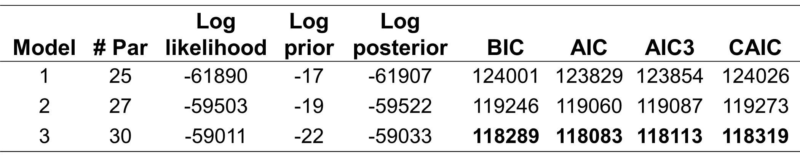
Model Comparison Statistics
One-dimensional: θ₁ trait having category slopes constrained to fixed equal interval values (-3, -1, 1, 3), and (3, 1, -1, -3) for reverse worded items.
Two-dimensional: An extended case of first model adding an ERS factor with fixed category slopes (1, -1, -1, 1).
Three-dimensional: An extended case of second model adding a DRS factor with fixed category slopes (-1, -1, 1, 1).

Slide 11
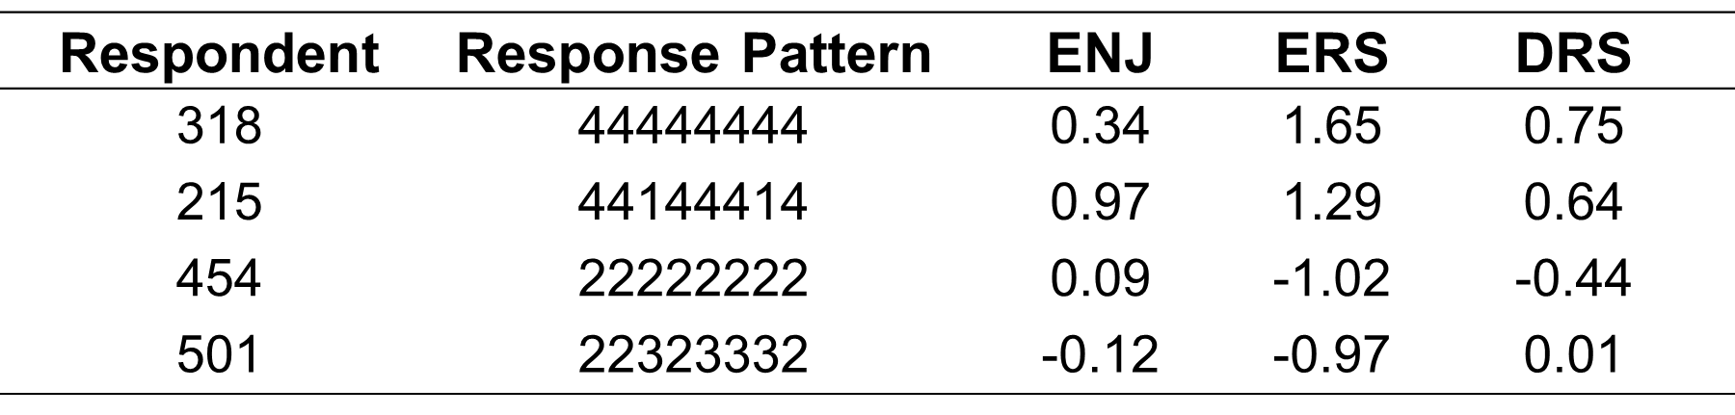
Example Response Patterns
Using the three-dimensional model, we estimated category intercepts for each item as well as student substantive trait estimates for both scales.
Example response patterns to the 8-item “Enjoyment of Science” scale. We assign mean θ values to 0 on all traits, and higher values of θ₁ correspond to less enjoyment.

Slide 12
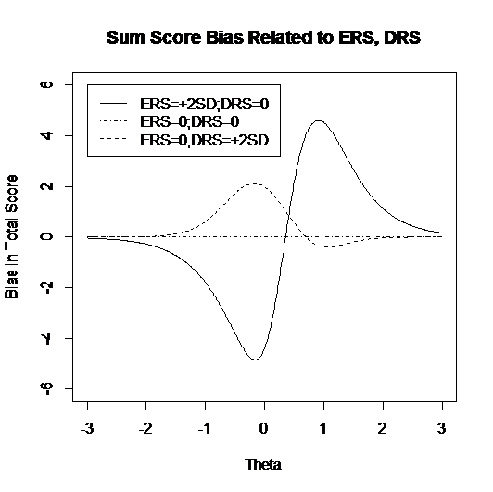
Examination of Relative Bias

Slide 13
Stability of Response Styles
We calculated the correlations between the ERS and DRS estimates for each respondent across both subscales as a measure of the stability of response style tendency.
 | Science θ₁ | Science θ_{ERS} | Science θ_{DRS}
Math θ₁ | .071**
Math θ_{ERS} |  | .286**
Math θ_{DRS} |  |  | .188**
**significant at .01 level (2-tailed)

Slide 14
Correlations θ₁ and Subject Achievement
We calculated the correlations between the student substantive trait estimates for each respondent with achievement scores in each discipline.
 | Math Achievement | Science Achievement
Math Sum Score | .346**
Math θ₁ | .335**
Science Sum Score |  | .300**
Science θ₁ |  | .300**
**significant at .01 level (2-tailed)

Slide 15
Conclusions
Using TIMSS data, the model statistically detected the presence of two response styles and controlled for them in estimating student substantive traits. The presence of reverse coded items on TIMSS is clearly helpful in indentifying additional response styles.
Through our model, we are able to quantify the relative bias introduced by ERS and DRS, as well as the stability of the response style traits across scales.
Future work is needed to evaluate the optimal design of survey instruments so as to maximize our potential in detecting response styles.

