Slide 1
IRT Model Misspecification and Metric Consequences
Sora Lee
Sien Deng
Daniel Bolt
Dept of Educational Psychology
University of Wisconsin, Madison

Slide 2
Overview
The application of IRT methods to construct vertical scales commonly suggests a decline in the mean and variance of growth as grade level increases (Tong & Kolen, 2006)
This result seems related to the problem of “scale shrinkage” discussed in the 80’s and 90’s (Yen, 1985; Camilli, Yamamoto & Wang, 1993)
Understanding this issue is of practical importance with the increasing use of growth metrics for evaluating teachers/schools (Ballou, 2009).

Slide 3
Purpose of this Study
To examine logistic positive exponent (LPE) models as a possible source of model misspecification in vertical scaling using real data
To evaluate the metric implications of LPE-related misspecification by simulation

Slide 4
Data Structure (WKCE 2011)
Item responses for students across two consecutive years (only including students that advanced one grade across years)
46 multiple-choice items each year, all scored 0/1
Sample sizes > 57,000 for each grade level
Grade levels 3-8

Slide 5
Wisconsin Knowledge and Concepts Examination (WCKE) Math Scores 2010-2011, Grades 4-8
 |  | 2010 Scale Scores |  | 2011 Scale Scores |  | Change
2011 Grade | Sample Size | Mean | SD | Mean | SD | Mean | SD
4 | 57652 | 437.9 | 46.4 | 470.8 | 43.6 | 32.9 | 30.9
5 | 58193 | 473.3 | 44.2 | 499.1 | 48.0 | 25.8 | 29.6
6 | 57373 | 498.0 | 49.3 | 523.5 | 48.9 | 25.5 | 28.7
7 | 57842 | 516.7 | 44.7 | 538.1 | 43.6 | 21.3 | 23.8
8 | 57958 | 540.1 | 43.7 | 548.5 | 50.3 | 8.4 | 26.4

Slide 6
Samejima’s 2PL Logistic Positive Exponent (2PL-LPE) Model
The probability of successful execution of each subprocess g for an item i is modeled according to a 2PL model:
while the overall probability of a correct response to
the item is
and ξ > 0 is an acceleration parameter representing the
complexity of the item.

Slide 7
Samejima’s 3PL Logistic Positive Exponent (3PL-LPE) Model
The probability of successful execution of each subprocess g for an item i is modeled according to a 2PL model:
while the overall probability of a correct response to
the item incorporates a pseudo-guessing parameter:
$$P\left(U_{ij}=1 | θ_{j}\right)=c_{i}+\left(1−c_{i}\right){\left[Ψ_{i,g}\left(θ_{j}\right)\right]}^{ξ_{i}}$$
and ξ > 0 is an acceleration parameter representing the
complexity of the item.

Slide 8
Effect of Acceleration Parameter on ICC
(a=1.0, b=0)

Slide 9
Item characteristic curves for an LPE item (a=.76, b=-3.62, ξ=8) when approximated by 2PL

Slide 10
Analysis of WKCE Data: Deviance Information Criteria (DIC) Comparing LPE to Traditional IRT Models
 | 2pl | 2lpe | 3pl | 3lpe
3 Grade | 36944.000 | 36934.200 | 36869.800 | 36846.100
4 Grade | 37475.600 | 37467.600 | 37448.400 | 37418.100
5 Grade | 44413.800 | 44395.400 | 44393.500 | 44338.900
6 Grade | 40821.100 | 40827.800 | 40739.600 | 40405.100
7 Grade | 44174.400 | 44145.300 | 44095.500 | 44030.200
8 Grade | 47883.700 | 47558.600 | 47742.900 | 47224.000

Slide 11
Example 2PL-LPE Item Parameter Estimates and Standard Errors (WKCE 8th Grade)
Item | a | S.E | b | S.E | ξ | S.E
1 | 0.382 | 0.057 | -3.327 | 1.492 | 3.500 | 1.983
2 | 1.076 | 0.081 | -2.407 | 0.393 | 8.727 | 3.271
3 | 1.350 | 0.106 | -2.950 | 0.273 | 11.540 | 3.564
4 | 1.201 | 0.120 | -1.816 | 0.610 | 5.090 | 2.562
5 | 0.508 | 0.059 | -3.337 | 0.684 | 4.649 | 1.765
6 | 2.240 | 0.242 | -2.411 | 0.271 | 7.253 | 3.564
7 | 1.462 | 0.119 | -2.250 | 0.420 | 8.419 | 4.006
8 | 0.752 | 0.072 | -2.256 | 0.697 | 4.087 | 1.753
9 | 0.838 | 0.075 | -3.041 | 0.523 | 7.956 | 2.600
10 | 1.780 | 0.195 | -3.001 | 0.357 | 12.580 | 5.257

Slide 12
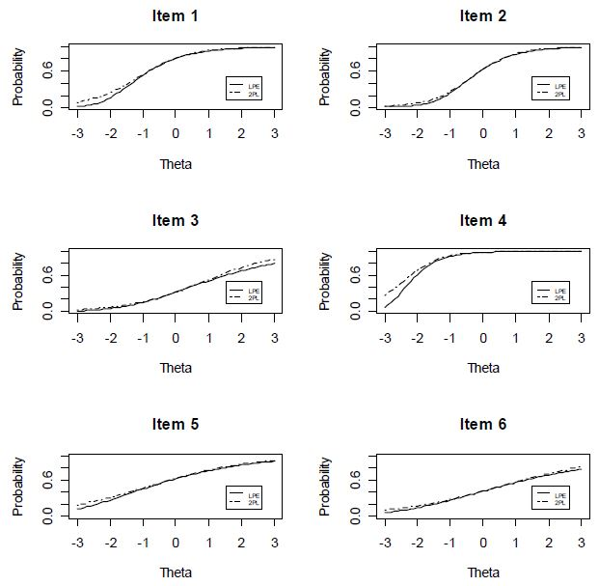
Item Characteristic Curves of 2PL and 2PL-LPE (WKCE 7th Grade)

Slide 13
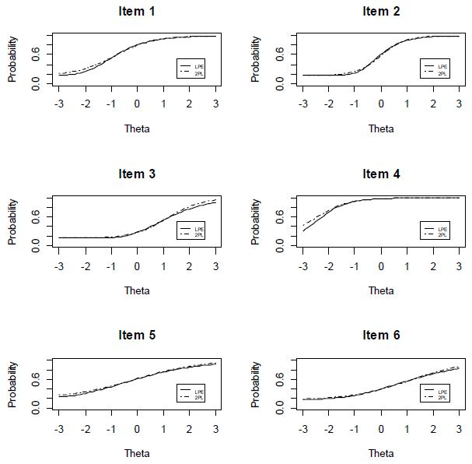
Item Characteristic Curves of 3PL and 3PL-LPE (WKCE 7th Grade)

Slide 14
Goodness-of-Fit Testing for 2PL model
(WKCE 6th Grade Example Items)
Item | Chi-square | P-value
1 | 25.307 | 0.001
2 | 6.596 | 0.580
3 | 7.146 | 0.520
4 | 5.494 | 0.703
5 | 12.501 | 0.130
6 | 4.069 | 0.850
7 | 15.003 | 0.059
8 | 11.359 | 0.182
9 | 10.658 | 0.221
10 | 7.591 | 0.474

Slide 15
Simulation Studies
Study 1: Study of 2PL and 3PL misspecification (with LPE generated data) across groups
Study 2: Hypothetical 2PL- and 3PL-based vertical scaling with LPE generated data

Slide 16
Study 1
Purpose:
The simulation study examines the extent to which the ‘shrinkage phenomenon' may be due to the LPE-induced misspecification by ignoring the item complexity on the IRT metric.
Method:
Item responses are generated from both the 2PL- and 3PL-LPE models, but are fit by the corresponding 2PL and 3PL IRT models.
All parameters in the models are estimated using Bayesian estimation methods in WinBUGS14.
The magnitude of the ϴ estimate increase against true ϴ change were quantified to evaluate scale shrinkage.

Slide 17
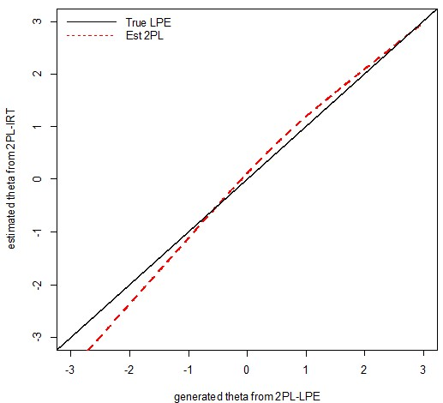
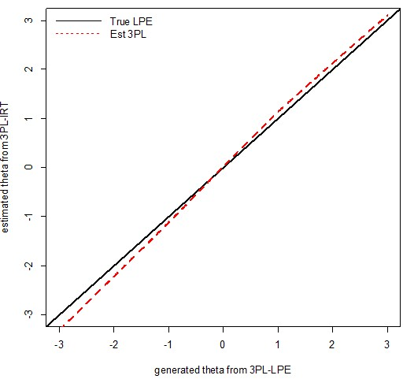
Results, Study 1
2PL
3PL

Slide 18
Study 2
Simulated IRT vertical equating study, Grades 3-8
We assume 46 unique items at each grade level, and an additional 10 items common across successive grades for linking
Data are simulated as unidimensional across all grade levels
We assume a mean theta change of 0.5 and 1.0 across all successive grades; at Grade 3, θ ~ Normal (0,1)
All items are simulated from LPE, linking items simulated like those of the lower grade level
Successive grades are linked using Stocking & Lord’s method (as implemented using the R routine Plink, Weeks, 2007)

Slide 19
Results, Study 2
Table: Mean Estimated Stocking & Lord (1980) Linking Parameters across 20 Replications, Simulation Study 2

Slide 20
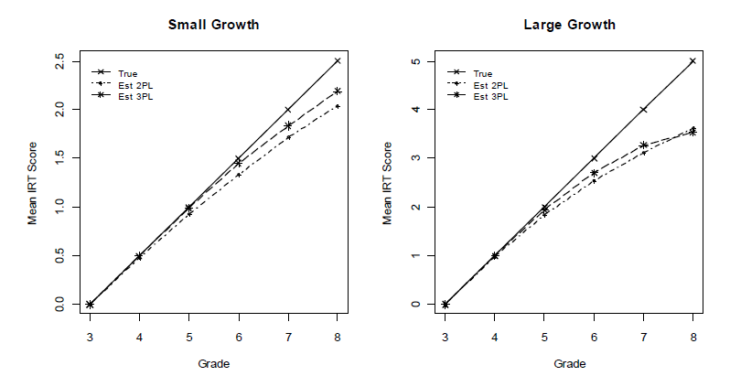
Results, Study 2
Figure: True and Estimated Growth By Grade, Simulation Study 2

Slide 21
Conclusions and Future Directions
Diminished growth across grade levels may be a model misspecification problem unrelated to test multidimensionality
Use of Samejima’s LPE to account for changes in item complexity across grade levels may provide a more realistic account of growth
Challenge: Estimation of LPE is difficult due to confounding accounts of difficulty provided by the LPE item difficulty and acceleration parameters.

