Slide 1
Optimal Delivery of Items in a Computer Assisted Pilot
Francis Smart
Mark Reckase
Michigan State University

Slide 2
Motivation
New item pools are constantly being developed
Item pools must be calibrated with pilot studies
Pilot studies can be expensive
Is there a way of reducing the size of the pilot study necessary to calibrate an item pool?
www.EconometricsBySimulation.com
“Visual Reasoning” Test
Zombie Apocalypse Survival Test

Slide 3
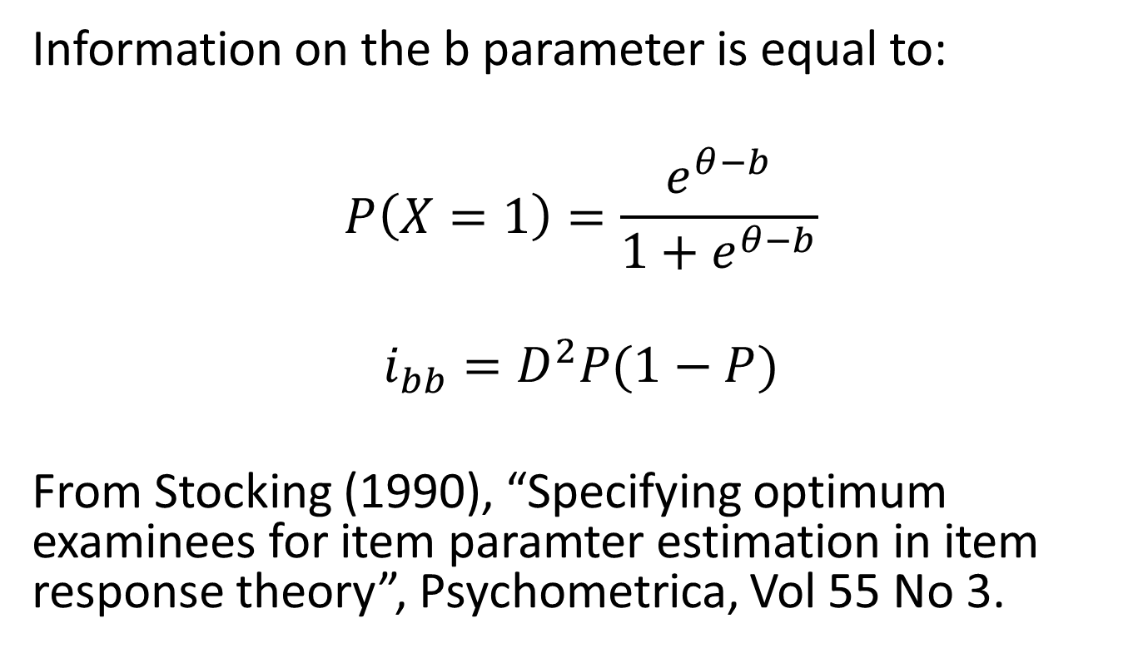
Item Parameter Information for a single parameter Rasch model
Information on the b parameter is equal to:
$$P\left(X=1\right)=\frac{e^{θ−b}}{1+e^{θ−b}}$$
$$i_{bb}=D^{2}P(1−P)$$
From Stocking (1990), “Specifying optimum examinees for item paramter estimation in item response theory”, Psychometrica, Vol 55 No 3.

Slide 4
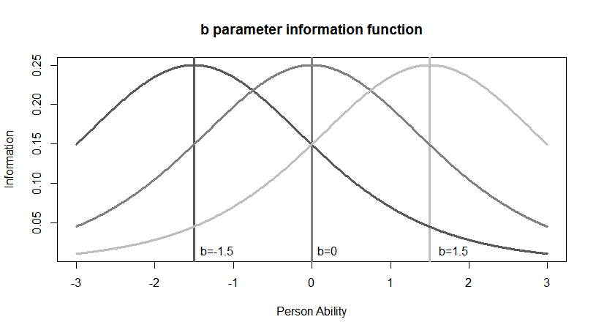
We can see the information functions for three different items.

Slide 5
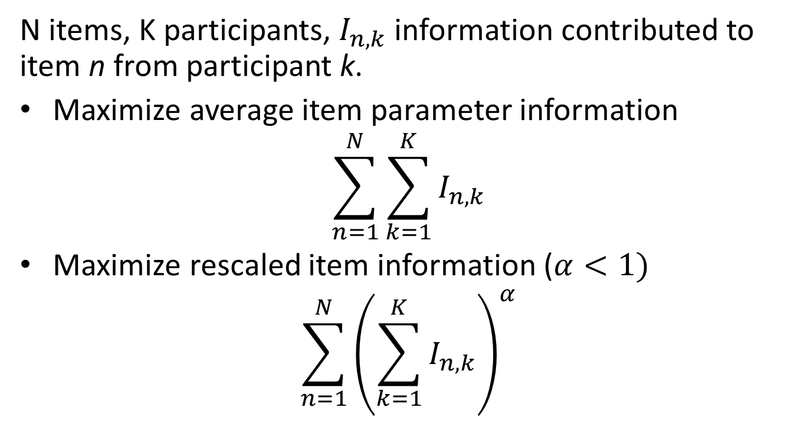
Pilot Objectives for a single parameter Rasch model
N items, K participants, $I_{n,k}$ information contributed to item n from participant k.
Maximize average item parameter information
$$\sum_{n=1}^{N}{\sum_{k=1}^{K}{I_{n,k}}}$$
Maximize rescaled item information ($α<1)$
$$\sum_{n=1}^{N}{{\left(\sum_{k=1}^{K}{I_{n,k}}\right)}^{α}}$$

Slide 6
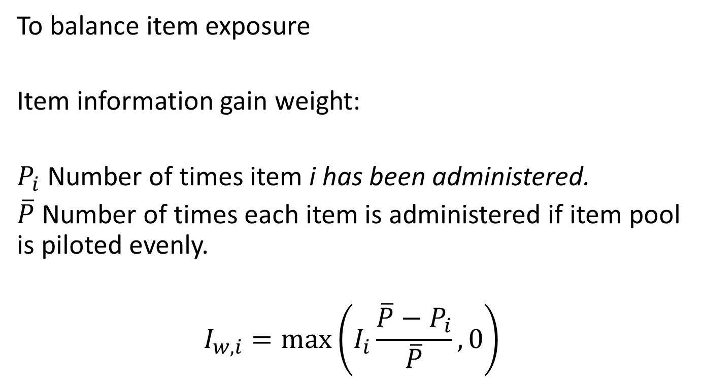
Expected Item Information Weights
To balance item exposure
Item information gain weight:
$P_{i}$ Number of times item i has been administered.
$\overline{P}$ Number of times each item is administered if item pool is piloted evenly.
$$I_{w,i}=\max\left(I_{i}\frac{\overline{P}−P_{i}}{\overline{P}},0\right)$$

Slide 7
Computer Assisted Pilot Design Strategy
N items, K participants, T test length, L common items
1. Fixed common items and random items
a. Each common item is exposed: K times
b. Each other item is exposed: ((T-L)*K)/(N-L)
c. Minimum number of forms: (N-L)/(T-L)

Slide 8
However more complex strategies are possible
2. Computer selected items:
a. First give L items to a subgroup of k participants (k<K, L=T).
b. Estimate item parameters for L common items.
c. Administer test to remaining participants (K-k)
d. First t items are selected from common items using standard CAT procedures. (R catR library)
e. Next (T-t) items are selected maximizing expected item parameter information given initial estimates of participant ability.

Slide 9
Simulation Setup
Population Ability ~ Normal(0,1)
nitems <- 100
npop <- 400, 800
testlength <- 30
common.N <- 10
min.ident <- 50
# Minimum number of times before identification is assumed for an item
divisor <- 100
# How many subjects before items are recalibrated

Slide 10
Simulation Results
5 replications
CAT gain in efficiency over that of random item assignment:
400 subjects:
15% gain on average information
23% gain for the minimum item
9% gain for maximum item
800 subjects:
17% gain on average information
26% gain for the minimum item
12% gain for maximum item

Slide 11
Where to Next?
Experiment with information weighting: Statistics and Expected item information
More complex (more than two stages) item and subject calibration
Alternative population specifications
Maximizing expected information across multiple parameters.

