Slide 1
IRT as a Method to Improve Matchmaking in Online Competitive Games
Matthew Lauritsen, PhD
City of Chicago

Slide 2
Overview
The Problem
Definitions and Assumptions
Ranking Systems
Elo
TrueSkill
IRT/CAT Framework

Slide 3
Definitions
Skill
The player’s ability level
Matchmaking System
A system to determine which players are placed together
Ranking System
A system by which players are informed of their relative standing to other players

Slide 4
The Problem: Poor Matchmaking (from Reddit)
“Bro. I've clocked nearly 1000 games this season and yes, the matchmaking is horrendous. The worst part is that if I get [someone really good in my team] I get [an inflated rating]. It’s so awful. I've gotten [a good rank] 5 different seasons and I can’t even get out of [a bad rank]. I have other friends in the same boat.”
“The number one thing I hate about this game is the [bleeping] matchmaking.”
“[Company] has a matchmaking team so I don’t know how it could possibly be this bad”

Slide 5
Main Assumptions of Matchmaking
An optimal match is where each player has a 50% chance to win
Greater competition
More fun and engagement
Over time, a player’s rating (and rank) is an accurate measure of their ability
The rating difference is a valid metric across the entire range of skill
Players are trying to win

Slide 6
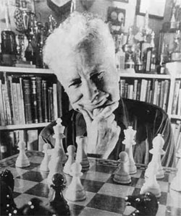
Elo Rating System
Assumption: Performance is a normally distributed random variable
After a match, points are transferred between players.
RatingDiff = (Score – Expected) * K-factor
Where:
Score is 0 = loss, 0.5 = draw, 1 = win
Expected is 0 to 1, probability of winning
K-factor is a constant for maximum change
Notes:
Slides 6, 7, and 8 were borrowed from a 2017 GDC talk by Twitch's Mario Izquierdo

Slide 7
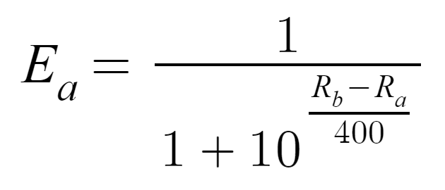
Elo Rating System: Formula
After a match, rating points are transferred between players:
RatingDiff = (Score – Expected) * K-factor
Expected result formula (from the normal distribution):
Expected [A] = 1/(1+10^(Rating[B-A]/400))
Which gives Player A the chance of winning for each Rating [B-A]
0: 50%, 100: 64%, 200: 76%, 300: 85%, 400: 91%, 500: 95%, 600: 97%

Slide 8
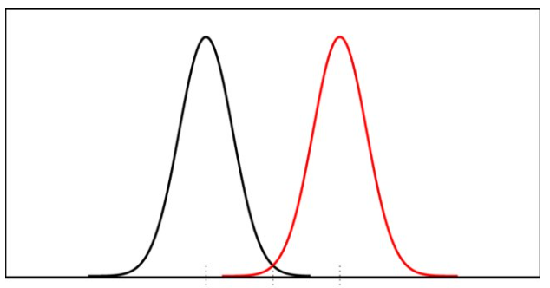
Elo Rating System: Formula
Players Juan: 1500 and Sarah: 1900
Expected [Juan] = .09
Expected [Sarah] = .91
With K-factor of 32, rating changes are:
Juan wins (Score = 1)
(1-.09)*32 = +29
Juan draws (Score = .5)
(.5-.09)*32= +13
Juan loses (Score = 0 )
(0-.09)*32= -3
Outcomes for Juan vs Sarah (9% chance of winning)
Win +29
Draw +13
Loss -3

Slide 9
Elo Rating Thoughts
Simple, easy to understand
Skill is relative to the players in the sample
Expected probability for a given difference is the same across all levels of skill (e.g., 500 vs 400 and 2500 vs 2400)
The K-factor (scale) is constant
may need to be adjusted for new vs pro players
New players can take a long time to converge to their true skill rating

Slide 10
Microsoft’s TrueSkill
Improves upon Elo by adding the uncertainty of the estimate
Skill = µ
Uncertainty = $σ$ (variance)
Rating displayed to player = µ - 3$σ$
Actual skill is greater than rating

Slide 11
Microsoft’s TrueSkill
Newer players have a greater variance, this goes down after matches
Matching is based on proximity to µ AND sorted by variance
Players with similar skill and low variance are matched before similar skill and high variance
Variance can increase and decrease
Example: Skill decay

Slide 12
TrueSkill Thoughts
It’s proprietary so this is all guesswork
Convergence is faster
Probably Bayesian
Calculations are complex
May seem unfair or confusing to players
Better at handling new players (e.g., increased variance)
Can account for other variables by increasing/decreasing variance

Slide 13
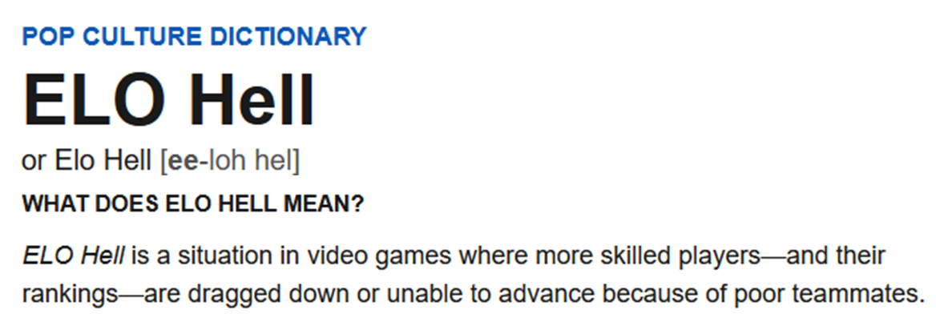

Slide 14
What can IRT offer?
Improve measurement of skill
Converge to the true skill faster
Paradigm shift in thinking about matchmaking

Slide 15
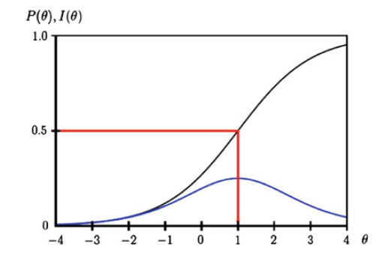
Can we model players as items?
Players exist in a bank and their parameters are estimated
The server calculates all possible matches and chooses the one that maximizes information
Depending on the IRC model, different selection criteria could be used (e.g, discrimination)
Choosing players who maximize information around a cut score when going to the next rank

Slide 16
ICC would give additional information about players and the game
Why are some players difficult to beat?
Examining Black’s behavior may reveal
Technique
Exploiting Bug
New Feature

Slide 17
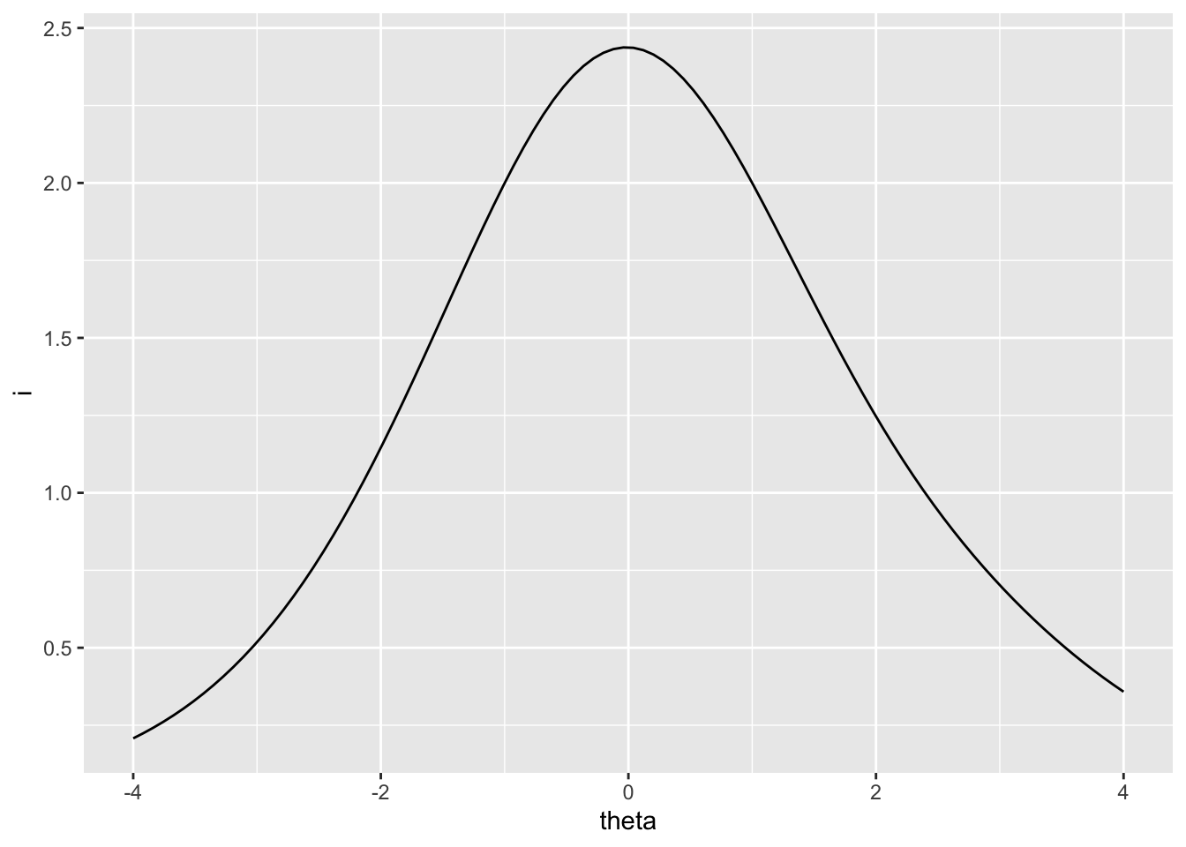
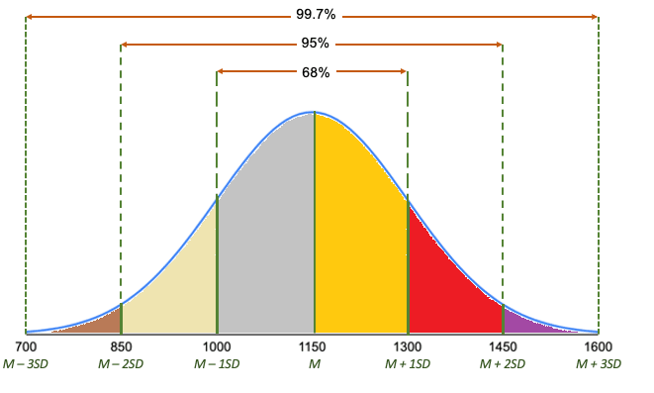
Theta Distribution to form Ranks

Slide 18
MIRT

Slide 19
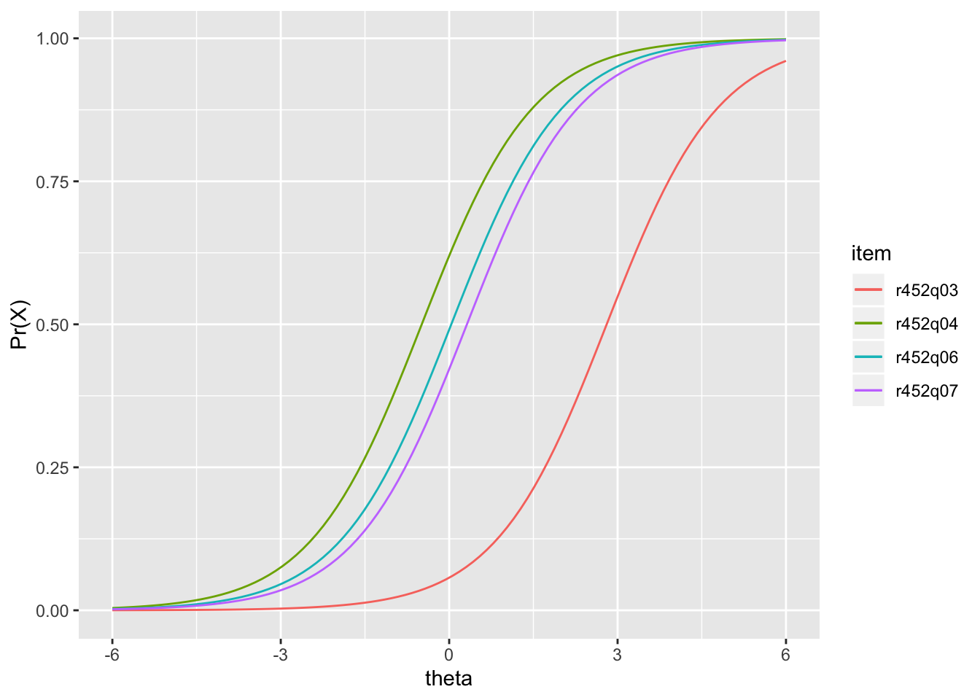
Does this solve any existing problems?
IRT can handle poor matches better
Not limited by K-factor
Skill measure should be more accurate
Faster convergence to true ability level
Matchmaking criteria need not always be a 50/50 prediction

Slide 20
Does this create any new problems?
Scoring non-win/loss is challenging
Estimation of players-as-items might not even be possible
The two players’ theta cannot be estimated simultaneously
Some ideas
Multiple databases
Matches (or “scenarios”) as items
Delayed calculations
It might get us right back to where we started
Adjusting rating by wins/losses and choosing theta-proximate opponents

Slide 21
Practical Concerns
What is the ultimate criterion?
Fun?
Developmental Feedback to Players via Rank?
Accuracy of Measurement?
Competing interests
Engineers
Business
Players

Slide 22
Conclusion
Matchmaking is perceived as generally poor
Existing systems are not concerned with measurement per se
IRT may be able to more accurately measure Skill thereby increasing the quality of matchmaking

